Slide 1
Chapter 10
States of matter

Slide 2
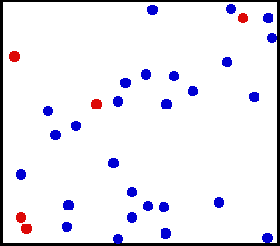
Kinetic Energy
Kinetic in Greek = motion
Kinetic energy – energy an object has due to motion
Gases have lots of small particles that move around.
These particles bump into each other and bounce back

Slide 3
Gas Pressure
Gas pressure – force given off by gas onto an object
Measured in Pascal (Pa)
Use to be measured in
atmospheric (atm)
Mercury (mmHg)
1 atm = 760mmHg = 101.3kPa

Slide 4
Gas Pressure

Slide 5
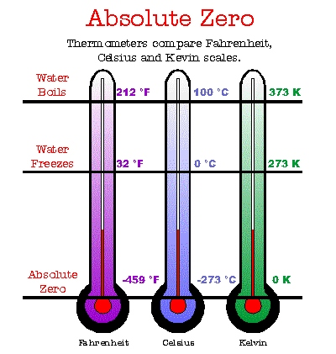
KINETIC ENERGY AND KELVIN TEMPERATURE

Slide 6
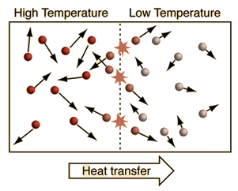
KINETIC ENERGY AND KELVIN TEMPERATURE
Kinetic energy increases as temperature increases
When particles collide energy is trasfered

Slide 7
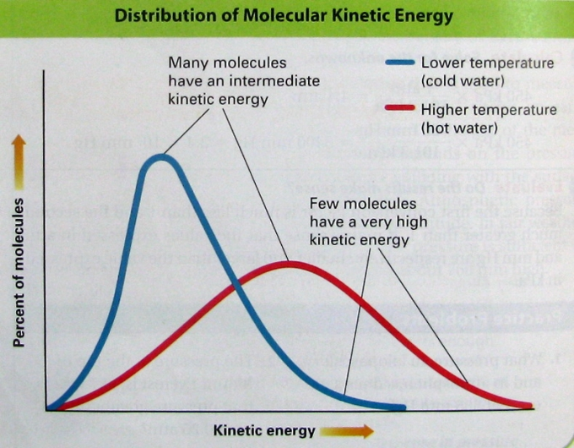

Slide 8
KINETIC ENERGY AND KELVIN TEMPERATURE
Higher temperature – faster particle motion – greater average kinetic energy.
0K (absolute zero) – in theory, zero particle motion and zero kinetic energy.

Slide 9
Calculations
1 atm = 760mmHg = 101.3kPa
Covert 1.50atm to kPa
1.50atm X 101.3kPa = 151.95kPa = 1.52 x 10²kPa
1 atm
Covert 1.50atm to mmHg
1.50atm X 760mmHG = 1140mmHg = 1.14 x 10³mmHG
1 atm

Slide 10
Textbook
Page 271 Q1,2
Page 272 Q3,4,5,6

Slide 11
10.2 The Nature of Liquids
Both liquids and gases are fluids, i.e. they can flow

Slide 12
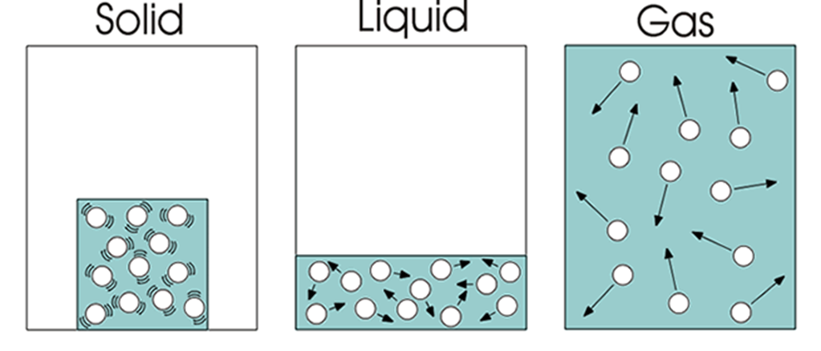
13.2 The Nature of Liquids
Liquids
Molecules are closer together and have intermolecular forces
Fixed volume
Molecules can flow past each other
Condensed matter:
Liquids and solids are known as condensed phases of matter

Slide 13
Evaporation

Slide 14
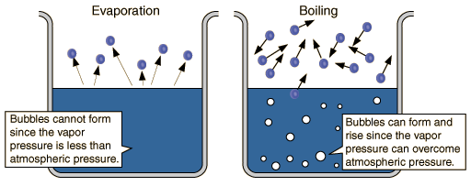
Evaporation
Vaporization: the conversion of a liquid to a gas or vapor
Evaporation: vaporization occurring at the surface of a liquid

Slide 15
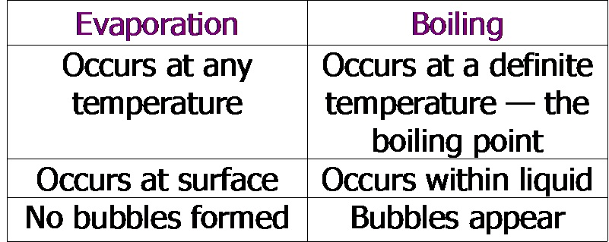
Evaporation
Vaporization

Slide 16
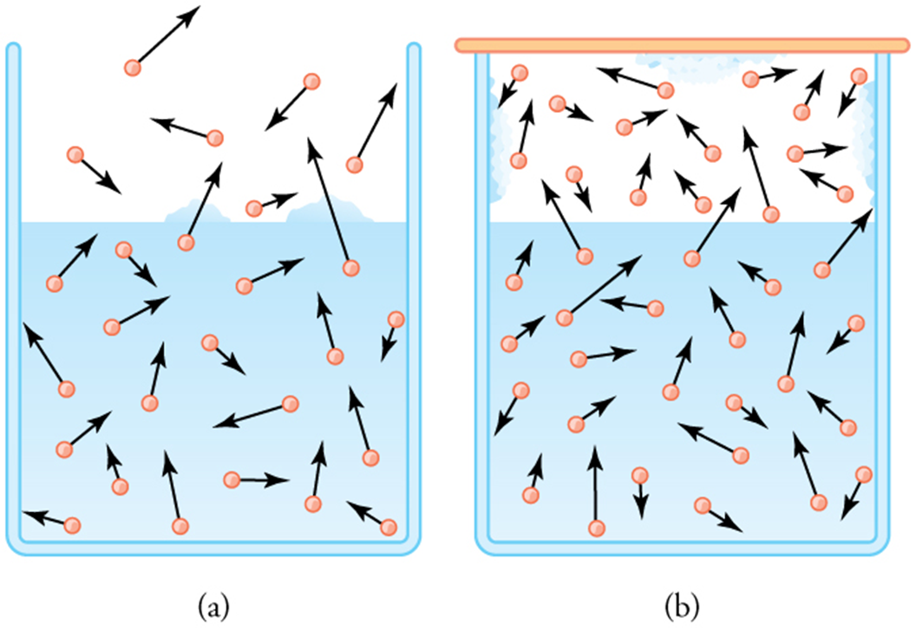
Evaporation
During evaporation, molecules of liquid with enough energy change in to the vapor phase
In a closed container, some molecules re-enter into the liquid phase (condense)
Eventually and equilibrium is reached where…
The rate of evaporation equals the rate of condensation
What would happen to the rate of evaporation when a liquid is heated? Why?

Slide 17
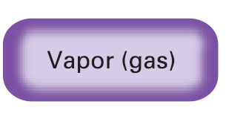
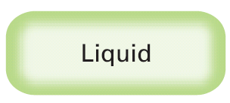
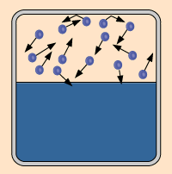
Vapor Pressure
13.2
Vapor pressure is a measure of the force exerted by a gas above a liquid.
States of matter phet

Slide 18
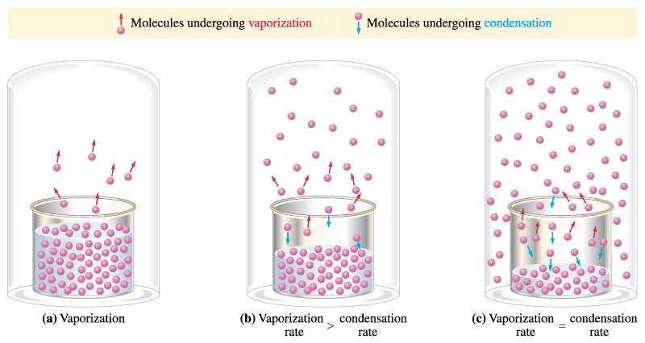
Vapor Pressure
vapor pressure: In a closed container, as molecules escape into the vapor phase, pressure builds
Equilibrium: the rate of vaporization equals the rate of condensation. Then vapor pressure is constant

Slide 19
Vapor Pressure
Depends upon the liquid
Depends upon temperature

Slide 20
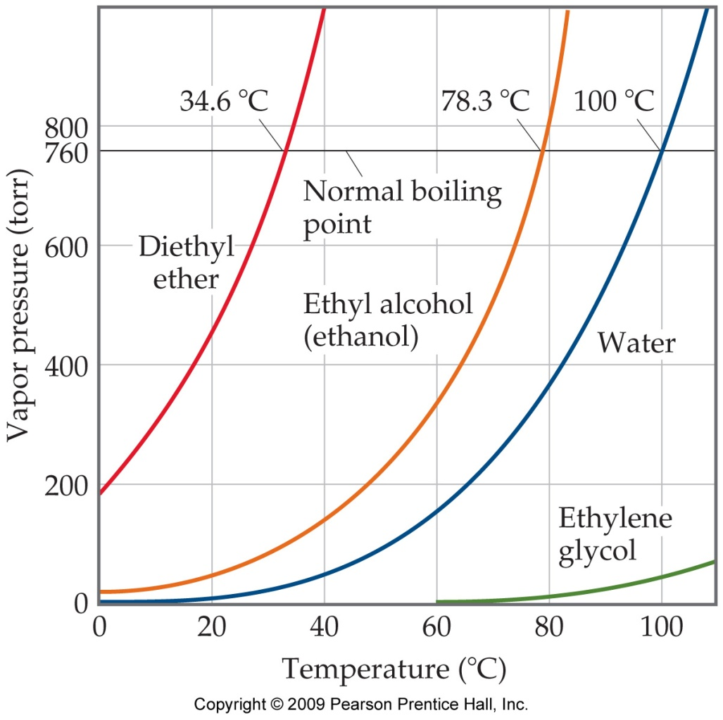
Vapor Pressure
Depends upon the liquid
Depends upon temperature

Slide 21
Boiling Point
A liquid boils when the particles thoughout the liquid have enough KE to vaporize
This occurs when the vapor pressure of the liquid equals the external pressure on the liquid (e.g. atmospheric pressure)
This means that a liquid can boil at different temperatures, depending on the external pressure.

Slide 22
Boiling Point & Normal Boiling Point
Normal boiling point is the boiling temperature when atmospheric pressure (P_{atm}) = 1 atm
What is the normal BP for ethanol?
What is the BP for ethanol at Patm = 600 mmHg?

Slide 23
Text book
Page 271 Q1,2
Page 272 Q3,4,5,6
Page 279 Q8,9,10,11,12,13

Slide 24
10.3 Solids
Crystal Structure
Simple cubic
Body centered cubic
Face centered cubic
Allotropes
Amorphous solids
Glasses

Slide 25
Some Types of Unit Cells

Slide 26
Allotropes
Allotropes are varying forms of an element
Example: oxygen (O₂) and ozone (O₃)
Example: allotropes of carbon

Slide 27
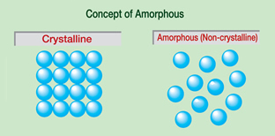
Non-Crystalline Solids
Amorphous solids lack an ordered internal structure.
Examples: rubber, plastic, asphalt, glass

Slide 28
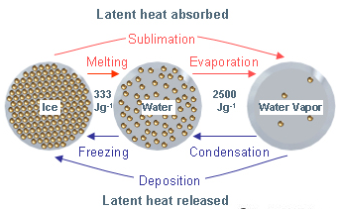
10.4 Changes of State
Vaporization/Condensation
Liquid ↔ Gas
Evaporation
Boiling
Vapor vs. Gas
Melting/Freezing
Liquid ↔ Solid
Solidification
Sublimation/Deposition
Solid ↔ Vapor
I2 (s) → I2 (g)

Slide 29
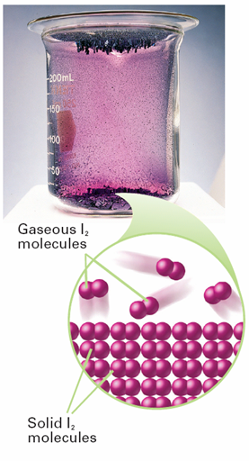
Sublimation
Sublimation
Solid → Vapor
occurs in solids
vapor pressures is above atmospheric pressure
room temperature.
Deposition
Vapor → Solid
Solidifying of gas

Slide 30
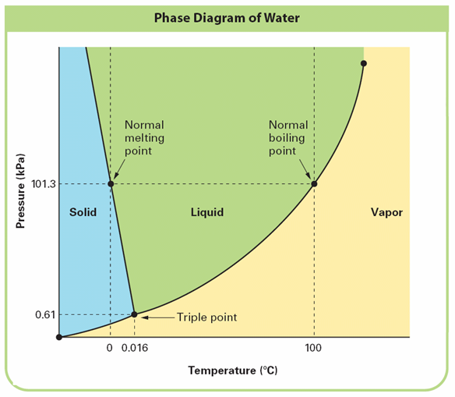
Phase Diagrams
A phase diagram
graph that gives the conditions of temperature and pressure at which a substance exists as solid, liquid, and gas (vapor).
Lines represent pressures and temperatures at which two phases are in equilibrium

Slide 31
Review Questions
Chapter 10 review
Page 289
Q,21,22,23,24,26,27,28,29,31,33,34,35,37,39,40,41,44,48,49
STP = standard Temperature Pressure
0°C and 1atm

