Slide 1
CHAPTER 10
CELL GROWTH AND DIVISION
Mitosis

Slide 2
https://www.youtube.com/watch?v=lpAa4TWjHQ4
https://www.youtube.com/watch?v=gwcwSZIfKlM

Slide 3
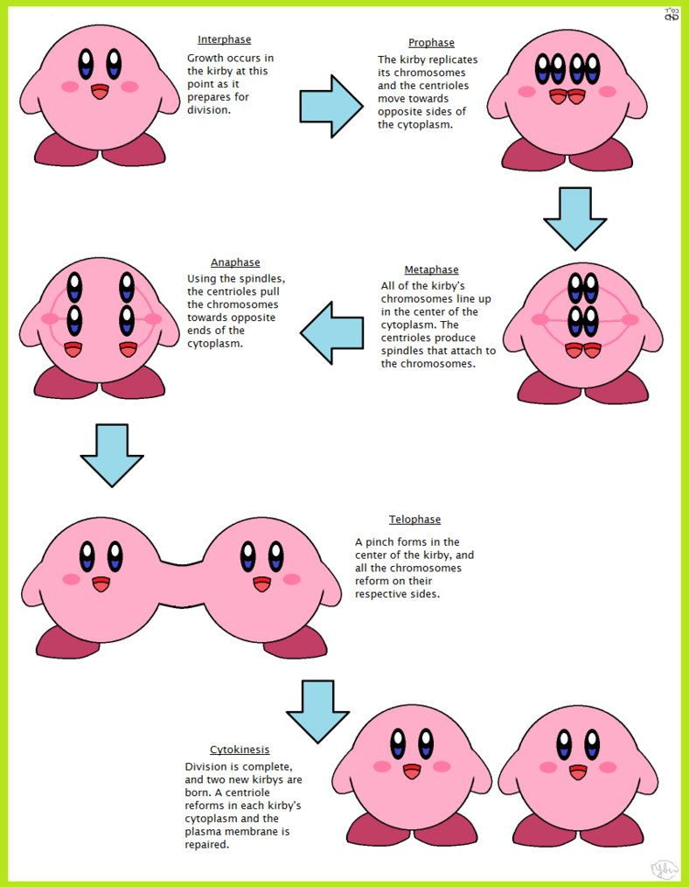

Slide 4
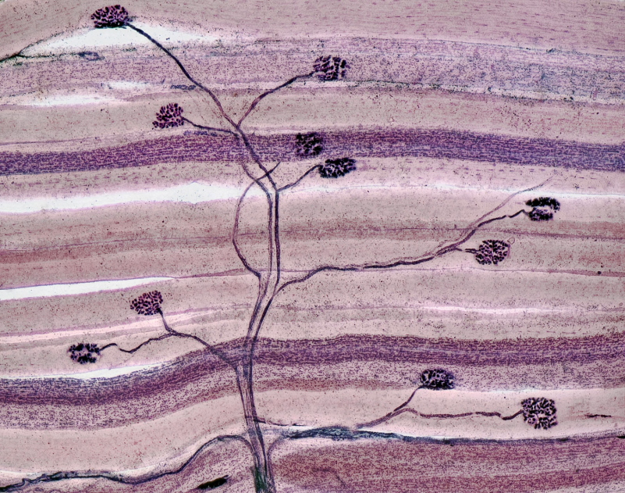
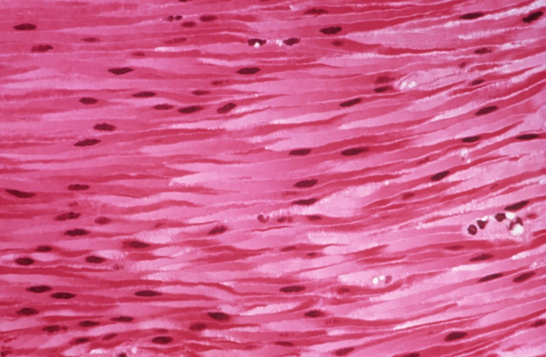
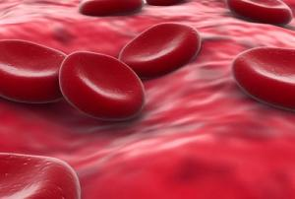
10-3 Regulating the Cell Cycle
Some cells divide quickly
Skin cells
Bone marrow cells
Some do not
Most muscle cells
Most nerve cells

Slide 5
10-3 Regulating the Cell Cycle
Cells in a petri dish will continue to divide until they come into contact with other cells

Slide 6
10-3 Regulating the Cell Cycle
The same thing happens when you have a cut
Cells multiply quickly until they come in contact with others
Once healed mitosis slows

Slide 7
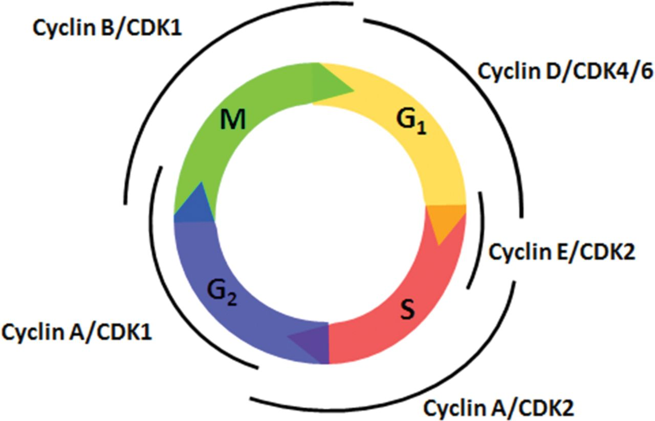
10-3 Cell Cycle Regulators
Cyclins regulate the timing of the cell cycle in eukaryotic cells.
The cell cycle is regulated by a specific protein.
Scientists called this protein cyclin because it seemed to regulate the cell cycle.

Slide 8
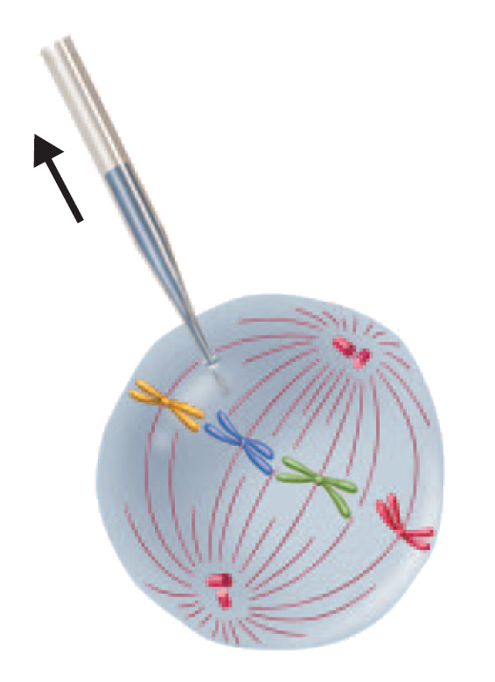
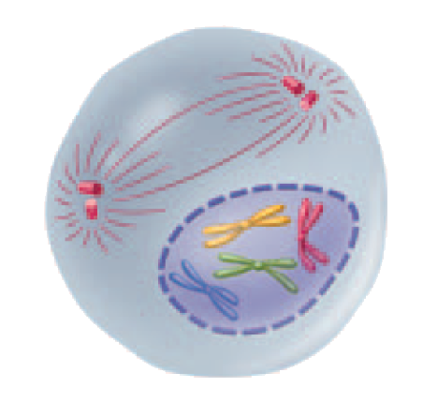
Cell Cycle Regulators
Cyclins were discovered during a similar experiment to this one.
A sample of cytoplasm is removed from a cell in mitosis.
The sample is injected into a second cell in G₂ of interphase.
As a result, the second cell enters mitosis.
Notes:
The timing of the cell cycle is regulated by cyclins. When cytoplasm from a cell in mitosis is injected into another cell, the second cell enters into mitosis. The reason for this effect is a protein called cyclin, which triggers cell division.

Slide 9
10-3 Cell Cycle Regulators
Internal Regulators - Proteins that respond to events inside the cell
Internal regulators allow the cell cycle to proceed only when certain processes have happened inside the cell.
Ex: Can’t start mitosis unless the DNA has been copied.

Slide 10
10-3 Cell Cycle Regulators
External Regulators - Proteins that respond to events outside the cell
External regulators direct cells to speed up or slow down the cell cycle.
Ex: growth hormone
Ex: Contact inhibition: molecules on neighboring cells that slow or stop cell cycles when the cells come into contact.

Slide 11
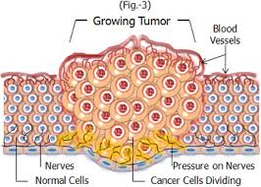
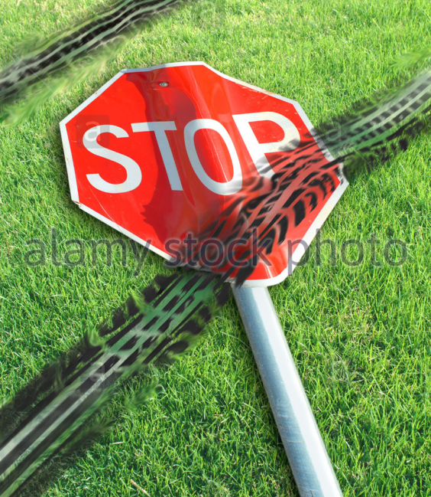
Uncontrolled Cell Growth
Cancer = some of the body's own cells lose the ability to control growth.
Cells stop responding to internal and external signals

Slide 12
Uncontrolled Cell Growth
Cancer cells divide uncontrollably and form masses of cells called tumors that can damage the surrounding tissues.
Cancer cells may break loose from tumors and spread throughout the body, disrupting normal activities and causing serious medical problems or even death.

Slide 13
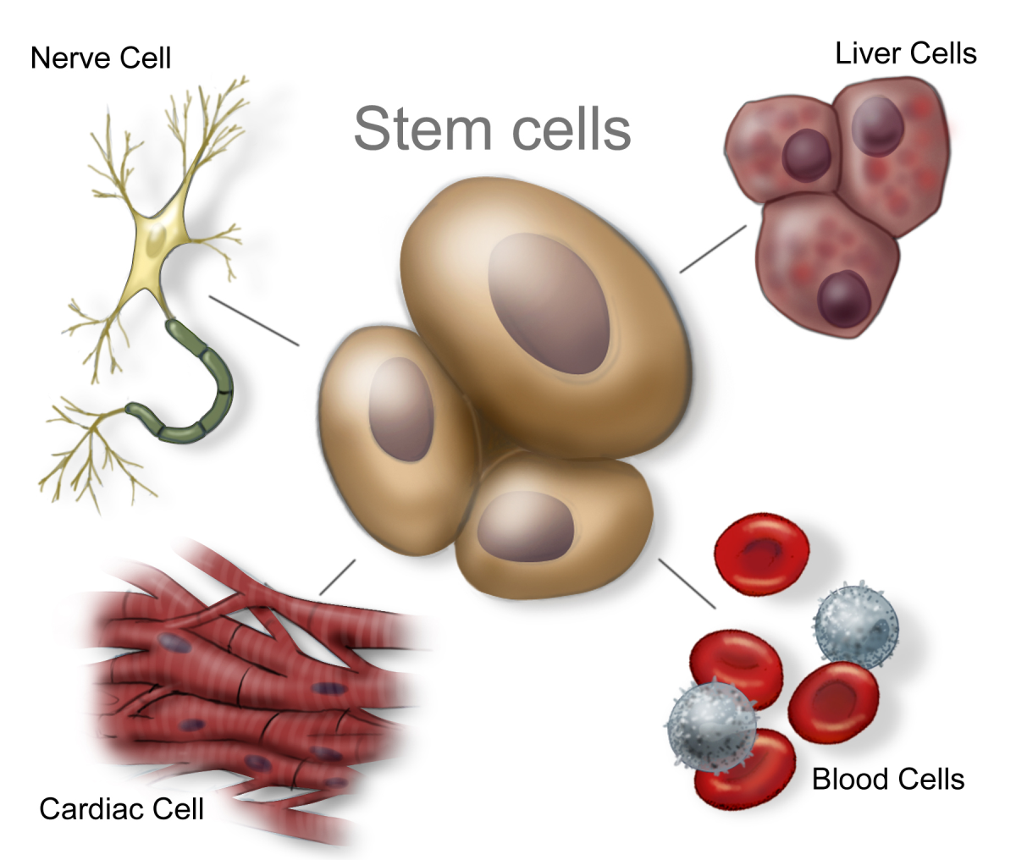
Stem Cells
Stem cells are unspecialized cells that have the potential to differentiate into a wide variety of cell types.

Slide 14
Stem Cells
One idea in medicine is to use stem cells to produce needed cells e.g. to produce new nerve cells to help someone with a spinal cord injury.

Slide 15
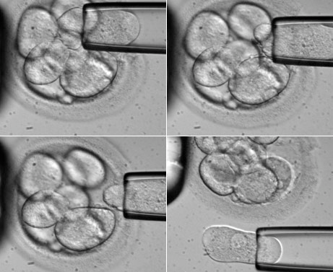
Stem Cells
A problem: Human stem cells can come from human embryos. Is it right to make human embryos to take stem cells from them?

Slide 16
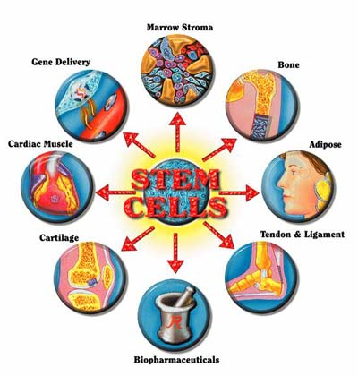
Stem Cells
A possible alternative: Nerve, muscle, and liver cells can sometimes be grown from adult stem cells that form human blood cells.

