Slide 1
Chapter 12
The Behaviour of Gases

Slide 2
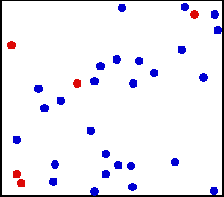
Kinetic Theory
Gas particles have lots of space between them
No attractive or repulsive forces between particles
Gas particles move very fast and in random motion
The higher the temperature the faster the particles move
How can gas be compressed when a
solid can’t be compressed?

Slide 3
Calculating Gas Pressure
When calculating pressure
Pressure (P or kPa)
Volume (V in Litres)
Temperature (T in Kalvin)
Number of moles (n)

Slide 4
Factors affecting Gas Pressure
Amount of gas
The more gas particles the more collisions
more collisions = more pressure
(as long as the size of the container stays the same)

Slide 5
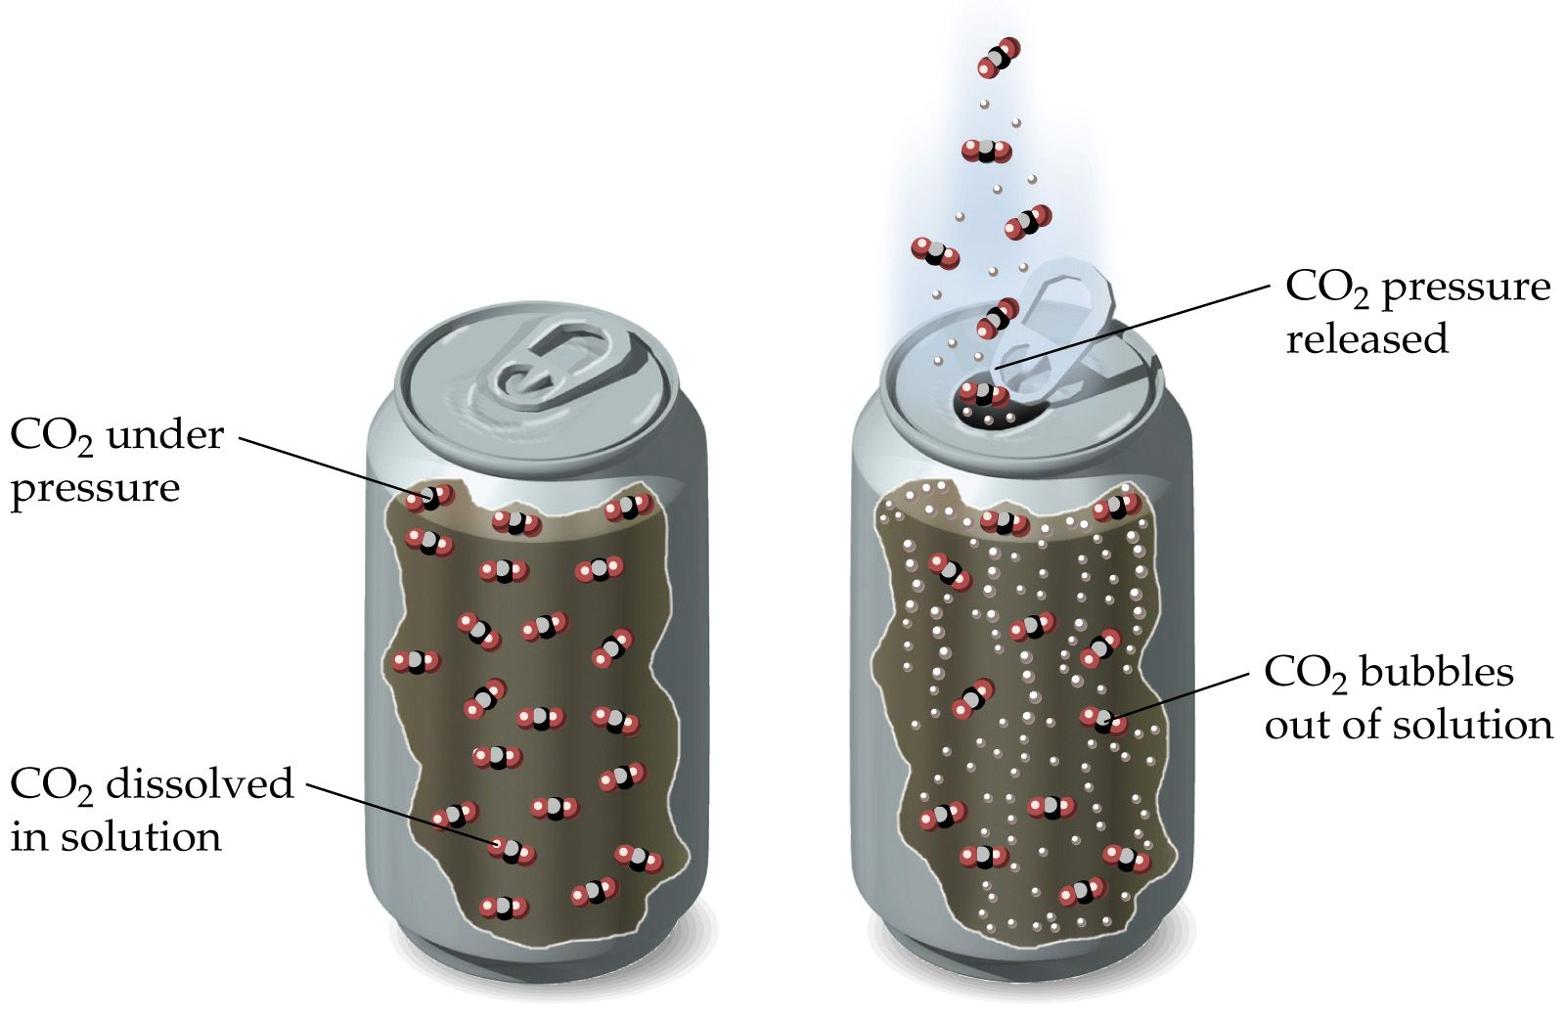
Factors affecting Gas Pressure
Amount of gas
The more gas particles the more collisions
more collisions → more pressure
(as long as the size of the container stays the same)

Slide 6
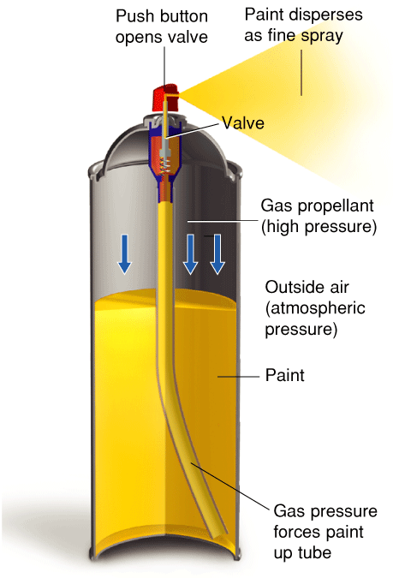
Factors affecting Gas Pressure
Gas is compressed
Gas becomes a liquid
High pressure inside can
Press button to open valve
As compressed gas leaves the can it becomes a mist spray or aerosol

Slide 7
Factors affecting Gas Pressure
Volume
Volume decreases → pressure increases
(only if number of particles stay the same)

Slide 8
Factors affecting Gas Pressure
Volume
When volume halves pressure doubles

Slide 9
Factors affecting Gas Pressure
Temperature
Temperature increases → pressure increases
(as long as size of container stays the same)

Slide 10
Section Quiz.
1. Compared to liquids and solids, gases are easily compressed because the particles in a gas
a) attract each other.
b) are spaced relatively far apart.
c) are very small.
d) repel each other.

Slide 11
Section Quiz.
2. Gas pressure is affected by
a) temperature, volume, and the amount of the gas.
b) temperature, volume, and the molar mass of the gas.
c) phase diagram, volume, and the size of the container.
d) temperature, phase diagram, and the mass of the gas container.

Slide 12
Section Quiz.
3. For gases, the SI units for volume (V), pressure (P), and temperature (T) are, respectively,
a) liters, kilopascals, and °C.
b) liters, kilopascals, and kelvins.
c) cm³, kilopascals, and kelvins.
d) liters, atmospheres, and °C.

Slide 13
Text Book
Page 332 Q5→Q9

Slide 14
Boyle’s Law: Pressure and Volume
Boyle’s law states that for a given mass of gas at constant temperature, the volume of the gas varies inversely with pressure.

Slide 15
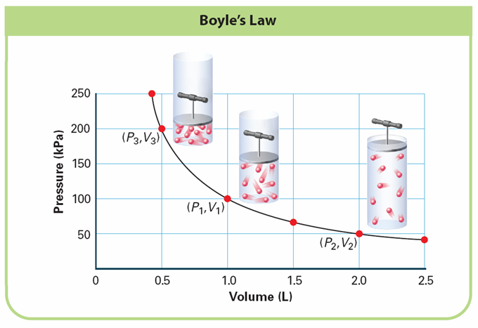
Boyle’s Law: Pressure and Volume
Notes:
The pressure of a gas changes as the volume changes. INTERPRETING GRAPHS a. Observing When the volume is 2.0 L, what is the pressure? b. Predicting What would the pressure be if the volume were increased to 3.0 L? c. Drawing Conclusions Based on the shape of the graph, describe the general pressure-volume relationship.

Slide 16
Sample Problem

Slide 17
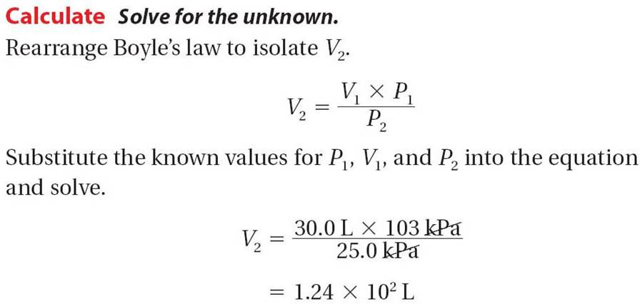
Sample Problem

Slide 18
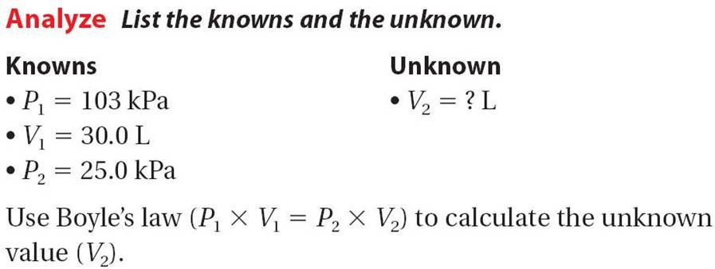
Sample Problem

Slide 19
Example Problems pg 335 # 10 &11
1. The pressure on 2.50 L of anesthetic gas changes from 105 kPa to 40.5 kPa. What will be the new volume if the temp remains constant?
P₁ = 105 kPa P₂ = 40.5 kPa
V₁ = 2.5 L V₂ = ?
P₁ × V₁ = P₂ × V₂
(105) (2.5) = (40.5)(V₂)
262.5 = 40.5 (V₂)
6.48 L = V₂

Slide 20
Example Problems pg 335 # 10 &11
2. A gas with a volume of 4.00L at a pressure of 205 kPa is allowed to expand to a volume of 12.0L. What is the pressure in the container if the temp remains constant?
P₁ = 205 kPa P₂ = ?
V₁ = 4.0 L V₂ = 12.0 L
P₁ × V₁ = P₂ × V₂
(205) (4.0) = (P₂)(12)
820 = (P₂) 12
68.3 kPa = P₂

Slide 21
Practice
1) Helium has a pressure of 3.54 atm with a volume of 23.1 L. The new pressure is 1.87 atm, what is the volume?
2) Argon has a pressure of 34.6 atm. It is transferred to a new tank with a volume of 456 L and pressure of 2.94 atm. What was the volume of the original container?

Slide 22
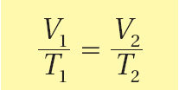
Charles’s Law: Temperature and Volume
Charles’s law: volume of gas is directly proportional to its Kelvin temperature if the pressure and mass is kept constant.

Slide 23
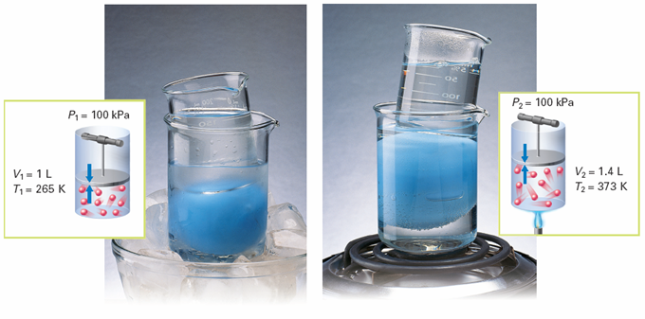
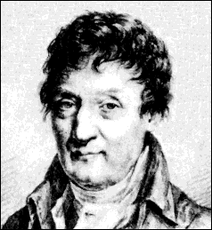
Charles’s Law: Temperature and Volume
As the temperature of the water increases, the volume of the balloon increases.
Notes:
When the gas in the blue balloon is cooled at constant pressure, the volume of the gas decreases. When the gas is heated at constant pressure, the volume increases. Calculating What is the ratio of volume to temperature for each set of conditions? Round your answer to two significant figures.

Slide 24
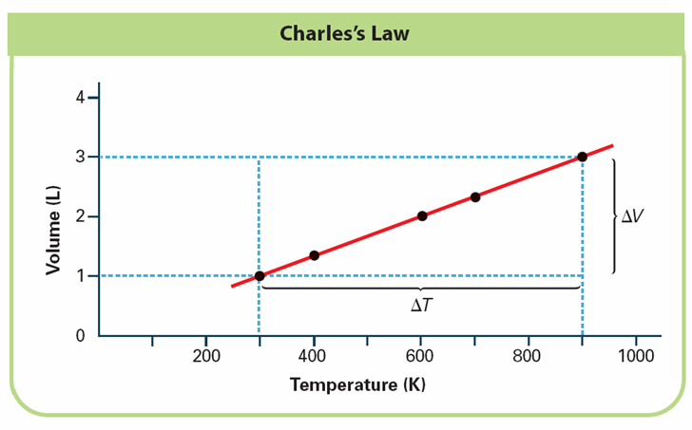
Charles’s Law: Temperature and Volume
Notes:
This graph shows how the volume changes as the temperature of a gas changes. INTERPRETING GRAPHS a. Observing What is the unit of temperature? b. Drawing Conclusions What happens to the volume as the temperature rises? c. Predicting If the temperature of a gas were 0 K, what would the volume of the gas be?

Slide 25
Sample Problem

Slide 26
Sample Problem

Slide 27
Sample Problem

Slide 28
Example Problems pg. 337 # 12 & 13
3. If a sample of gas occupies 6.80 L at 325°C, what will be its volume at 25°C if the pressure does not change?
V₁= 6.8L V₂ = ?
T₁ = 325°C = 598 K T₂ = 25°C = 298 K
6.8 = V₂
298
6.8 X 298 = V₂ X 598
2026.4 = V₂ X 598
3.39 L = V₂

Slide 29
Example Problems pg. 337 # 12 & 13
4. Exactly 5.00 L of air at -50.0°C is warmed to 100.0°C. What is the new volume if the pressure remains constant?
V₁= 5.0L V₂ = ?
T₁ = -50°C = 223 K T₂ = 100°C = 373 K
5 = V₂
223 373
5 X 373 = V₂ X 223
1865 = V₂ X 223
8.36L = V₂

Slide 30
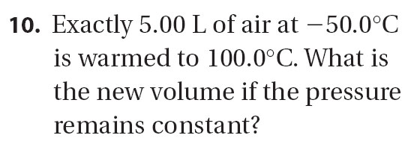
for Sample Problem

Slide 31
Practice
1) A sample of oxygen gas has a volume of 4.55 L at 25°C. Calculate volume when the temp is raised to 45°C.
2) A sample of hydrogen is collected at 34°C and heated to 68°C. At 68°C the volume is 26.0 L. What was the volume at 34°C?

Slide 32
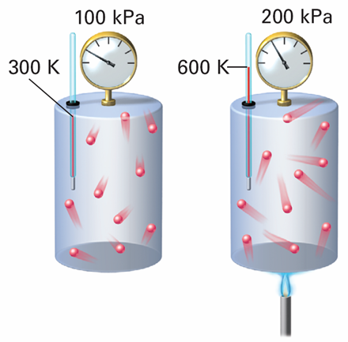
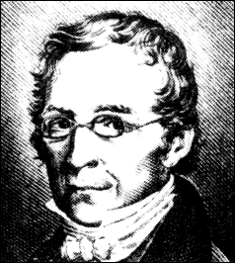
Gay-Lussac’s Law: Pressure and Temperature
When a gas is heated at constant volume, the pressure increases.
Notes:
When a gas is heated at constant volume, the pressure increases. Interpreting Diagrams How can you tell from the drawings that there is a fixed amount of gas in the cylinders?

Slide 33
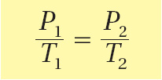
Gay-Lussac’s Law: Pressure and Temperature
Gay-Lussac’s law: pressure of a gas is directly proportional to the temperature (K) (volume remains constant)

Slide 34
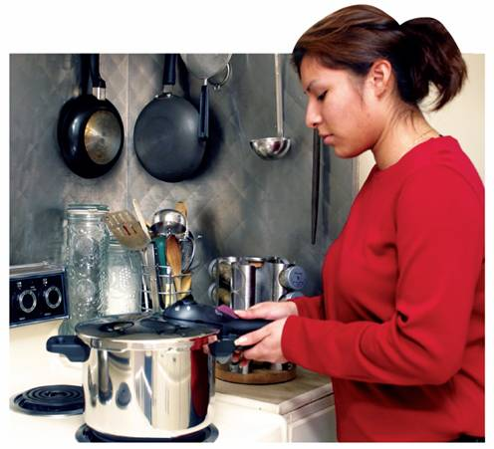
Gay-Lussac’s Law: Pressure and Temperature
A pressure cooker demonstrates Gay-Lussac’s Law
Notes:
In a pressure cooker, food cooks faster than in an ordinary pot with a lid.

Slide 35
Sample Problem

Slide 36
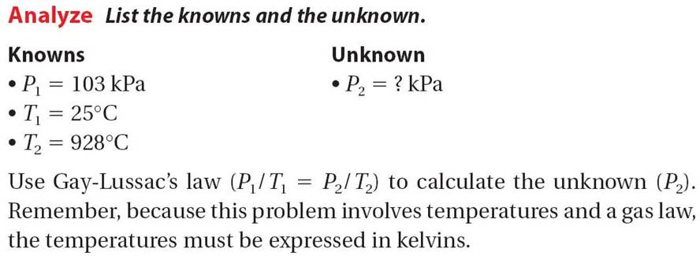
Sample Problem

Slide 37
14.3

Slide 38
Example Problems
5. The gas left in a used aerosol can is at a pressure of 103 kPa at 25°C. If this can is thrown onto a fire, what is the pressure of the gas when its temperature reaches 928°C?
P₁= 103 kPa P₂ = ?
T₁ = 25°C = 298 K T₂ = 928°C = 1201 K
103 = P₂
298 1201
298 × P₂ = 123,703
P₂ = 415 kPa

Slide 39
Example Problem pg. 338 # 14
6. A gas has a pressure of 6.58 kPa at 539 K. What will be the pressure at 211 K if the volume does not change?
P₁= 6.58 kPa P₂ = ?
T₁ = 539 K T₂ = 211 K
6.58 = P₂
211
6.58 X 211 = P₂ X 539
1388.38 = P₂ X 539
2.58 kPa = P₂

Slide 40
Sample Problem

Slide 41
Practice
1) The pressure of a gas in a tank is 3.2 atm at 22°C. If temp rises to 60°C, what will the pressure be?
2) A gas has a pressure of 125 kPa at 30°C. If the pressure increases to 201 kPa, what is the new temp?

Slide 42
How to Remember which law goes with each pair of variables:
Boyle’s
P V
T
Gay-Lussac’s
Charles’

Slide 43
The Combined Gas Law
The combined gas law describes the relationship among the pressure, temperature, and volume of an enclosed gas.

Slide 44
The Combined Gas Law
The combined gas law allows you to do calculations for situations in which only the amount of gas is constant.

Slide 45
Sample Problem

Slide 46
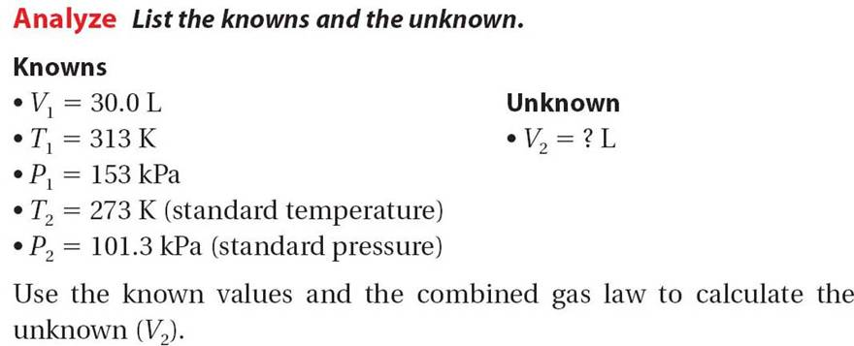
Sample Problem

Slide 47
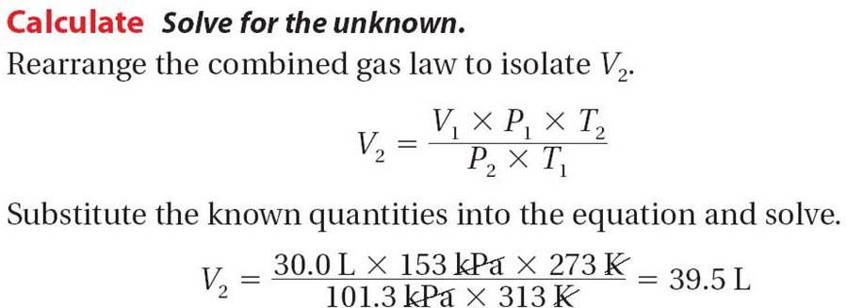
Sample Problem

Slide 48
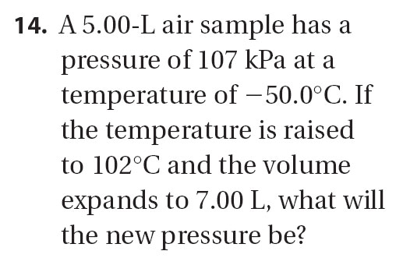
Sample Problem

Slide 51
Practice
1) Helium at 23°C with a volume of 5.60 L at 2.45 atm is changed to a pressure of 8.75 atm and cooled to 15°C. What is the volume?

Slide 52
Practice
2) Helium at 28°C and a volume of 3.80 L at a pressure of 3.15 atm expands to a volume of 9.50 L and is heated to 43°C. Calculate the new pressure.

Slide 53
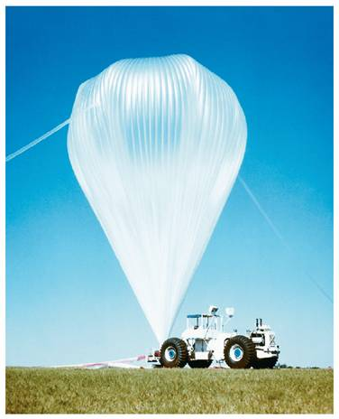
The Combined Gas Law
Weather balloons carry data-gathering instruments high into Earth’s atmosphere. At an altitude of about 27,000 meters, the balloon bursts.
Notes:
Weather balloons carry instruments that can gather data about Earth’s atmosphere. Predicting Explain why helium is more likely than air to be used in weather balloons.

Slide 54
Section Quiz.
1. If the volume of a gas in a container were reduced to one fifth the original volume at constant temperature, the pressure of the gas in the new volume would be
a) one and one fifth times the original pressure.
b) one fifth of the original pressure.
c) four fifths of the original pressure.
d) five times the original pressure.

Slide 55
Section Quiz.
2. A balloon appears slightly smaller when it is moved from the mountains to the seashore at constant temperature. The best gas law to explain this observation would be
a) Gay-Lussacs's Law.
b) Graham's Law.
c) Boyle's Law.
d) Charles's Law.

Slide 56
Section Quiz.
3. At 46°C and 89 kPa pressure, a gas occupies a volume of 0.600 L. How many liters will it occupy at 0°C and 20.8 kPa?
a) 0.600 L
b) 2.58 L
c) 0.140 L
d) 2.20 L

Slide 57
Ideal Gas Law
The gas law that includes all four variables—P, V, T, and n—is called the ideal gas law.
The ideal gas constant (R) has the value 8.31 (L·kPa)/(K·mol).

Slide 58
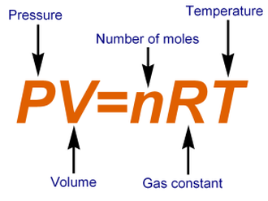
Ideal Gases

Slide 60
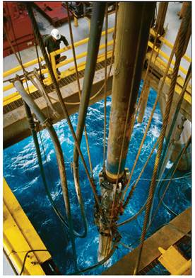
Sample Problem

Slide 61
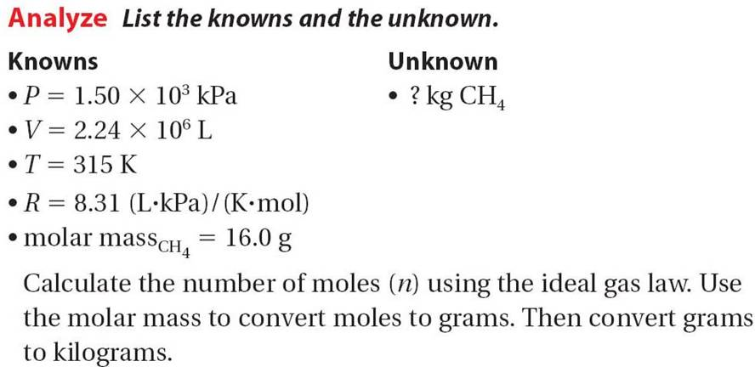
14.5

Slide 62
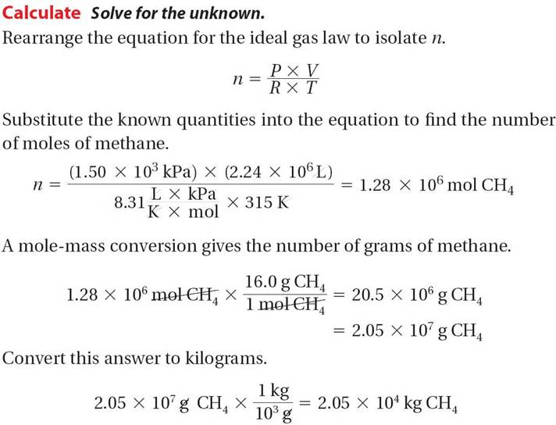
14.5

Slide 63
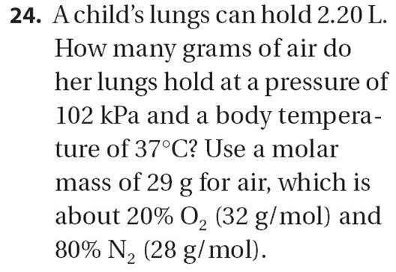
for Sample Problem

Slide 64
Practice
1) A 2.50 mol sample of nitrogen gas has a volume of 5.50 L at 27°C. Calculate pressure.
2) A 5.00 mol sample of oxygen gas has a pressure of 110 kPa at 22°C. Calculate volume.

Slide 65
Practice
3) What volume is occupied by 0.250 mol CO₂ at 25°C and 80.5 kPa?
4) A 1.5 mol sample of radon has a volume of 21.0 L at 33°C. What is the pressure?

Slide 66
Practice
5) A sample of neon has a volume of 3.45 L at 25°C and 90 kPa. Calculate moles.
6) A 25 g sample of argon has a volume of 9.00 L at 875 mmHg. What is the temp in °C?

Slide 67
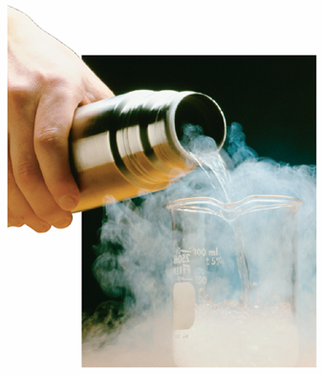
Ideal Gases and Real Gases
There are attractions between the particles in an ideal gas. Because of these attractions, a gas can condense,or even solidify, when it is compressed or cooled.
Notes:
In this flask used to store liquid nitrogen, there are two walls with a vacuum in between.

Slide 68
Ideal Gases and Real Gases
Real gases differ most from an ideal gas at low temperatures and high pressures.

Slide 69
Ideal Gases and Real Gases
Notes:
This graph shows how real gases deviate from the ideal gas law at high pressures. INTERPRETING GRAPHS a. Observing What are the values of (PV)/(nRT) for an ideal gas at 20,000 and 60,000 kPa? b. Comparing What variable is responsible for the differences between the two (CH₄) curves? c. Making Generalizations How does an increase in pressure affect the (PV)/(nRT ) ratio for real gases?

Slide 70
14.3 Section Quiz.
1. An aerosol spray can with a volume of 325 mL contains 3.00 g of propane (C₃H₈) as a propellant. What is the pressure in atm of the gas in the can at 28°C?
a) 524 kPa
b) 2.31 10⁴ kPa
c) 475 kPa
d) 0.524 kPa

Slide 71
14.3 Section Quiz.
2. Find the volume of a gas in liters if 2.95 mol has a pressure of 77.0 kPa at a temperature of 52°C.
a) 22.4 L
b) 16.6 L
c) 103 L
d) 50.2 L

Slide 72
14.3 Section Quiz.
3. An ideal gas differs from a real gas in that the molecules of an ideal gas
a) have no attraction for one another.
b) have a significant volume.
c) have a molar mass of zero.
d) have no kinetic energy.

