Slide 1
Chapter 13
Electrons in Atoms

Slide 2
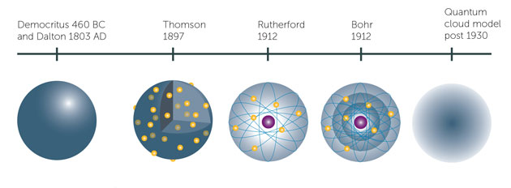

Slide 3
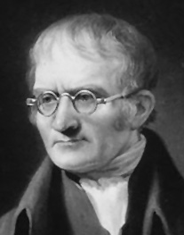
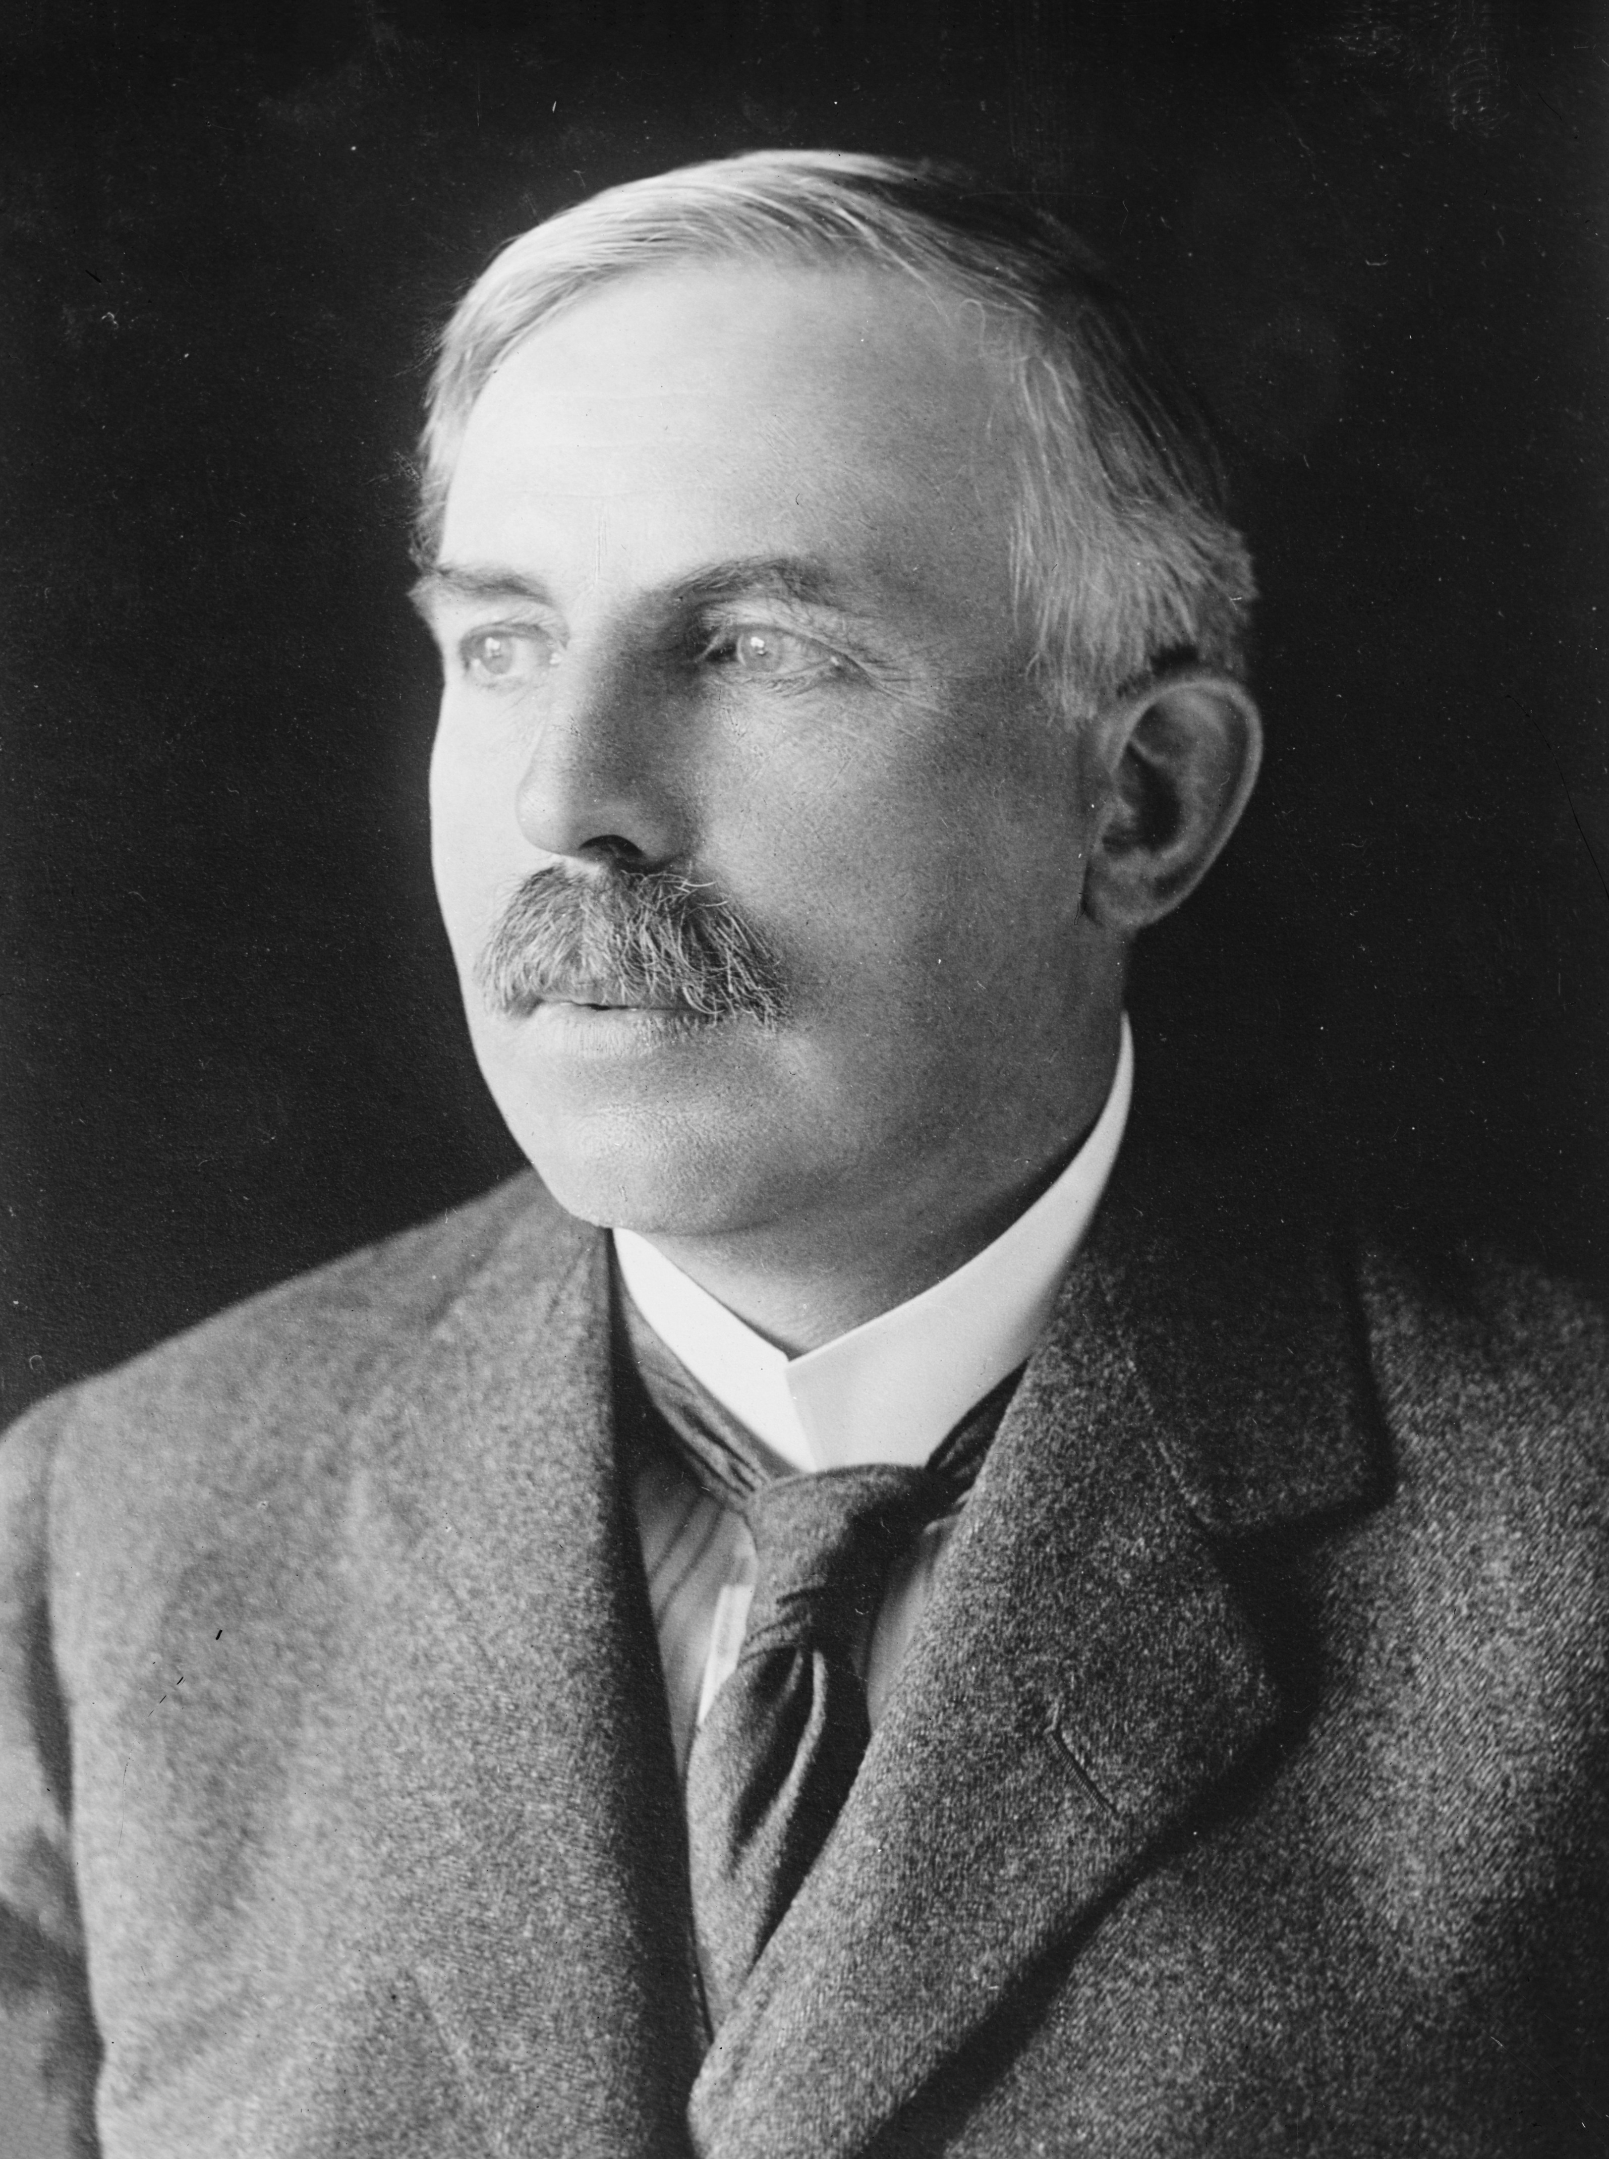
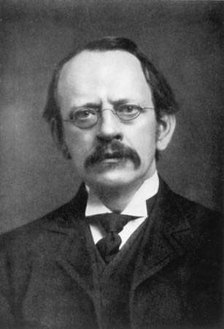
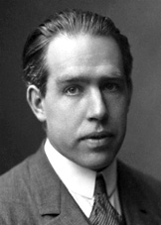
Models of the Atom
John Dalton
1766-1844
J.J. Thompson
1856-1940
Ernest Rutherford
1871-1937
Niels Bohr
1885-1962

Slide 4
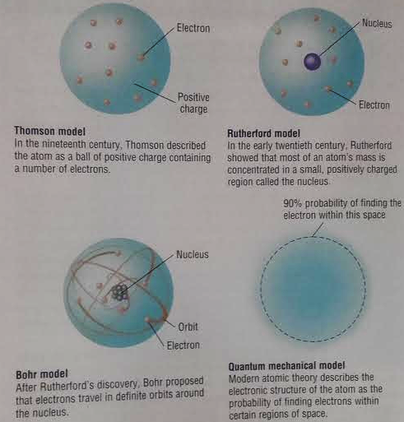

Slide 5
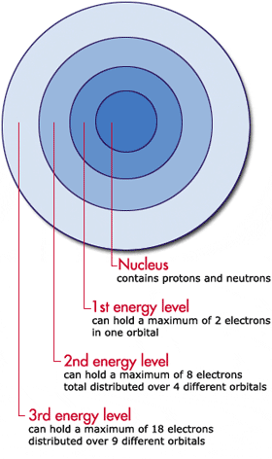
Energy levels
Energy level: The region around the nucleus where the electron is likely to be moving.

Slide 6
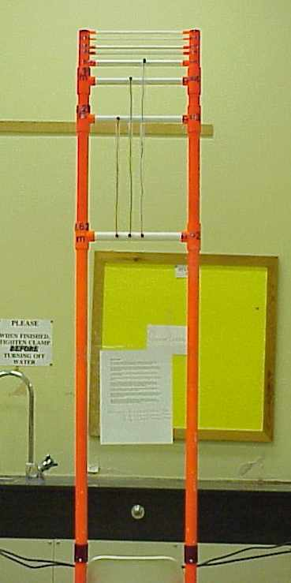
Think of energy levels like a ladder:
What is the difference between the two ladders?

Slide 7
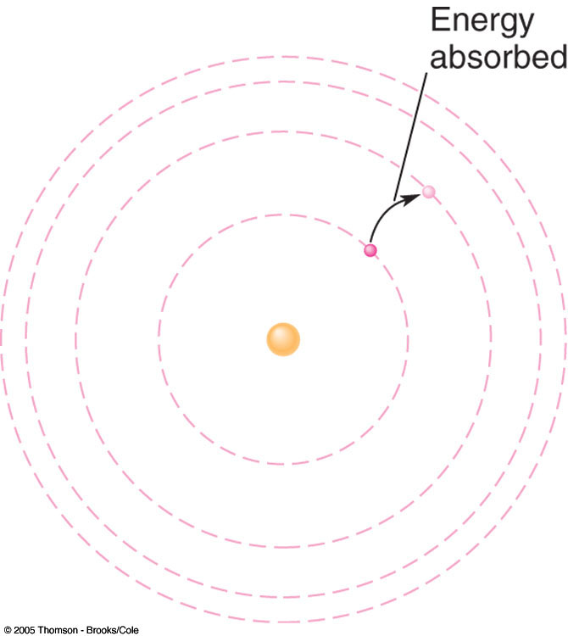
Electrons cannot exist between energy levels.
Highest energy is farthest away from the nucleus
Highest Energy Level
Lowest Energy Level
Lowest energy level is closest to the nucleus

Slide 8
The quantum Mechanical model
To move from rung (or orbit) to the next electrons must gain or lose the right amount of energy.
This amount is called
a quantum of energy.

Slide 9
s always holds 2 electrons
p always holds 6 electrons
d always holds 10 electrons

Slide 10
Energy levels are broken into sublevels
Energy level 1 has 1 sub level
Energy level 2 has 2 sub levels
Energy level 3 has 3 sub levels
Energy level 4 ahs 4 sub levels

Slide 11
Each sublevel has orbitals
Each orbital can hold 2 electrons
s shell has 1 orbital = 2 electrons
p shell has 3 orbitals = 6 electrons
d shell has 5 orbitals = 10 electrons
f shell has 7 orbitals = 14 electrons

Slide 12
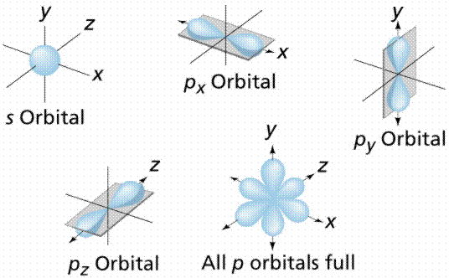
Orbitals

Slide 13
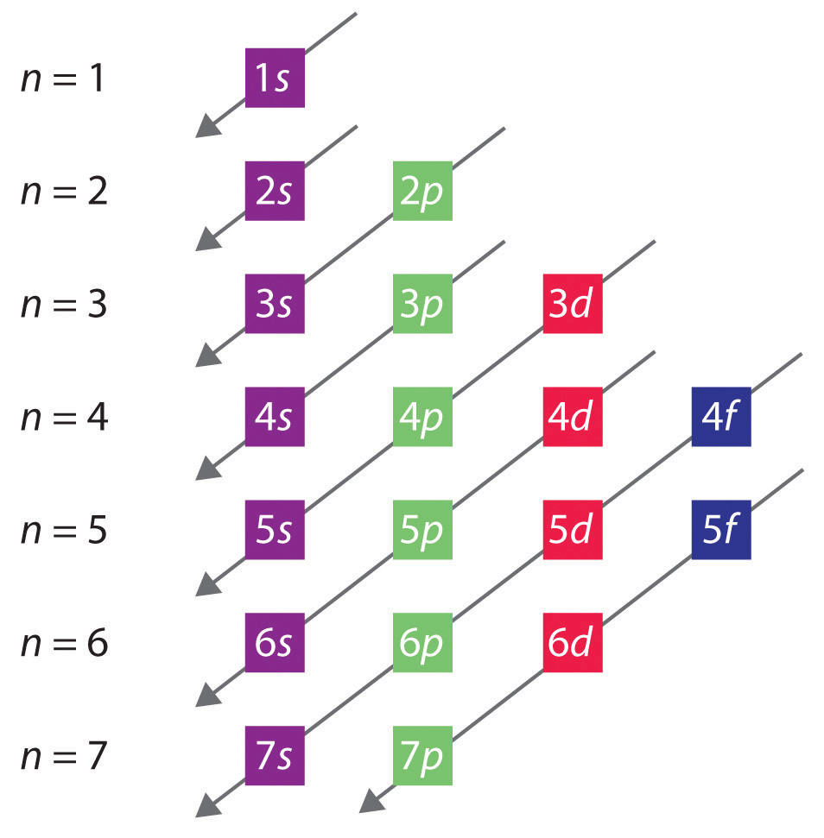
How to put electrons in orbitals

Slide 14
7p
6d
7s
5f
6p
5d
6s
4f
5p
4d
5s
4p
4s
3d
3p
Increasing energy
3s
2p
2s
Orbital (Aufbau) diagram
1s

Slide 15
How electrons fill orbitals (writing electron configurations)
1. Aufbau Principle
Electrons enter orbitals of lowest energy first.
Look at figure 13.6. The lowest energy level is the 1s.
Electrons go here first

Slide 16
How electrons fill orbitals (writing electron configurations)
2. The Pauli Exclusion Principle
Only 2 electrons per orbital
Don’t squish more than 2 electrons in a box!
Each of the electrons must have opposite spin
One up arrow and one down arrow

Slide 17
How electrons fill orbitals (writing electron configurations)
3. Hund‘s Rule
When electrons occupy orbitals of equal energy (ex. 2p) one electron enters each orbital until all orbitals contain one electron with parallel (the same) spin.

Slide 18
Example
Let’s determine the electron configuration & orbital diagram for Phosphorus
Need to account for 15 electrons

Slide 19
7p
6d
7s
5f
6p
5d
6s
4f
5p
4d
5s
4p
4s
3d
3p
Increasing energy
3s
2p
2s
1s
1s²
2s²
2p⁶
3s²
3p³

Slide 20
Example
Let’s determine the electron configuration & orbital diagram for Nickel
Need to account for 28 electrons

Slide 21
7p
6d
7s
5f
6p
5d
6s
4f
5p
4d
5s
4p
4s
3d
3p
Increasing energy
3s
2p
2s
1s
1s²
2s²
2p⁶
3s²
3p⁶
3d¹⁰

Slide 22
Example
Let’s determine the electron configuration & orbital diagram for Nitrogen
Need to account for 7 electrons

Slide 23
7p
6d
7s
5f
6p
5d
6s
4f
5p
4d
5s
4p
4s
3d
3p
Increasing energy
3s
2p
2s
1s
1s²
2s²
2p³

Slide 24
Example
Let’s determine the electron configuration & orbital diagram for Aluminum
Need to account for 13 electrons

Slide 25
7p
6d
7s
5f
6p
5d
6s
4f
5p
4d
5s
4p
4s
3d
3p
Increasing energy
3s
2p
2s
1s
1s²
2s²
2p⁶
3s²
3p¹

Slide 26
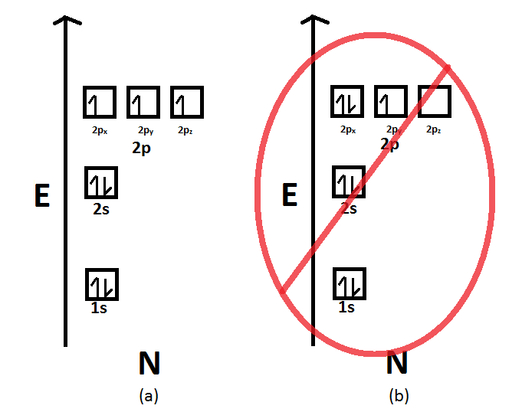

Slide 27
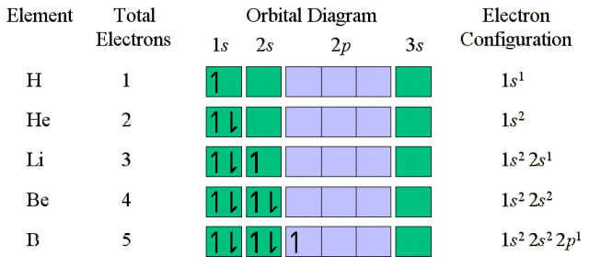

Slide 28
Physics & the Quantum Mechanical Model
Electromagnetic radiation
Radio waves
Microwaves
Infrared waves
Visible light
Ultraviolet waves
X-rays
Gamma rays

Slide 29
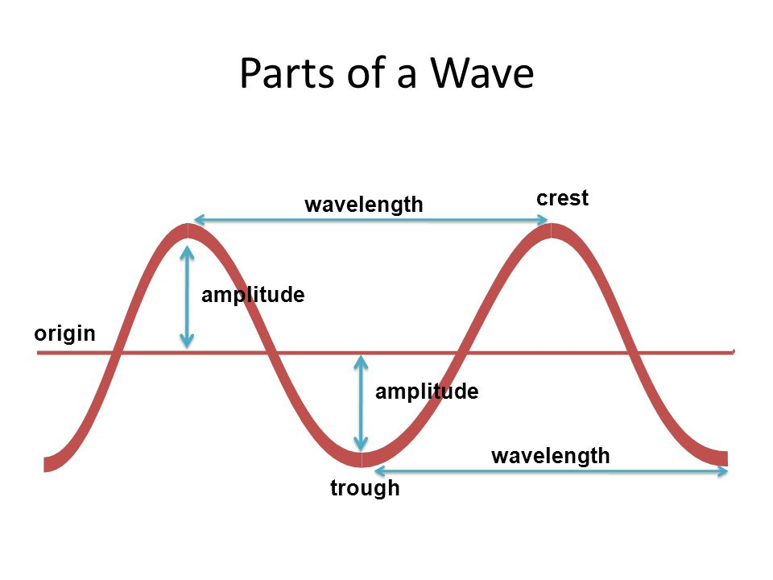
Physics & the Quantum Mechanical Model

Slide 30
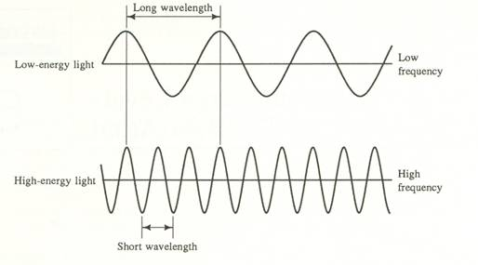
Physics & the Quantum Mechanical Model

Slide 31
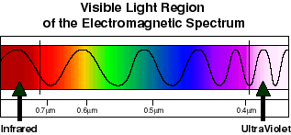
Physics & the Quantum Mechanical Model
Speed of light
Frequency is measured in Hertz(Hz)
c= 3.0x10⁸ m/s

Slide 32
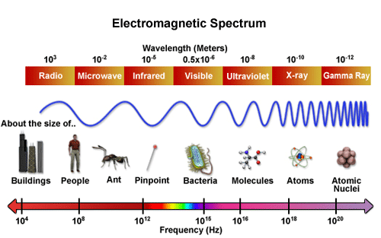
Physics & the Quantum Mechanical Model

Slide 33
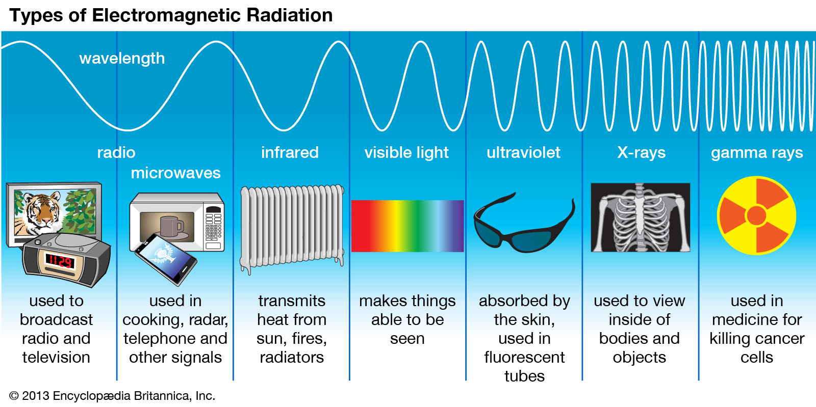
Physics & the Quantum Mechanical Model

Slide 34
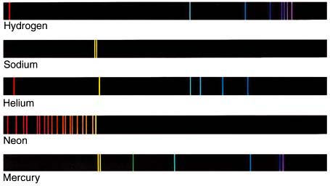
Physics & the Quantum Mechanical Model
Emission spectrum

Slide 35
Calculate the wave length of the yellow light emitted by a sodium lamp if the frequency of the radiation is 5.10x10¹⁴Hz
c= λv
λ=c/v

