Slide 1
Chapter 20
Acids and Bases

Slide 2
Chapter 20.1
Describing Acids and Bases

Slide 3
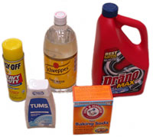
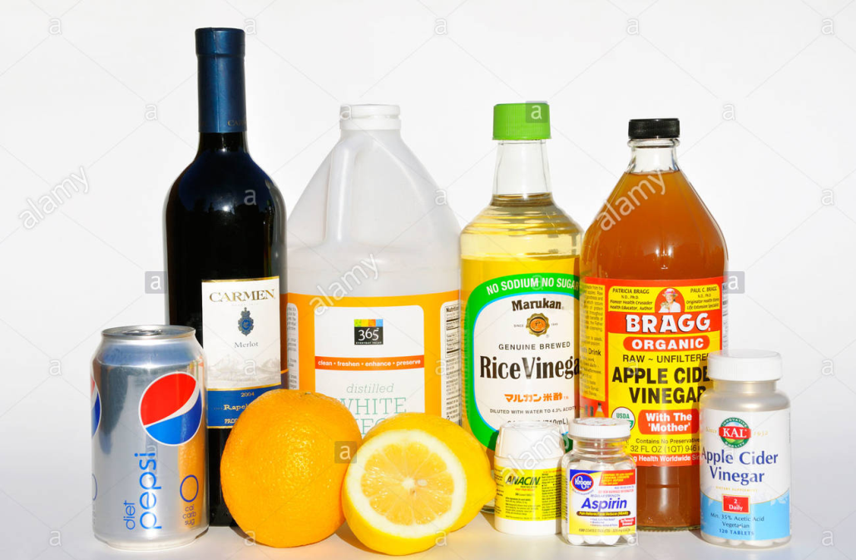
Acids and Bases

Slide 4
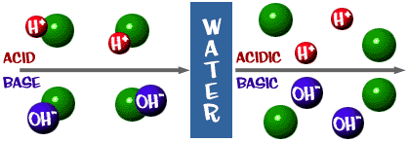
Acids & Bases
Acids: Compound that produces H⁺ when dissolved in water
Bases: compound that produces hydroxide ions when dissolved in water.

Slide 6
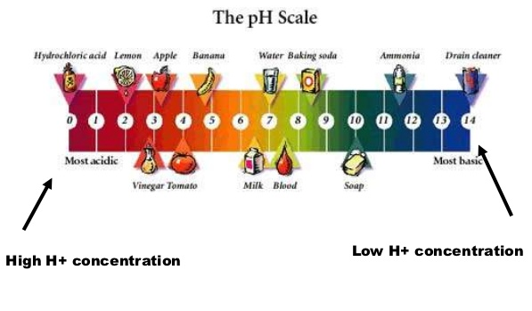

Slide 7
Acids
Hydrochloric acid HCl
Sulfuric acid H₂SO₄
Nitric acid HNO₃
Ethanoic/acetic acid HC₂H₃O₂ or CH₃COOH
Phosphoric acid H₃PO₄
Carbonic acid H₂CO₃

Slide 8
Questions
Page 579
Q1 Name each acid or base
a) HF
b) HNO₃
c) KOH
d) H₂SO₄
Q2 Write formulas for each acid or base
b) Iron (II) hydroxide
d) Lithium hydroxide

Slide 9
Questions
Page 579
Q1 Name each acid or base
a) HF acid
b) HNO₃ acid
c) KOH base
d) H₂SO₄ acid
Q2 Write formulas for each acid or base
b) Iron (II) hydroxide Fe(OH)₂
d) Lithium hydroxide LiOH

Slide 10
Chapter 20.2
Hydrogen Ions and Acidity

Slide 11
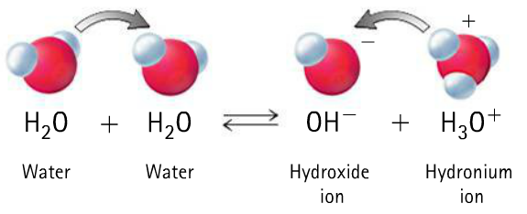
HYDROGEN IONS FROM WATER
Self ionization of water – creating negative hydroxide ions (OH⁻) and positive hydronium ions (H₃O⁺)

Slide 12
Aqueous solutions
In aqueous solutions [OH–] and [H⁺] act independently
Or in other words:
When [OH–] increases [H⁺] decreases
or when [H⁺] increases [OH–] decreases

Slide 13
Aqueous Solutions
[OH–] + [H⁺] $↔$ H₂O
K_{w}= [OH–] X [H⁺] = 1.0 x 10^{–14}
K_{w} = 1.0 x 10^{–7} X 1.0 x 10^{–7} = 1.0 x 10^{–14}
K_{w} = ion-product constant for water
Acidic solution [H⁺] greater than [OH–],
[H⁺] greater than 1.0 x 10^{–7} M.
Basic or alkaline solution [H⁺] less than [OH–],
[H⁺] less than 1.0 x 10^{–7} M

Slide 14
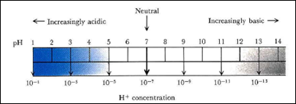
Aqueous Solutions
Acidic solution [H⁺] greater than [OH–]
[H⁺] greater than 1.0 x 10^{–7} M.
Basic or alkaline solution [H⁺] less than [OH–]
[H⁺] less than 1.0 x 10^{–7} M

Slide 15
Questions
Page 582 Q6&7

Slide 16
Chapter 20.3
Acid-Base Theories

Slide 17
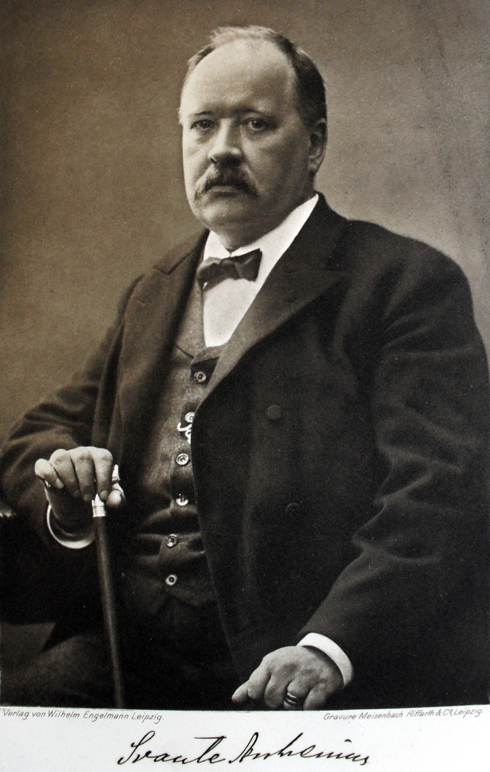
ARRHENIUS ACIDS AND BASES
Svante Arrhenius 1859-1927
His theory:
An acid is something that contributes hydrogen ions (H⁺) to a solution
A base is something that contributes hydroxide ions (OH⁻) to a solution

Slide 20
Questions
Page 609 Q 45

Slide 21
More examples

Slide 22
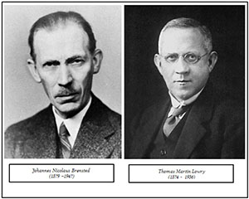
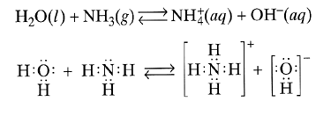
BRØNSTED-LOWRY ACIDS AND BASES
The theory. An acid is a proton (hydrogen ion) donor. A base is a proton (hydrogen ion) acceptor.
Denmark England

Slide 23
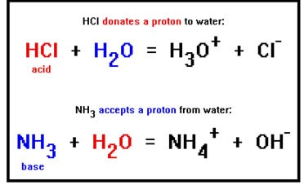

Slide 24
Remember
An acid gives a hydrogen ion to a base

Slide 25
Chapter 22.1
The Meaning of Oxidation and Reduction

Slide 26
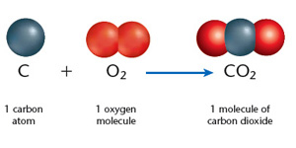
OXYGEN IN REDOX REACTIONS
Oxidation – combining something with oxygen

Slide 27
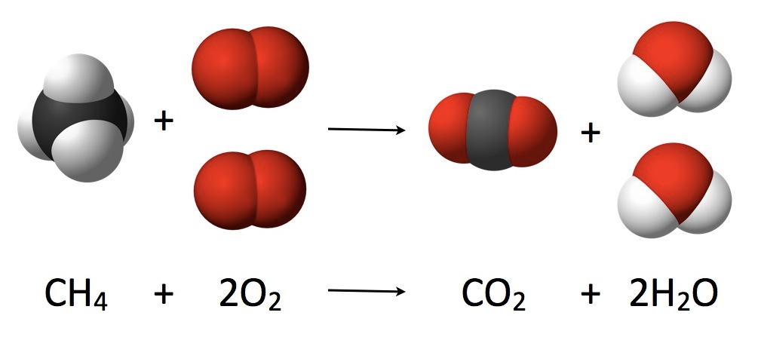
OXYGEN IN REDOX REACTIONS
Oxidation – combining something with oxygen

Slide 28
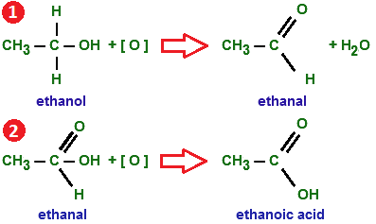
OXYGEN IN REDOX REACTIONS
Reduction reactions - oxygen is lost from compound

Slide 29
OXYGEN IN REDOX REACTIONS
Oxidation-reductions reactions(redox reactions)
Oxidation reactions need reduction reactions

Slide 30
ELECTRON TRANSFER IN REDOX REACTIONS
Oxidation – Loss of electrons
– Gain of oxygen
Reduction – Gain of electrons
– Loss of oxygen

Slide 31
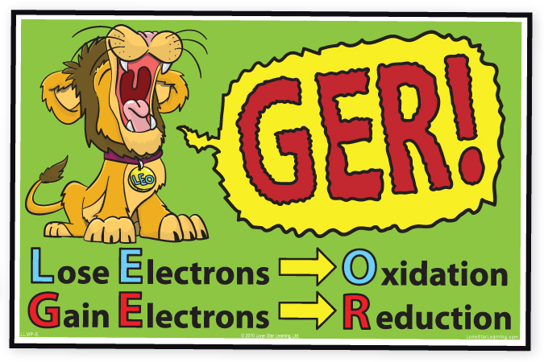
ELECTRON TRANSFER IN REDOX REACTIONS

Slide 32
ELECTRON TRANSFER IN REDOX REACTIONS

Slide 33
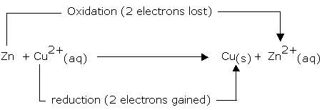
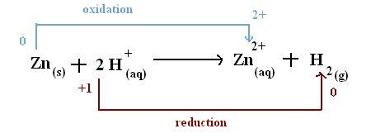
ELECTRON TRANSFER IN REDOX REACTIONS

Slide 34
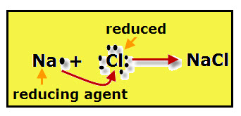
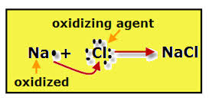
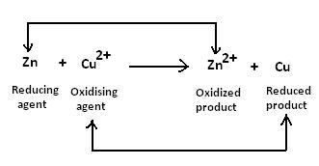
ELECTRON TRANSFER IN REDOX REACTIONS
Reducing agent – substance that loses electrons
Oxidising agent - substance that gains electrons

Slide 35
Questions
Page 649 Q 1&2
All questions you should have done
P579Q1,3,5 P582Q6,7 P593Q16 p599Q21a,22P609Q45,65 P649Q1,2 P653Q3,4,6

