Slide 1


CHAPTER
NEW CHAPTER
Mountains and Volcanoes
the BIG idea
Mountains and volcanoes form as tectonic plates move.
3.1
Movement of rock builds mountains.
3.2
Volcanoes form as molten rock erupts.
3.3
Volcanoes affect Earth’s land, air, and water.
CHAPTER OUTLINE
CHAPTER RESOURCES

Slide 2
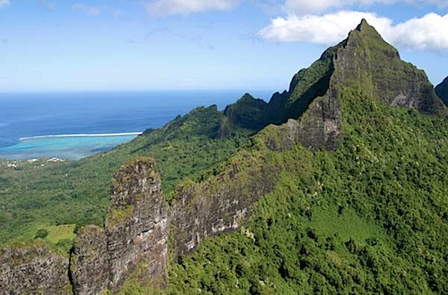
Mountain Ridges
3.1
Movement of rock builds mountains.
chain of mountains or hills that form a continuous raised crests
folded mountain
fault-block mountain
CHAPTER
RESOURCES
KEY CONCEPT
SUMMARY

Slide 3
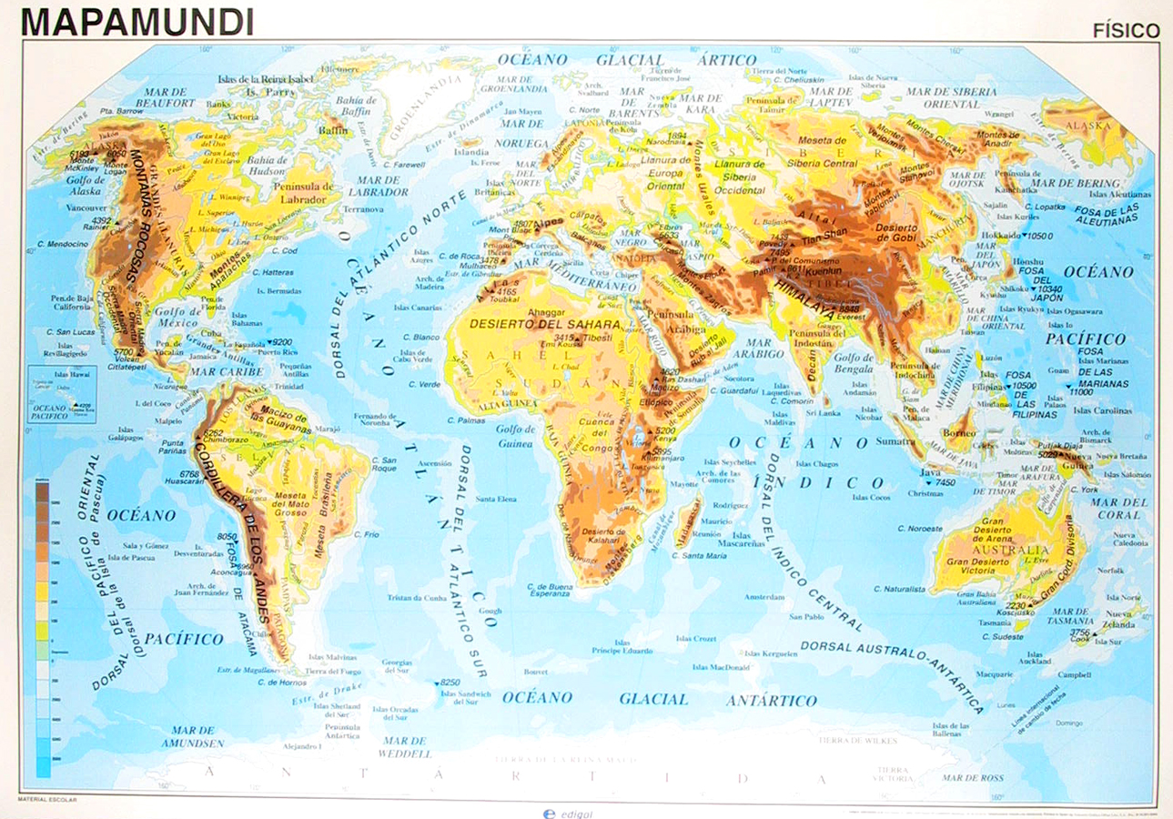
Mountain Ridges
3.1
Movement of rock builds mountains.
chain of mountains or hills that form a continuous raised crests
folded mountain
fault-block mountain
CHAPTER
RESOURCES
KEY CONCEPT
SUMMARY

Slide 4
Mountains
Most mountains form along plate boundaries
Different types of mountains
  Folded mountains
  fault-block mountain

Slide 5
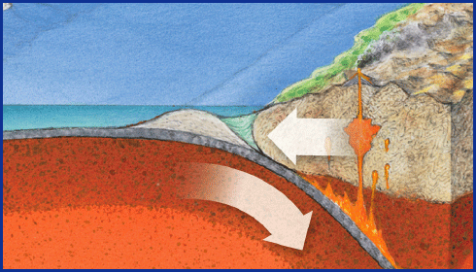
folded mountain
3.1
Movement of rock builds mountains.
A mountain that forms as continental crust is pushed together and rocks bend into large folds.
folded mountain
fault-block mountain
CHAPTER
RESOURCES
KEY CONCEPT
SUMMARY

Slide 6
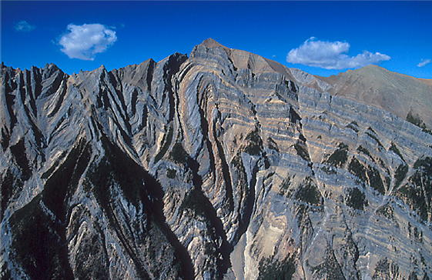
folded mountain
3.1
Movement of rock builds mountains.
A mountain that forms as continental crust is pushed together and rocks bend into large folds.
folded mountain
fault-block mountain
CHAPTER
RESOURCES
KEY CONCEPT
SUMMARY

Slide 7
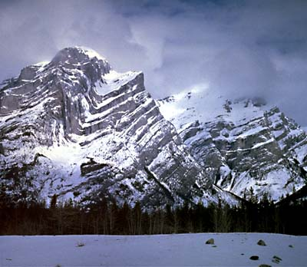
folded mountain
3.1
Movement of rock builds mountains.
A mountain that forms as continental crust is pushed together and rocks bend into large folds.
folded mountain
fault-block mountain
CHAPTER
RESOURCES
KEY CONCEPT
SUMMARY

Slide 8
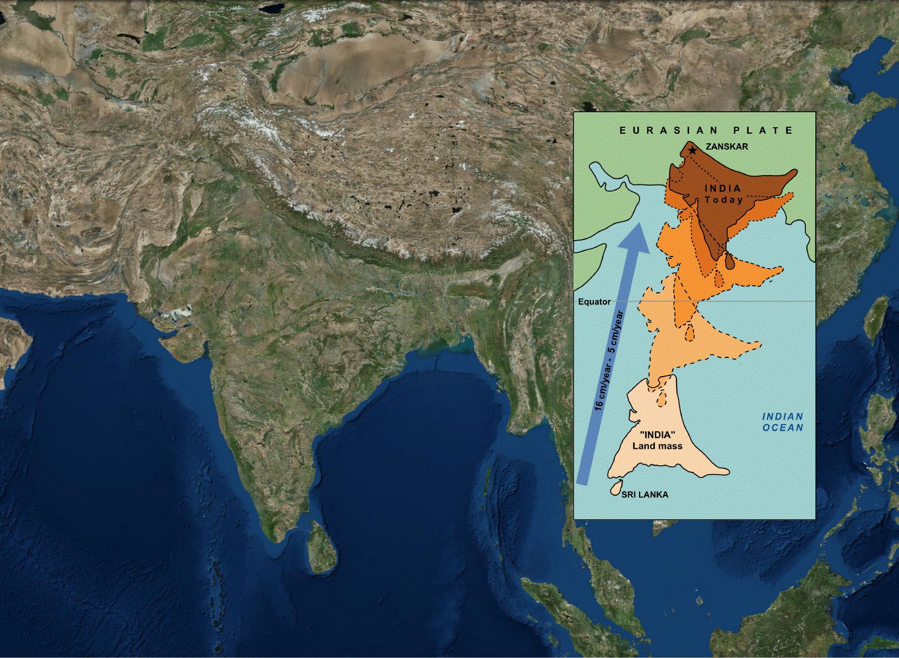

Slide 9
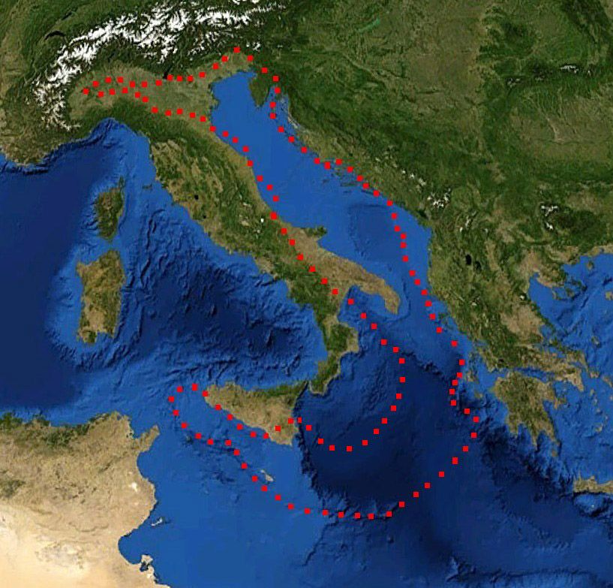

Slide 10
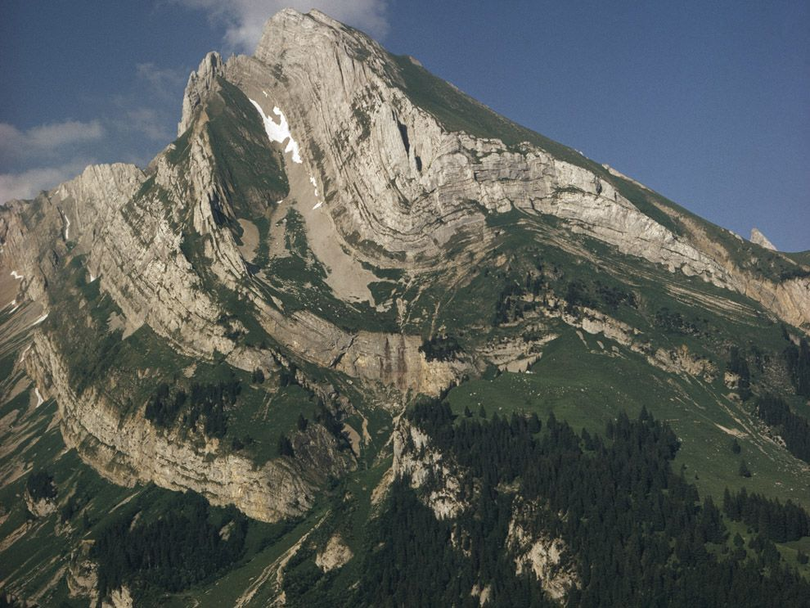

Slide 11
folded mountain
3.1
Movement of rock builds mountains.
What causes folded mountains to be created?
What type of plate boundary do folded mountain occur at?
What impact would folded mountains have on the land around them?
What impact folded mountains have on the people who live close to them?
folded mountain
fault-block mountain
CHAPTER
RESOURCES
KEY CONCEPT
SUMMARY

Slide 12
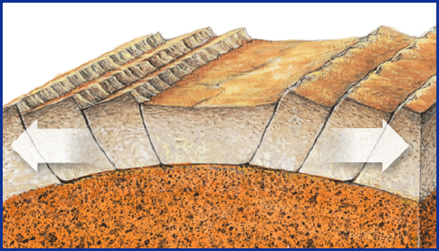
fault-block mountain
3.1
Movement of rock builds mountains.
folded mountain
A mountain that forms as blocks of rock move up or down along normal faults where the lithosphere is being pulled apart.
fault-block mountain
CHAPTER
RESOURCES
KEY CONCEPT
SUMMARY

Slide 13
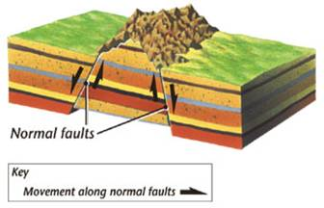
fault-block mountain
3.1
Movement of rock builds mountains.
folded mountain
A mountain that forms as blocks of rock move up or down along normal faults where the lithosphere is being pulled apart.
fault-block mountain
CHAPTER
RESOURCES
KEY CONCEPT
SUMMARY

Slide 14
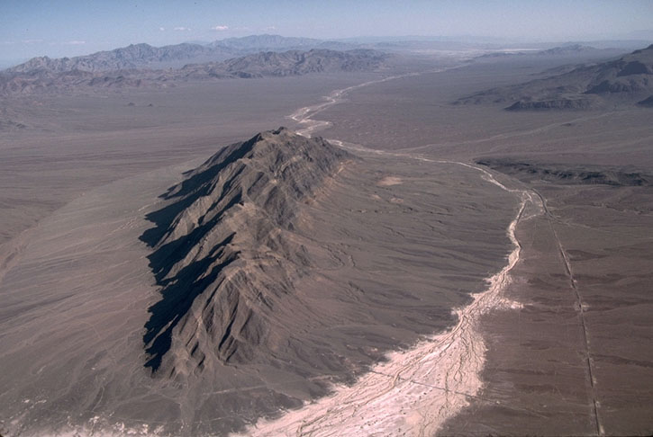
fault-block mountain
3.1
Movement of rock builds mountains.
folded mountain
A mountain that forms as blocks of rock move up or down along normal faults where the lithosphere is being pulled apart.
fault-block mountain
CHAPTER
RESOURCES
KEY CONCEPT
SUMMARY

Slide 15
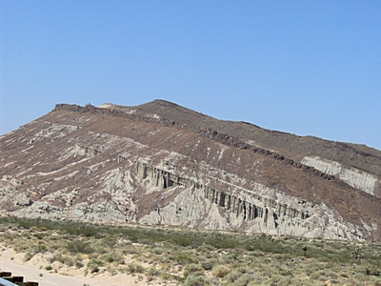
fault-block mountain
3.1
Movement of rock builds mountains.
folded mountain
A mountain that forms as blocks of rock move up or down along normal faults where the lithosphere is being pulled apart.
fault-block mountain
CHAPTER
RESOURCES
KEY CONCEPT
SUMMARY

Slide 16
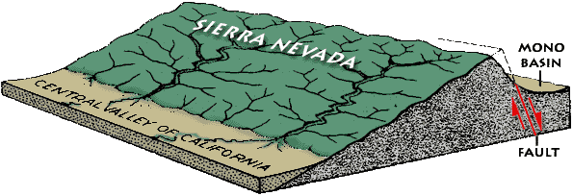
fault-block mountain
3.1
Movement of rock builds mountains.
folded mountain
A mountain that forms as blocks of rock move up or down along normal faults where the lithosphere is being pulled apart.
fault-block mountain
CHAPTER
RESOURCES
KEY CONCEPT
SUMMARY

Slide 17
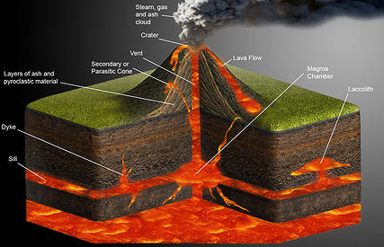
volcano
3.2
Volcanoes form as molten rock erupts.
volcano
An opening in the crust through which molten rock, rock fragments, and hot gases erupt; a mountain built up from erupted materials.
lava
pyroclastic flow
CHAPTER
RESOURCES
KEY CONCEPT
SUMMARY

Slide 18
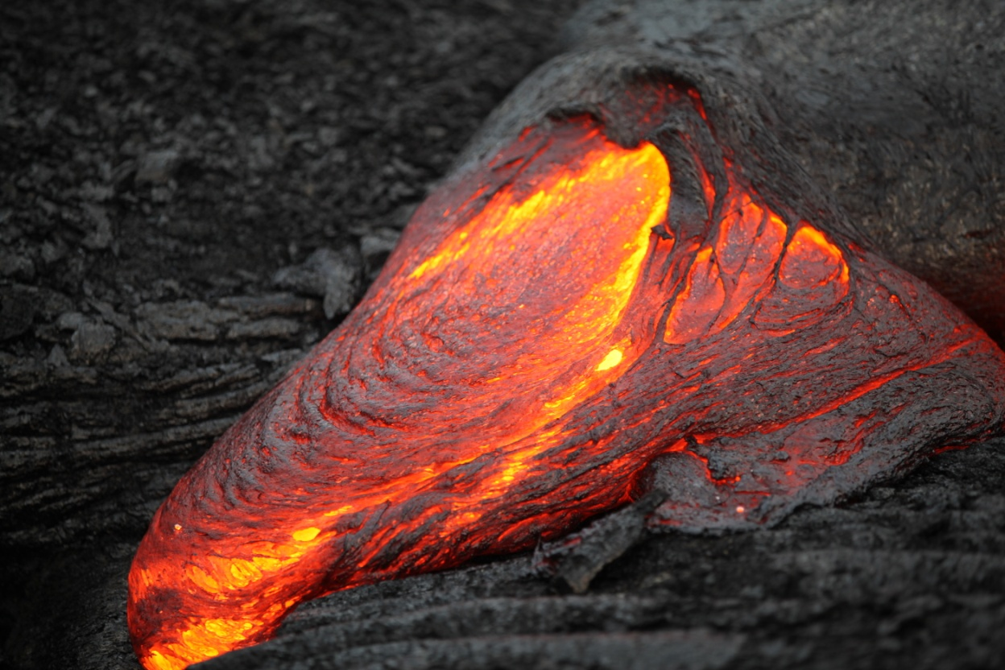
lava
3.2
Volcanoes form as molten rock erupts.
Molten rock that reaches a planet’s surface through a volcano.
volcano
lava
pyroclastic flow
CHAPTER
RESOURCES
KEY CONCEPT
SUMMARY

Slide 19
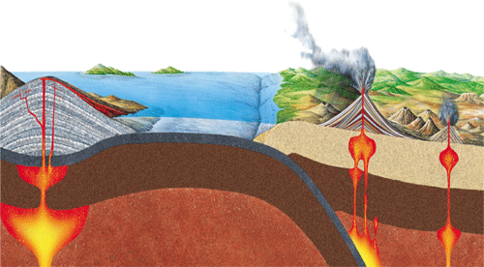
Volcanoes form as molten rock erupts.
3.2
Volcanoes erupt molten rock, rock fragments, and gases. Different types of erupted materials build up different types of volcanoes.
volcano
lava
A cinder cone is made up of loose rock fragments and cinders that form as gas-rich magma erupts.
pyroclastic flow
A shield volcano is made up of many layers of low-silica lava.
A composite volcano consists of layers of erupted rock fragments and cooled flows of high-silica lava.
CHAPTER
RESOURCES
SECTION
OUTLINE

Slide 20

Volcanoes form as molten rock erupts.
3.2
Volcanoes erupt molten rock, rock fragments, and gases. Different types of erupted materials build up different types of volcanoes.
volcano
lava
pyroclastic flow
SIMULATION
Make a volcano erupt.
file:///F:/To%20Fiona/From%20David/8%20Science/Text%20book/animations/cem05_pg75_volcano.html
CHAPTER
RESOURCES
SECTION
OUTLINE

Slide 21
Volcanoes form as molten rock erupts.
3.2
Volcanoes erupt molten rock, rock fragments, and gases. Different types of erupted materials build up different types of volcanoes.
volcano
lava
pyroclastic flow
https://www.youtube.com/watch?v=BUREX8aFbMs
CHAPTER
RESOURCES
SECTION
OUTLINE

Slide 22
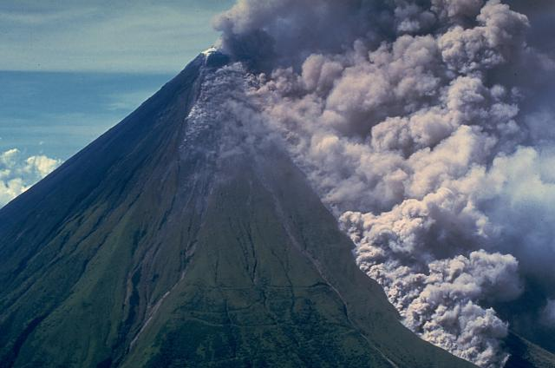
pyroclastic flow
3.2
Volcanoes form as molten rock erupts.
A dense cloud of superheated gases and rock fragments that moves quickly downhill from an erupting volcano.
volcano
lava
pyroclastic flow
CHAPTER
RESOURCES
KEY CONCEPT
SUMMARY

Slide 23
pyroclastic flow
3.2
Volcanoes form as molten rock erupts.
A dense cloud of superheated gases and rock fragments that moves quickly downhill from an erupting volcano.
volcano
lava
pyroclastic flow
https://www.youtube.com/watch?v=Cvjwt9nnwXY
CHAPTER
RESOURCES
KEY CONCEPT
SUMMARY

Slide 24
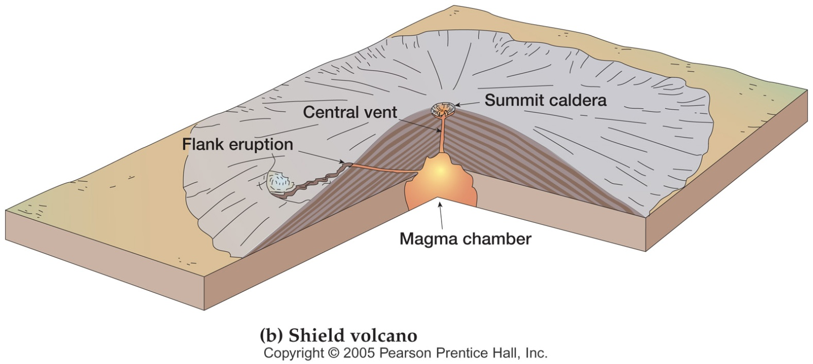
Volcanoes form as molten rock erupts.
3.2
Shield volcano
made of lava with little ash
lava flows in sheets building up over time
very gentle slope to cones
large volcanoes, created by hot spots
examples: Hawaiian Islands (hot spot), Iceland (rift zone), Galapagos Islands (hot spot)
volcano
lava
pyroclastic flow
CHAPTER
RESOURCES
SECTION
OUTLINE

Slide 25
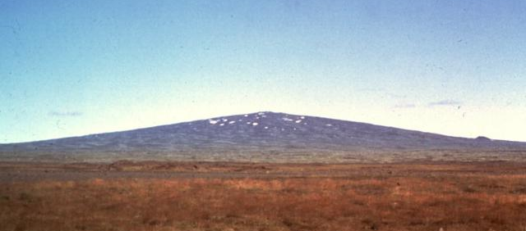
Volcanoes form as molten rock erupts.
3.2
Shield volcano
made of lava with little ash
lava flows in sheets building up over time
very gentle slope to cones
large volcanoes, created by hot spots
examples: Hawaiian Islands (hot spot), Iceland (rift zone), Galapagos Islands (hot spot)
volcano
lava
pyroclastic flow
CHAPTER
RESOURCES
SECTION
OUTLINE

Slide 26
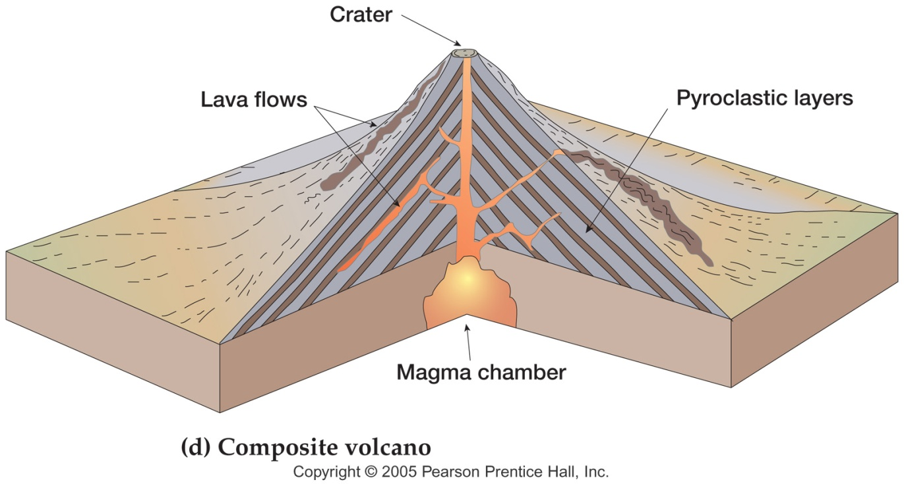
Volcanoes form as molten rock erupts.
3.2
Composite volcano
associated with subduction zones - most located around "Pacific Ring of Fire"
very explosive with rock fragments (pyroclasts, gases, ash)
has steep sides and often symmetrical
examples: Mt. St. Helens in USA, Mt. Mayon in the Phillipines, Mt. Fuji in Japan
volcano
lava
pyroclastic flow
CHAPTER
RESOURCES
SECTION
OUTLINE

Slide 27
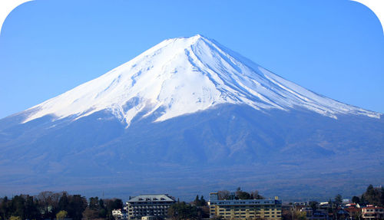
Volcanoes form as molten rock erupts.
3.2
Composite volcano
associated with subduction zones - most located around "Pacific Ring of Fire"
very explosive with rock fragments (pyroclasts, gases, ash)
has steep sides and often symmetrical
examples: Mt. St. Helens in USA, Mt. Mayon in the Phillipines, Mt. Fuji in Japan
volcano
lava
pyroclastic flow
CHAPTER
RESOURCES
SECTION
OUTLINE

Slide 28
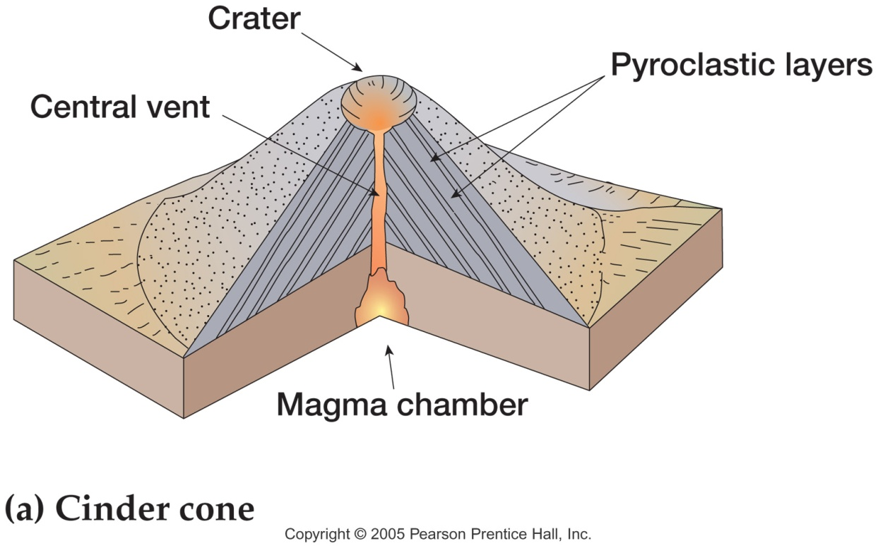
Volcanoes form as molten rock erupts.
3.2
Cinder Cone Volcanoes
smallest type of volcano, usually not more than 1000 feet
make small amount of lava and lots of pyroclasts
form steep cone shaped made of rock
examples: Sunset Crater, AZ; Craters of the Moon, Idaho; Paricutin, Mexico
volcano
lava
pyroclastic flow
CHAPTER
RESOURCES
SECTION
OUTLINE

Slide 29
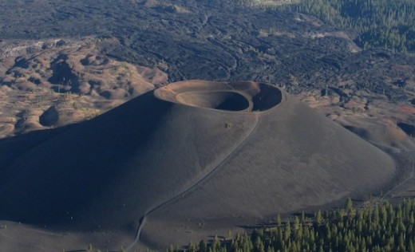
Volcanoes form as molten rock erupts.
3.2
Cinder Cone Volcanoes
smallest type of volcano, usually not more than 1000 feet
make small amount of lava and lots of pyroclasts
form steep cone shaped made of rock
examples: Sunset Crater, AZ; Craters of the Moon, Idaho; Paricutin, Mexico
volcano
lava
pyroclastic flow
CHAPTER
RESOURCES
SECTION
OUTLINE

Slide 30
Volcanoes affect Earth’s land, air, and water.
3.3
Materials erupted from volcanoes, as well as heat from molten rock underground, affect Earth’s surface.
acid rain
geyser
Land
Air
Water
• lava
• volcanic ash
• landslides
• mudflows
• pyroclastic flows
• poisonous gases
• adds to acid rain
• haze
• lower temperatures
• hot springs
• geysers
• fumaroles
• deep-sea vents
VISUALIZATION
CHAPTER
RESOURCES
CLASSZONE.COM
Watch clips of erupted volcanic material.
SECTION
OUTLINE

Slide 31
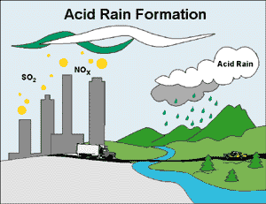
acid rain
3.3
Volcanoes affect Earth’s land, air, and water.
Rain that has become more acidic than normal due to pollution.
acid rain
geyser
CHAPTER
RESOURCES
KEY CONCEPT
SUMMARY

Slide 32
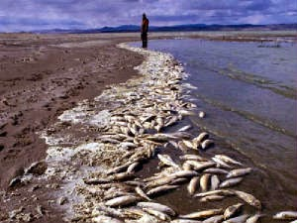
acid rain
3.3
Volcanoes affect Earth’s land, air, and water.
Rain that has become more acidic than normal due to pollution.
acid rain
geyser
CHAPTER
RESOURCES
KEY CONCEPT
SUMMARY

Slide 33
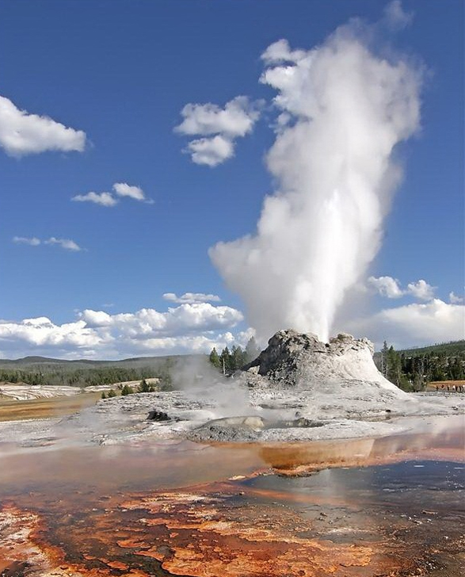
geyser
3.3
Volcanoes affect Earth’s land, air, and water.
acid rain
A type of hot spring that shoots water into the air.
geyser
CHAPTER
RESOURCES
KEY CONCEPT
SUMMARY

Slide 34
3.1
Movement of rock builds mountains.
I. Movement of rock builds mountains.
folded mountain
A. Most mountains form along plate boundaries.
fault-block mountain
1. Mountain Ranges and Belts
2. Mountains, Rocks, and Sediment
B. Mountains can form as rocks fold.
C. Mountains can form as rocks move along faults.
CHAPTER
RESOURCES
KEY CONCEPT
SUMMARY

Slide 35
Volcanoes form as molten rock erupts.
3.2
II. Volcanoes form as molten rock erupts.
A. Volcanoes erupt many types of material.
volcano
1. Magma
lava
2. Rock Fragments
pyroclastic flow
3. Volcanic Gases
B. Most volcanoes form along plate boundaries.
C. Volcanoes can be many shapes and sizes.
D. Scientists monitor volcanoes.
CHAPTER
RESOURCES
KEY CONCEPT
SUMMARY

Slide 36
Volcanoes affect Earth’s land, air, and water.
3.3
III. Volcanoes affect Earth’s land, air, and water.
acid rain
A. Volcanic eruptions affect the land.
geyser
1. Immediate Effects
2. Long-term Effects
B. Volcanic gases and ash affect the air.
C. Volcanic activity affects water.
1. Hot Springs, Geysers, and Fumaroles
2. Deep-Sea Vents
CHAPTER
RESOURCES
KEY CONCEPT
SUMMARY

Slide 37

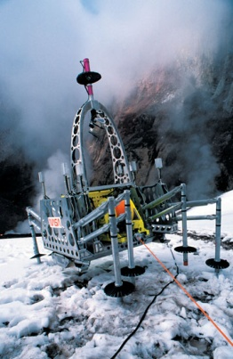
Image Gallery
CHAPTER HOME
Click on the icons to see a larger image or animation.
SIMULATION
VISUALIZATION
Make a volcano erupt.
CLASSZONE.COM
Watch clips of erupted volcanic material.

Slide 38
Image Gallery
CHAPTER HOME
BACK TO IMAGE GALLERY

Slide 39
Image Gallery
CHAPTER HOME
BACK TO IMAGE GALLERY

Slide 40
Image Gallery
CHAPTER HOME
BACK TO IMAGE GALLERY

Slide 41

Image Gallery
CHAPTER HOME
BACK TO IMAGE GALLERY

Slide 42


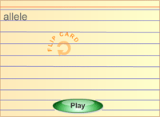
Chapter Resources
CHAPTER HOME
Image Gallery
Click here to review chapter
images and animations
Review Game
Play a fun interactive
review game
Animations
Link to all the McDougal
Littell Science animations
Click on the items below to access resources on
CLASSZONE.COM
Audio Readings
Hear chapter audio readings
Resource Centers
Get more information on select science
topics
Content Review
Review key concepts and vocabulary
Standardized Test Practice
Practice state standardized tests
Math Tutorial
Review math concepts
BACK TO CHAPTER

