Slide 1
Chapter 8
Chemical Reactions

Slide 2
Representing Chemical Reactions
Chemical Equations- are statements that chemists use to represent chemical reactions
They show:
Reactants- the starting substances
Products- the substances formed during a reaction

Slide 3
Symbols
Chemical equations show the direction in which a reaction takes place, so, an arrow is used rather than an equals sign. You read the arrow as “react to produce” or “yield”.

Slide 4
Word Equations
Word equations describe the reactants and products of chemical reactions.
Ex. reactant1 + reactant 2 → product 1
iron(s) + chlorine(g) → iron(III) chloride(s)
This equation is read: iron and chlorine react to produce iron(III)chloride

Slide 5
Word Equations
Iron + oxygen ––––> iron (III) oxide
The reaction in the equation above can also be described using a sentence: ''Iron reacts with oxygen to produce iron (III) oxide (rust).''
Hydrogen peroxide ––––> water + oxygen
The reaction in the equation above can also be described using a sentence: ''Hydrogen peroxide reacts to form water and oxygen gas.''
Methane + oxygen ––––> carbon dioxide + water
The equation involving methane shows a chemical reaction that can happen when methane is burnt.
Burning a substance typically requires oxygen; notice that oxygen is one of the reactants.

Slide 6
Text book
Page 211 Q 9

Slide 7
Chemical Equations
A chemical equation uses chemical formulas rather than words to identify the reactants and the products.
Ex: iron(s) + chlorine(g) → iron(III) chloride(s)
Fe(s) + Cl₂(g) → FeCl₃ (s)

Slide 8
Text book
P206 Q1,2

Slide 9
Writing Ionic Compound Formulas
Review.
1. Write the symbols
2. Write the charges
3. Cross the charges from top to bottom.
4. Remove the charges
5. Simplify the numbers (ratios) and remove the ones.
Reminder: treat polyatomic ions as one ion.

Slide 10
Practice Chemical Equations
Write the word equations for each of the following chemical reactions:
1) When dissolved beryllium chloride reacts with dissolved silver nitrate in water, aqueous beryllium nitrate and silver chloride powder are made.
2) When isopropanol (C₃H₈O) burns in oxygen, carbon dioxide, water, and heat are produced.
3) When dissolved sodium hydroxide reacts with sulfuric acid (H₂SO­₄), aqueous sodium sulfate, water, and heat are formed.
4) When fluorine gas is put into contact with calcium metal at high temperatures, calcium fluoride powder is created in an exothermic reaction.
5) When sodium metal reacts with iron (II) chloride, iron metal and sodium chloride are formed.

Slide 11
Practice Chemical Equations
Write the word equations for each of the following chemical reactions:
1) When dissolved beryllium chloride reacts with dissolved silver nitrate in water, aqueous beryllium nitrate and silver chloride powder are made.
BeCl_{2(aq)} + 2 AgNO_{3(aq)} → Be(NO₃)_{2(aq)} + 2 AgCl_{(s)}
2) When isopropanol (C₃H₈O) burns in oxygen, carbon dioxide, water, and heat are produced.
2 C₃H₈O_{(l)} + 9 O_{2(g)} → 6 CO_{2(g)} + 8 H₂O_{(g)­}
3) When dissolved sodium hydroxide reacts with sulfuric acid (H₂SO­₄), aqueous sodium sulfate, water, and heat are formed.
2 NaOH_{(aq)} + H₂SO­_{4(l)} → Na₂SO₄ + 2 H₂O_{(l)}
4) When fluorine gas is put into contact with calcium metal at high temperatures, calcium fluoride powder is created in an exothermic reaction.
F_{2(g)} + Ca_{(s)} → CaF_{2(s)}
5) When sodium metal reacts with iron (II) chloride, iron metal and sodium chloride are formed.
2 Na_{(s)} + FeCl_{2(s)} → 2 NaCl_{(s)} + Fe_{(s)}

Slide 12
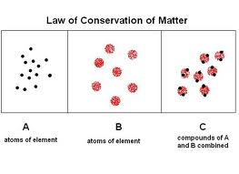
Balancing Chemical Equations.
The law of conservation of matter states that, in a chemical change, matter is neither created nor destroyed.

Slide 13
Balancing Chemical Equations.
Chemical equations must show that matter is conserved during a chemical reaction. Such an equation is called a balanced equation.

Slide 14
Balancing Chemical Equations.
To balance an equation you must find the correct coefficients for the chemical formulas in the chemical equations. A coefficient in a chemical equation is the number written in front of a reactant or product.

Slide 15
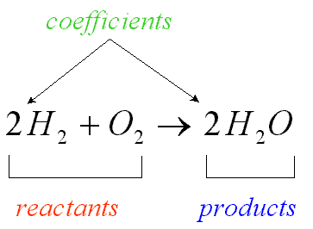
Balancing Chemical Equations.
Coefficients are whole numbers and are not written if the value is 1. In a balanced equation, coefficient is the lowest whole-number ratio of the amounts of all the reactants and products.

Slide 16
Steps for Balancing Equations
1. Write the chemical equation for the reaction.
2. Count the atoms of the elements in the reactants.
3. Count the elements in the products.
4. Change the coefficients to make the number of atoms of each element equal on both
sides of the equation.
5. Write the coefficients in their lowest possible ratio.
6. Check your work.

Slide 17
Steps for Balancing Equations
1. Write the chemical equation for the reaction.

Slide 18
Steps for Balancing Equations
2. Count the atoms of the elements in the reactants.

Slide 19
Steps for Balancing Equations
3. Count the elements in the products.

Slide 20
Steps for Balancing Equations
4. Change the coefficients to make the number of atoms of each element equal on both

Slide 21
Steps for Balancing Equations
5. Write the coefficients in their lowest possible ratio.
Ratio is 1:1:2; so it is the lowest possible ratio

Slide 22
Steps for Balancing Equations
6. Check your work.
Make sure the chemical formulas are written correctly.
Check that the number of atoms is equal on both sides.

Slide 23
Recommended order of balancing
1. Metals
2. Non-metals
3. Polyatomic ions
4 Oxygen and hydrogen
MgCl₂ + Na₂O → MgO + NaCl
MgCl₂ + Na₂O → MgO + 2NaCl

Slide 24
Try to balance these equations!
H₂ + Cl₂ → HCl
H₂ + Cl₂ → 2HCl
NaOH + CaBr₂ → Ca(OH) ₂ + NaBr
2NaOH + CaBr₂ → Ca(OH)₂ + 2NaBr

Slide 25
(a) Fe+ Cl₂ −−→ FeCl₃
(b) Fe+ O₂ −−→ Fe₂O₃
(c) FeBr₃ + H₂ SO₄ −−→ Fe₂ (SO₄)₃ + HBr
(d) C₄H₆O₃ + H₂O −−→ C₂H₄O₂
(e) C₂H₄ + O₂ −−→ CO₂ + H₂O
(f) C₄H₁₀O+ O₂ −−→ CO₂ + H₂O
(g) C₇H₁₆ + O₂ −−→ CO₂ + H₂O
(h) H₂ SiCl₂ + H₂O −−→ H₈ Si₄O₄ + HCl
(i) HSiCl₃ + H₂O −−→ H₁₀Si₁₀O₁₅ + HCl
(j) C₇H₉ + HNO₃ −−→ C₇H₆ (NO₂)₃ + H₂O
(k) C₅H₈O₂ + NaH+ HCl −−→ C₅H₁₂O₂ + NaCl

Slide 26
(a) 2 Fe + 3Cl₂ −−→ 2FeCl₃
(b) 4 Fe + 3O₂ −−→ 2Fe₂O₃
(c) 2 FeBr₃ + 3H₂SO₄ −−→ Fe₂(SO₄)₃ + 6HBr
(d) C₄H₆O₃ + H₂O −−→ 2C₂H₄O₂
(e) C₂H₄ + 3O₂ −−→ 2CO₂ + 2H₂O
(f) C₄H₁₀O+ 6O₂ −−→ 4CO₂ + 5H₂O
(g) C₇H₁₆ + 11O₂ −−→ 7CO₂ + 8H₂O
(h) H₂SiCl₂ + 4H₂O −−→ H₈Si₄O₄ + 8HCl
(i) HSiCl₃ + 15H₂O −−→ H₁₀Si₁₀O₁₅ + 30HCl
(j) C₇H₉ + 3HNO₃ −−→ C₇H₆(NO₂)₃ + 3H₂O
(k) C₅H₈O₂ + 2NaH+2 HCl −−→ C₅H₁₂O₂ + 2NaCl

Slide 27
Fe + Cl₂ −−→ FeCl₃
KMnO₄ + HCl −−→ KCl + MnCl₂ + H₂O + Cl₂
K₄Fe(CN)₆ + H₂SO₄ + H₂O −−→ K₂SO₄ + FeSO₄ + (NH₄)₂SO₄ + CO
C₆H₅COOH + O₂ −−→ CO₂ + H₂O
PhCH₃ + KMnO₄ + H₂SO₄ −−→ PhCOOH + K₂SO₄ + MnSO₄ + H₂O
CuSO₄ + 5H₂O −−→ CuSO₄ + H₂O
K₄Fe(CN)₆ + KMnO₄ + H₂SO₄ −−→ KHSO₄ + Fe₂(SO₄)₃ + MnSO₄ + HNO₃ + CO₂ + H₂O

Slide 28
Text book
P209 Q3,4
P210 Q 5,6,7
P 211 Q8,10

Slide 29
Do Now
Write a chemical equation of the following reactions and then balance.

Slide 30
FeCl_{3(aq)} + 3NaOH → Fe(OH)_{3(s)} + 3NaCl_{(aq)}
CS_{2(L)} + 3O_{2(g)} → CO_{2(g)} + 2SO_{2(g)}
Zn_{(s)} + H2SO_{4(aq)} → H_{2(g)} + ZnSO_{4(aq)}

Slide 31
Text book
P206 Q1,2
P209 Q3,4
P210 Q 5,6,7
P 211 Q8,9, 10,12

Slide 32
Types of Chemical Reactions
Classifying Reactions
Combination
Decomposition
Single replacement
Double replacement
Combustion

Slide 33
Combination Reactions
Reactant + reactant → product
Two or more substances combine to form a single product

Slide 34
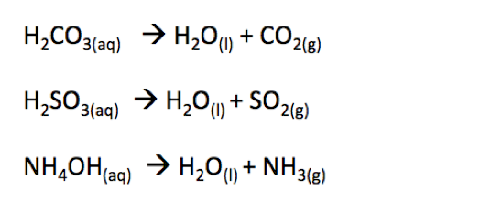
Decomposition Reactions
Reactant → product + product
a single compound is broken down into two or more products

Slide 35
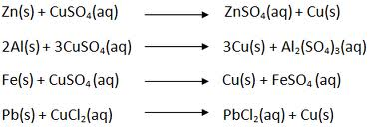
Single Replacement Reactions
Reactant + reactant → Product + Product
one element replaces a second element in a compound

Slide 36
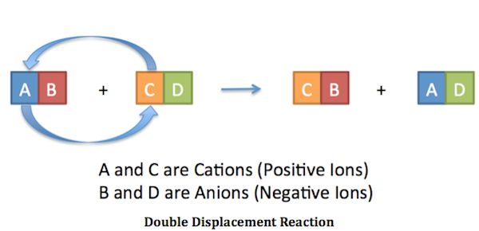
Double Replacement Reactions
Reactant + reactant → Product + Product
involve an exchange of positive ions between two reacting compounds.

Slide 37
Combustion Reactions
Reactant + reactant → Product + Product
an element or compound reacts with oxygen, often producing energy as heat and light.

Slide 38
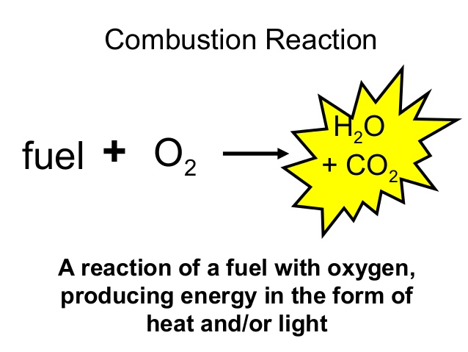

Slide 39
Text book
Page 214 Q13a, 14
Page 216 Q 15, 16
Page 218 Q 17
Page 220 Q18a, 19a
Page 221 Q20b, 21
Page 224 Q22, 23, 24

Slide 40
Combination reaction

Slide 41
Single replacement

Slide 42
Double replacement

Slide 43
Which one is which?

Slide 44
Combustion

Slide 49
Exothermic & Endothermic

Slide 50
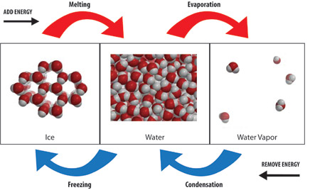
Exothermic & Endothermic

Slide 51
Exothermic & Endothermic

Slide 52
SPONTANEOUS AND NONSPONTANEOUS REACTIONS
spontaneous reaction - occurs without energy being put in. The product is favoured.
Example: iron rusting, ice melting

Slide 53
SPONTANEOUS AND NONSPONTANEOUS REACTIONS
Non spontaneous reaction – requires energy to be put in. Products are not favoured.
Example: cellular respiration, protein synthesis, photosynthesis

Slide 54
1 Exothermic and endothermic reactions
Decide whether each of these reactions is exothermic or endothermic:
a) When two chemicals mix their temperature rises: _______________
b) A solid burns brightly and releases heat, light and sound: _______________
c) When two chemicals are mixed their temperature drops: _______________
d) Two chemicals will only react if you heat them continually: _______________
e) Plants take in light energy for photosynthesis: _______________

Slide 55
1. Classify each of the following reactions as either exothermic or endothermic.
a. 2H₂O(l) + heat → 2H₂(g) + O₂(g)
b. Mg(s) + Cl₂(g) → MgCl₂(s) + heat

