Slide 1
Chapter 9 Cellular Respiration

Slide 2
https://www.youtube.com/watch?v=uixA8ZXx0KU

Slide 3
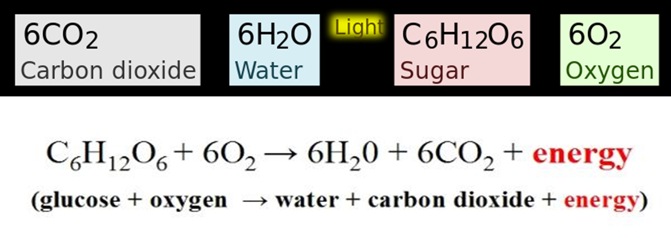

Slide 4
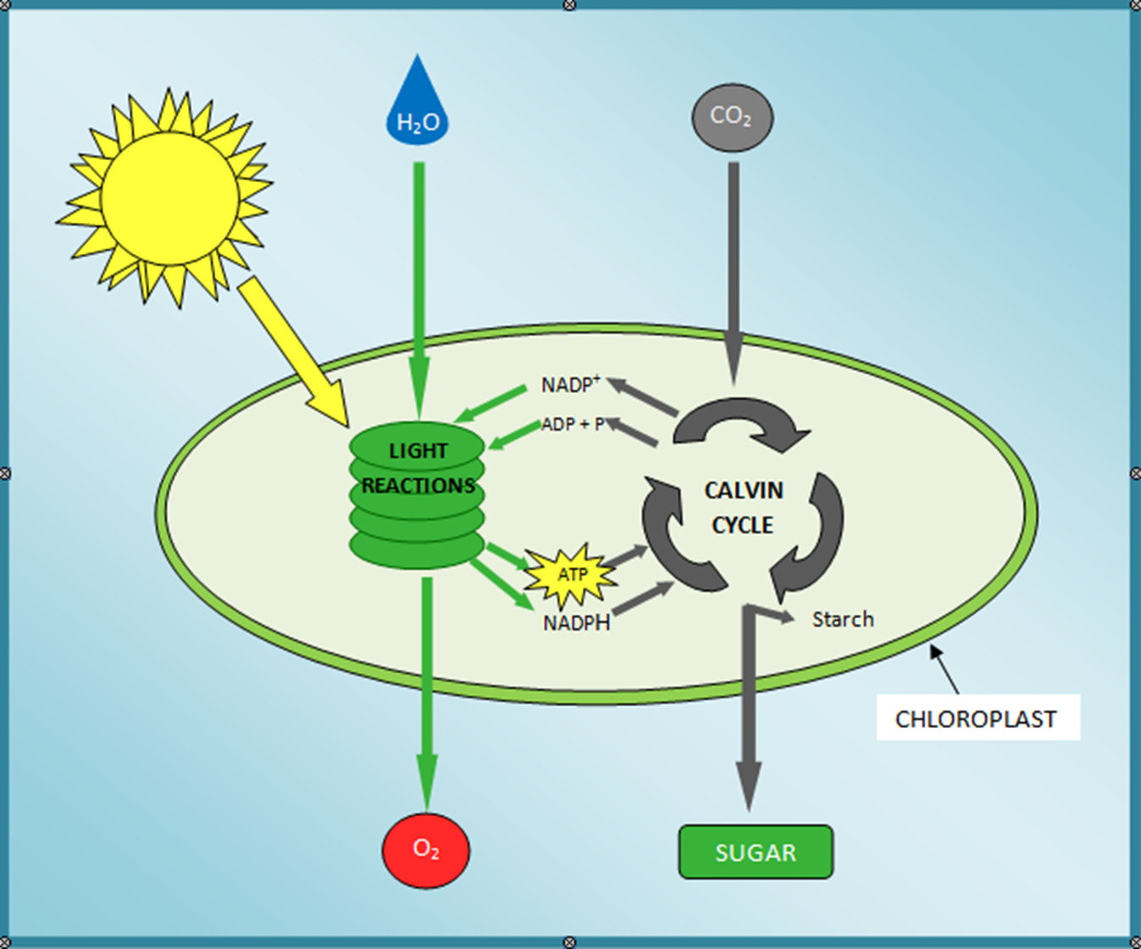
Photosynthesis

Slide 5
Compare mitochondria to chloroplasts

Slide 6
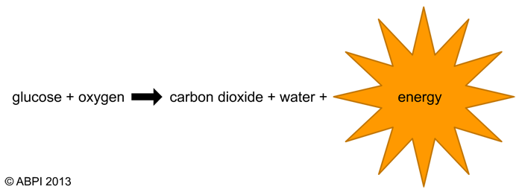
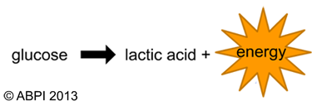
Respiration
Two different types
Aerobic respiration – in the presence of oxygen
Anaerobic respiration – in the absence of oxygen

Slide 7
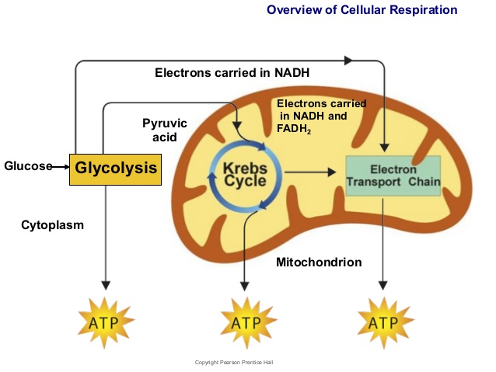
Aerobic respiration
Occurs in the presence of oxygen
Three sages:
Glycolysis
Krebs Cycle
Electron
Transport chain

Slide 8
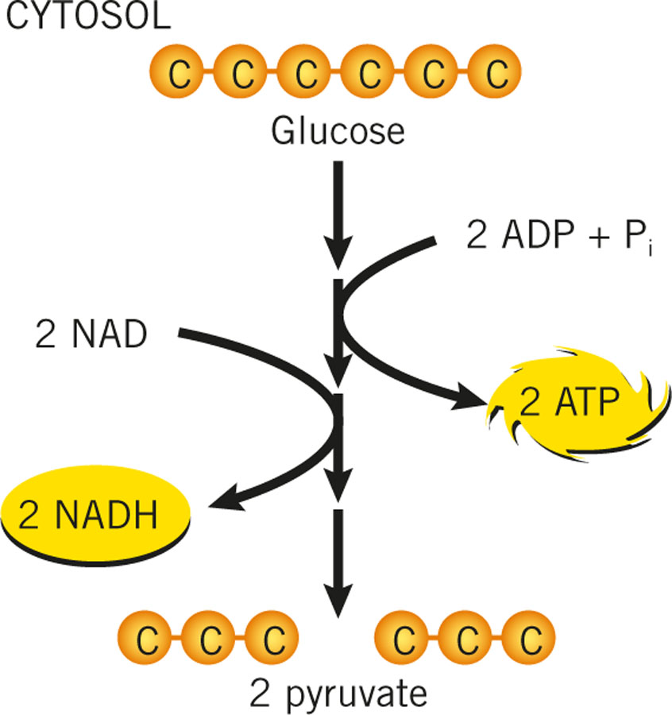
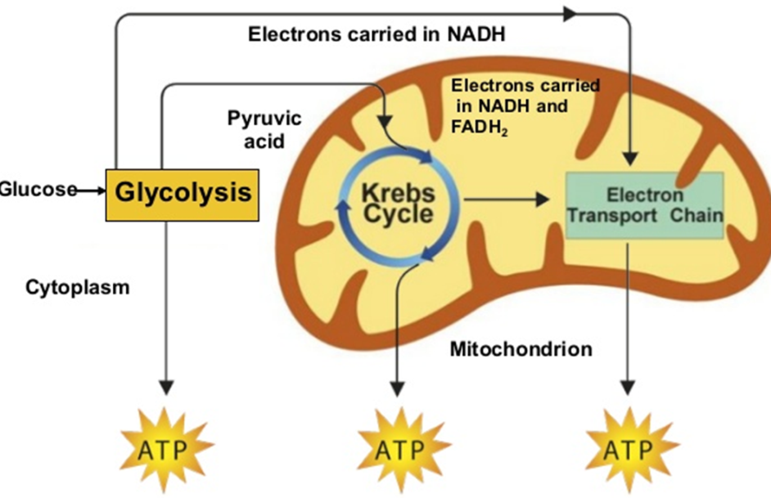
First stage: Glycolysis
Occurs in the cytosol of cell
Aerobic
2 pyruvate produced
Only 2ATP produced
Electron carrier
2 ATP are needed to start the process 4 are created. Net gain = 2

Slide 9
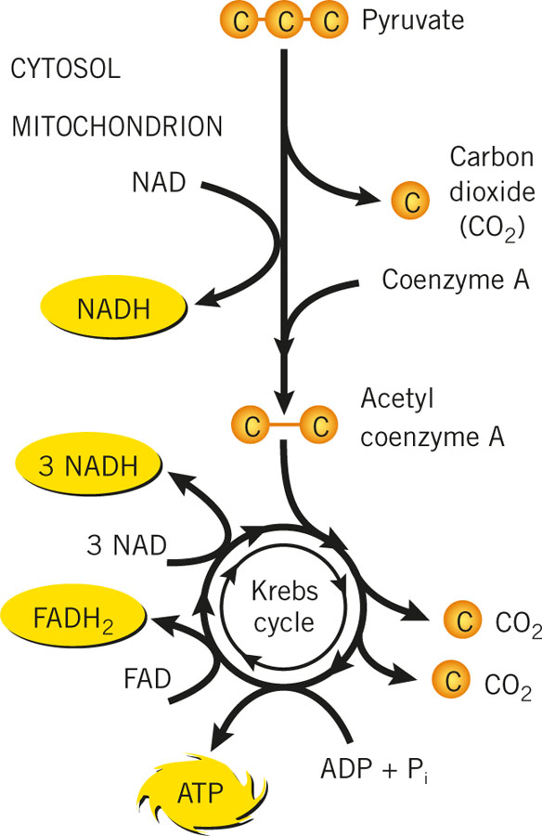
Second stage: Krebs Cycle
Occur in mitochondria
1 pyruvate enter mitochondria
1 Carbon dioxide produced
Coenzyme A enters
Acetyl coenzyme A is formed
2 Carbon dioxide produced
1 ATP produced
Electron carrier

Slide 10
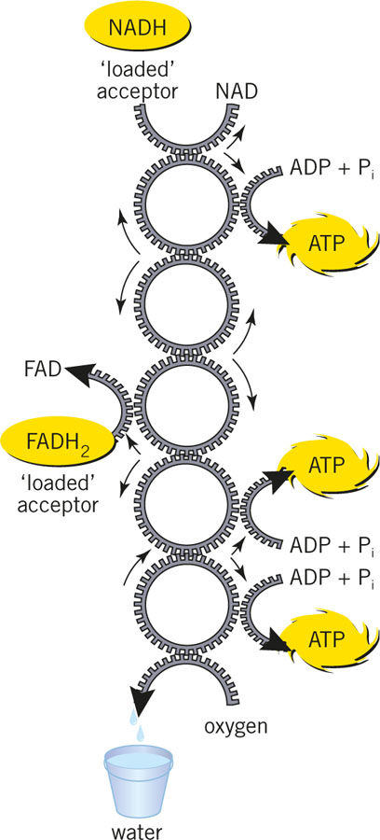
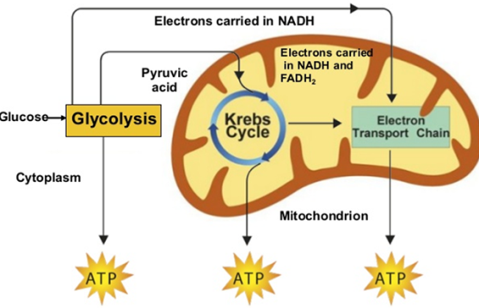
Third Stage: Electron transport
Electron carrier
Occurs in inner membrane of mitochondria
NADH and FADH2 take electrons into the inner membranes of mitochondria
The electron carriers pass electrons around and eventually create water
Each time electrons are passed down the electron transport chain 2 or 3 ATPs are produced

Slide 11
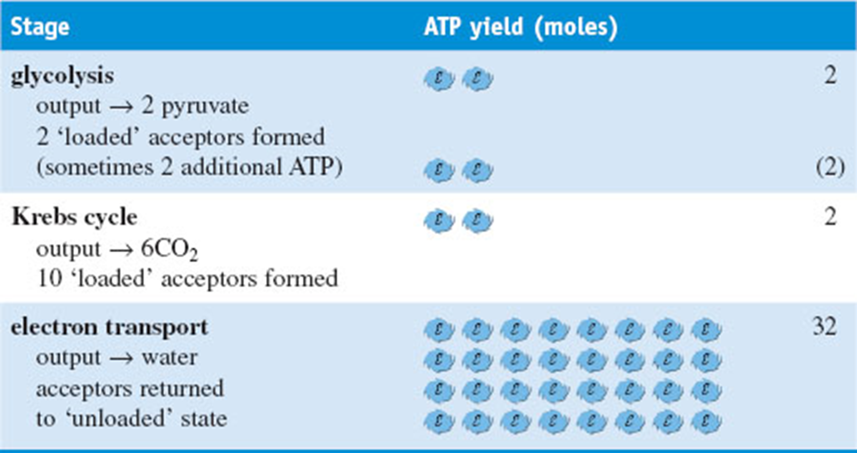
How many ATP produced?

Slide 12
Glucose + Oxygen → carbon dioxide + water + energy

Slide 13
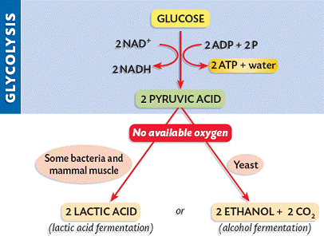
Fermentation
Occurs in the absence of oxygen
Glycolysis produces 2 ATP and 2 NADH
Two types
Lactic acid fermentation
2 lactic acid molecules produced
pyruvic + NADH → lactic acid + NAD⁺
Alcohol fermentation.
Pyruvic acid + NADH → alcohol + CO₂ + NAD⁺
2 ethanol + 2 carbon dioxide

Slide 14
https://www.youtube.com/watch?v=4Eo7JtRA7lg

Slide 15
Chapter 8 & 9 test
ATP – structure, energy stored/released. ADP – ATP
Photosynthesis
Word equation
Two different stages
Location
Energy source
Cellular respiration
Worded equation
Three stages
Location
Energy source
Fermentation
Alcohol fermentation
Lactic acid fermentation

