Slide 1
Chapter 16.1
Covalent bonding

Slide 2
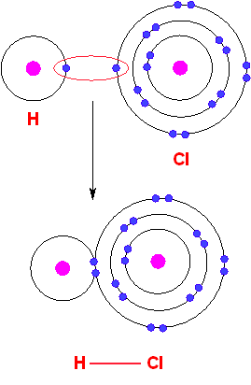
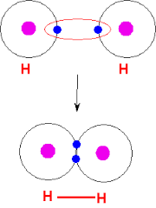
Covalent bonding
Covalent bonding
Sharing of electrons between atoms

Slide 3
Remember
Molecular compound Ionic compound

Slide 4
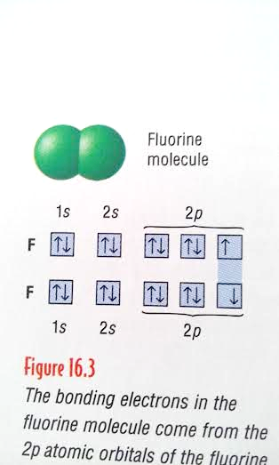
Covalent bonding
Bonding between Florine

Slide 5
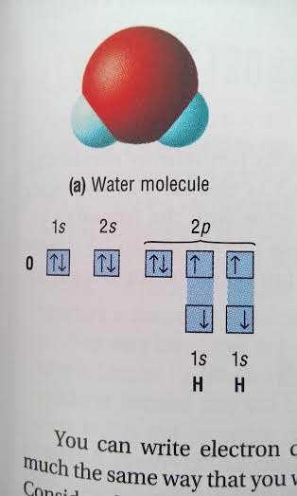
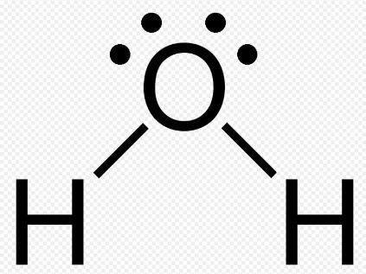
Covalent bonding
Bonding in water

Slide 6
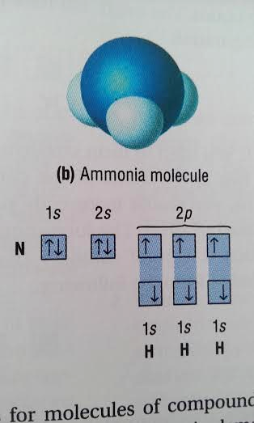
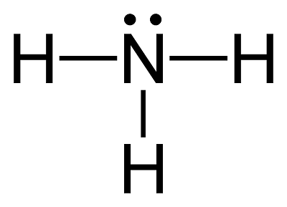
Covalent bonding
Bonding in Ammonia molecule

Slide 7
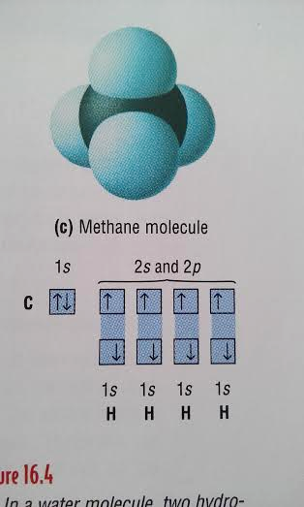
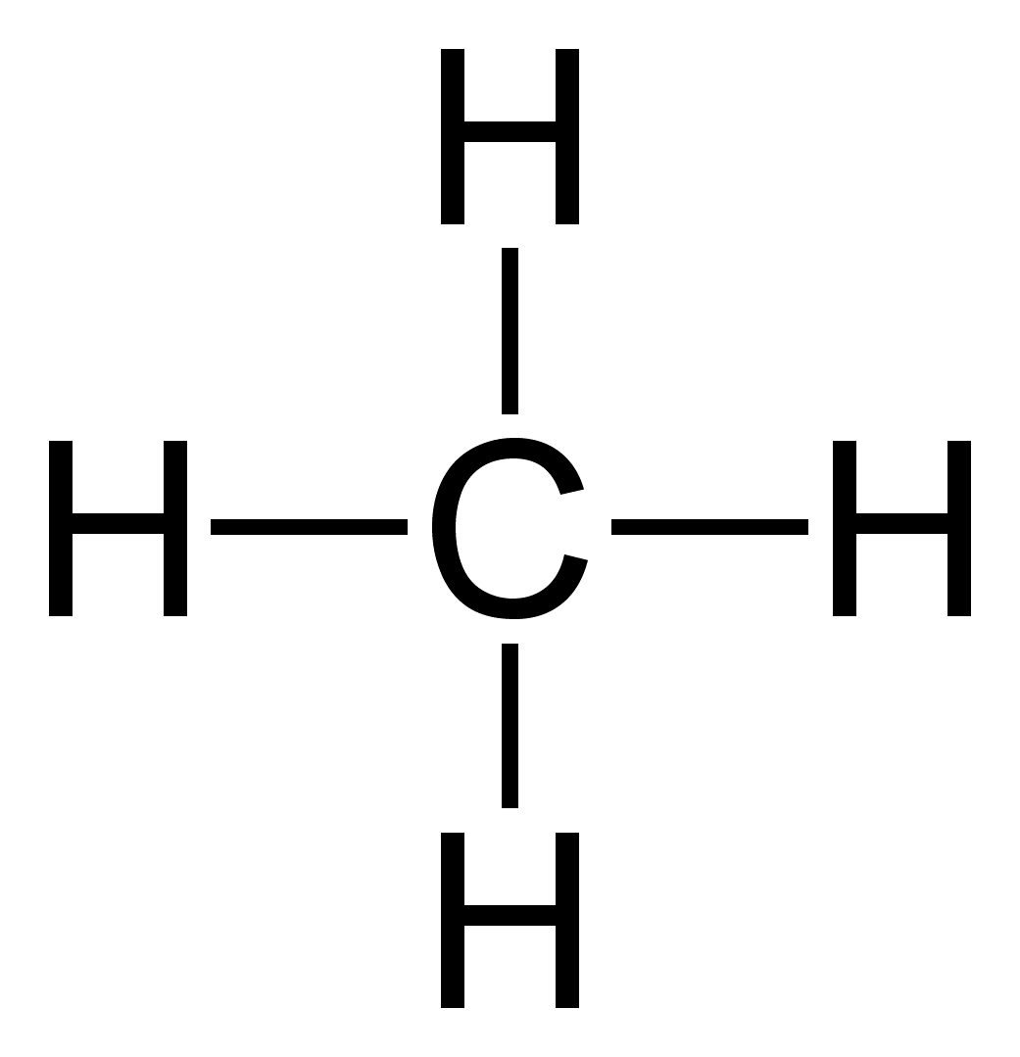
Covalent bonding
Bonding in Methane molecule

Slide 8
Questions
Draw a dot diagram for Hydrogen chloride (HCl)

Slide 9
Questions
Page 440
Q1&2

Slide 10
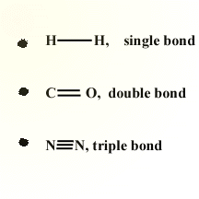
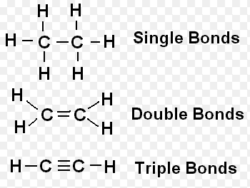
DOUBLE AND TRIPLE COVALENT BONDS
Sharing more than one pair of electrons

Slide 11
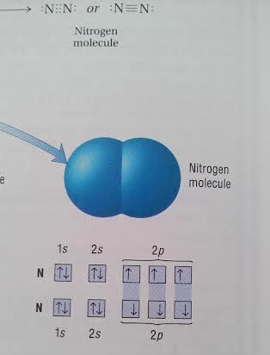
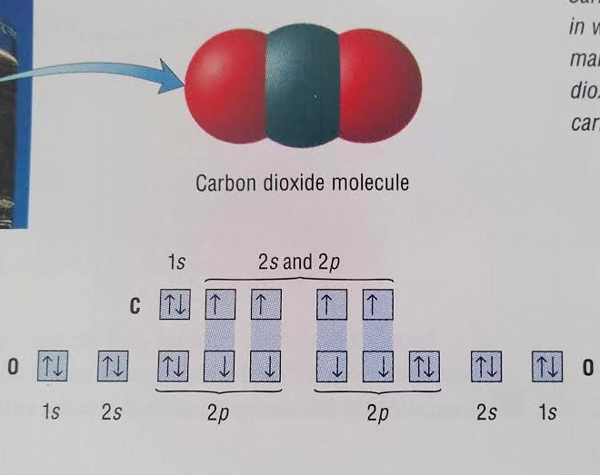
DOUBLE AND TRIPLE COVALENT BONDS
Sharing more than one pair of electrons

Slide 12
Draw the following dot diagrams
NI₃
CBr₄
H₂O
H₂Se
PI₃
HCl
CF₂Cl₂
Double bonds
CO₂
O₂
C₂H₄
N₂H₂
Triple bonds
N₂
C₂H₂

Slide 13
Chapter 25.5
Hydrocarbons

Slide 14
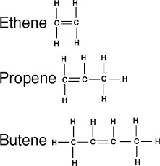
Hydrocarbons
Compounds that only contain carbon and hydrogen

Slide 15
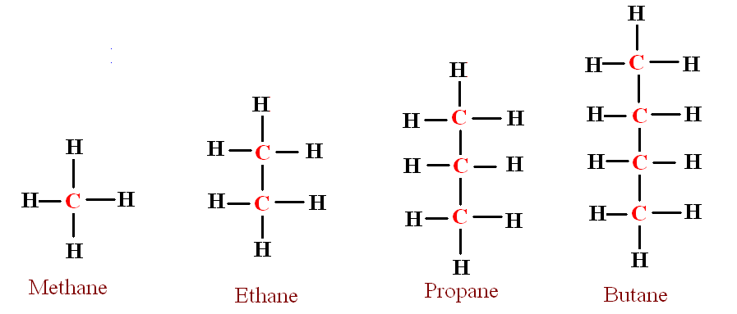
Alkanes
Hydrocarbons that only contain single bonds

Slide 16
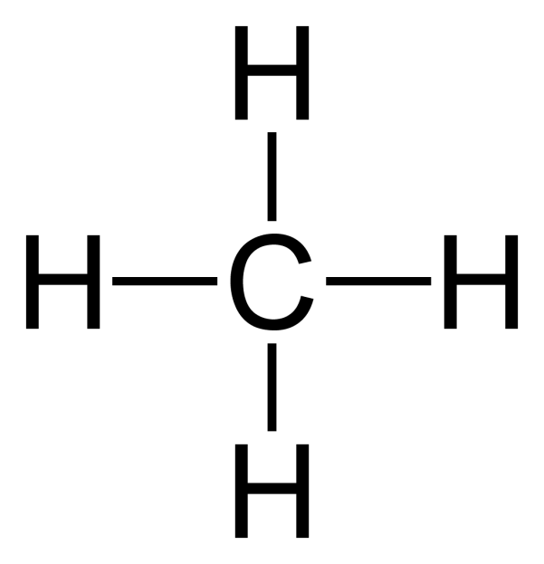
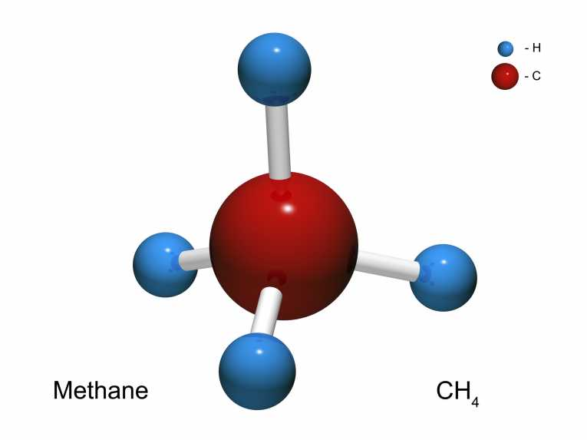
Methane

Slide 17
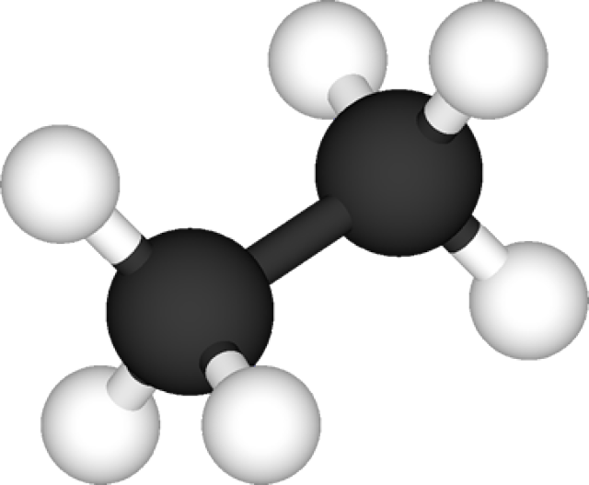
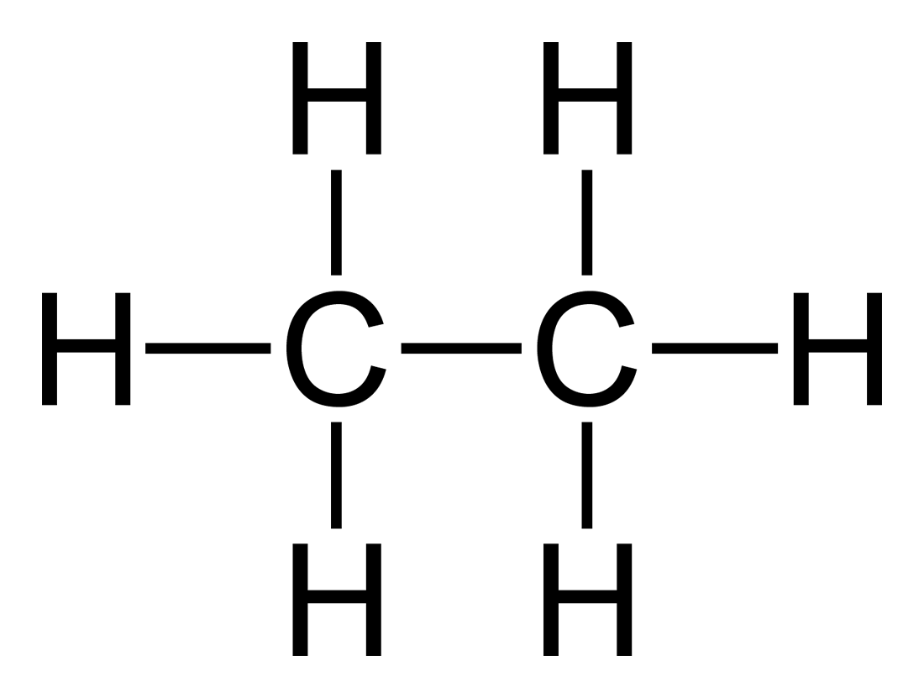
Ethane

Slide 18
Naming Carbon chains
IUPAC - International Union of Pure and Applied Chemistry

Slide 19
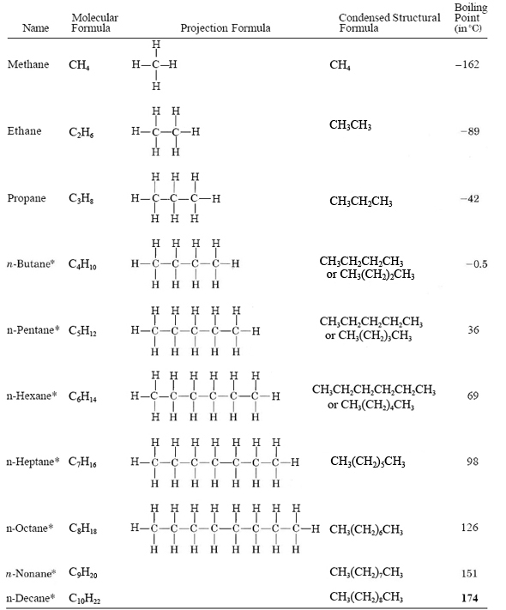
Straight-chain alkanes
contain any number of carbon atoms, one after the other, in a chain.

Slide 20
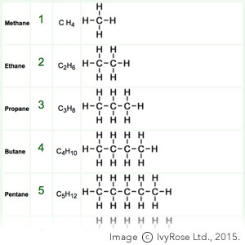
Homologous series
Increase CH₂

Slide 21
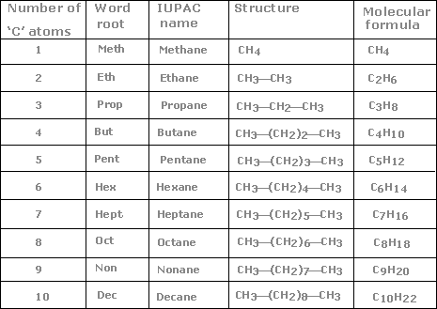
Naming of alkanes
Use the IUPAC system

Slide 22
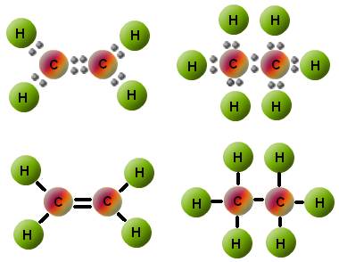
Alkenes
Alkenes – hydrocarbons that contain one or more double bonds.

Slide 23
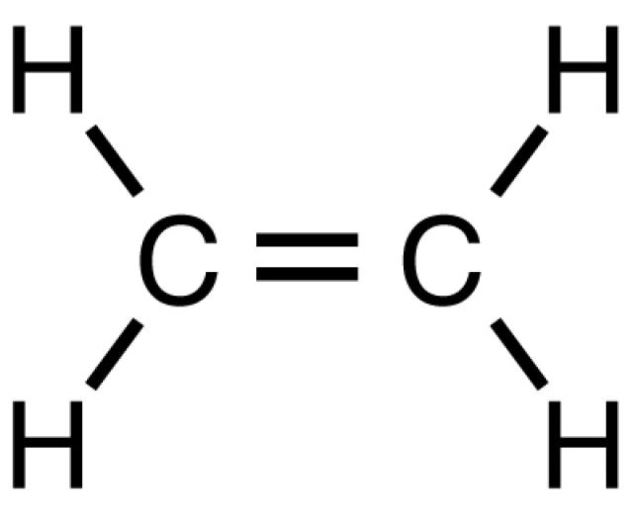
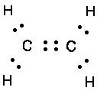
Ethene

Slide 24
Alkenes

Slide 26
Questions
Write formula and draw electron dot structures for ethene and propene
draw and name the alkene with formula C₄H₈

Slide 27
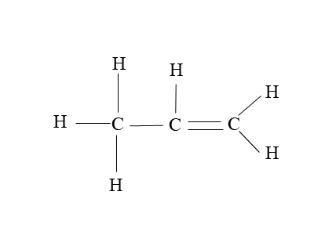
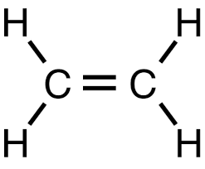
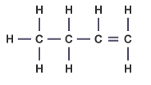
Questions
Write formula and draw electron dot structures for ethene and propene
draw and name the alkene with formula C₄H₈

Slide 28
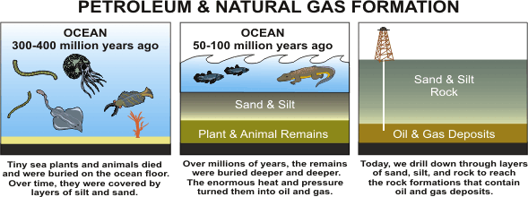
Hydrocarbons from the earth
Back in geologic history, the remains of living organisms were buried in ocean sediments. Heat, pressure and the action of bacteria changed these remains into petroleum, natural gas and other products. Petroleum and natural gas are important fossil fuels

Slide 30
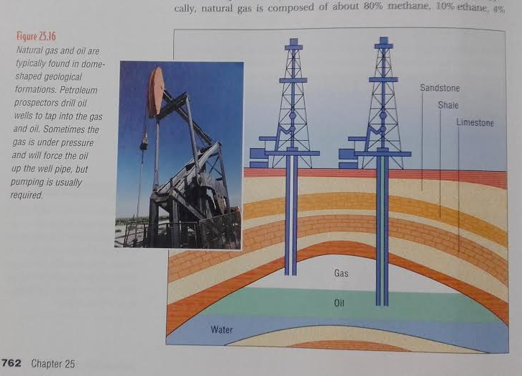

Slide 31
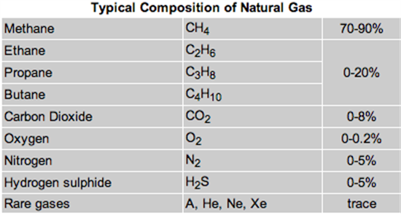
Natural gas
Natural gas is composed of about 80% methane, 10% ethane, 4% propane, and 2% butane. Methane, the major constituent of natural gas, is especially useful for combustion because it burns with a hot, clean flame.

Slide 32
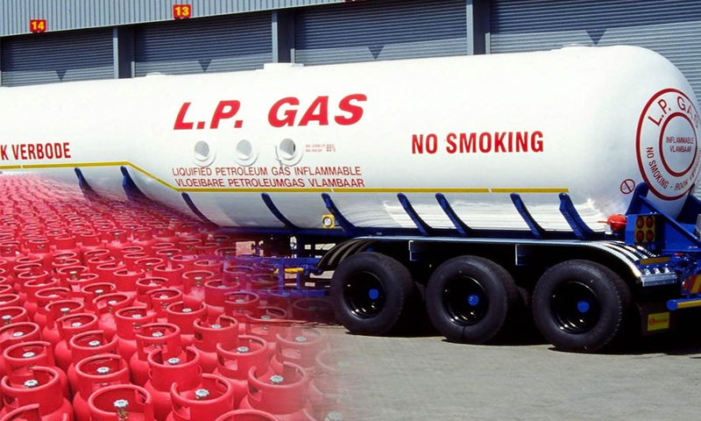
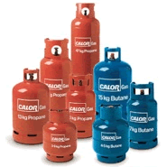
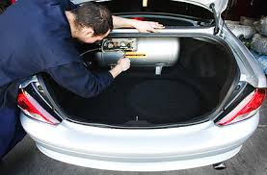
Natural gas
Propane and butane are also good heating fuels. They are sold in liquid form in pressurized tanks as liquid petroleum gas (LPG).

Slide 33
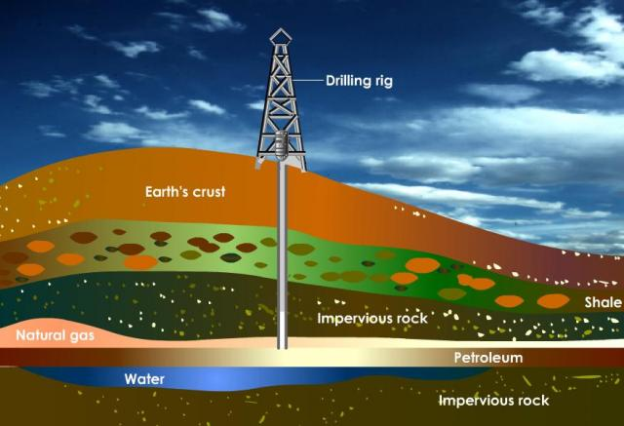
Petroleum

Slide 34
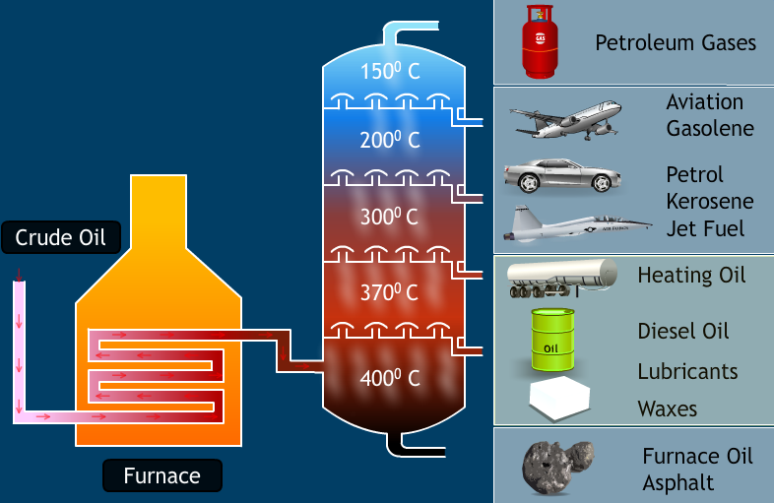
Petroleum

Slide 35
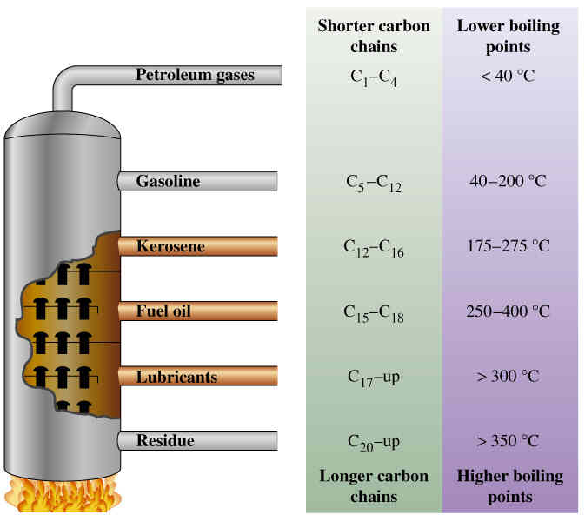
Terminology
Fractional distillation:separation of a liquid mixture into fractions differing in boiling point (and hence chemical composition) by means of distillation, typically using a fractionating column.

Slide 36
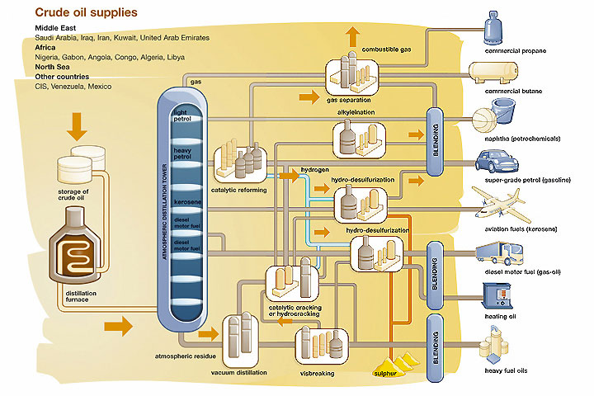
Terminology
Refine: remove impurities or unwanted elements from (a substance), typically as part of an Industrial process.

Slide 37
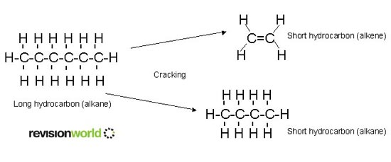
Terminology
Cracking: breaking petroleum molecules into shorter molecules and to extract low-boiling fractions, such as gasoline, from petroleum

Slide 38
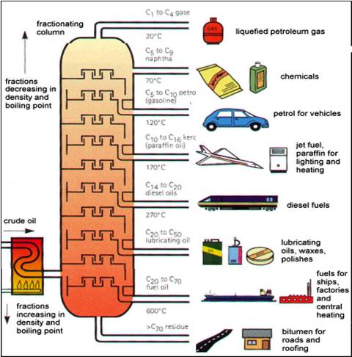

Slide 39
What is the molecular formula for this hydrocarbon?
What is the molecular formula for this hydrocarbon?
This molecule is an example of an:
C5H6
C5H9
C5H10
C5H12
C5H6
C5H9
C5H10
C5H12
alkane
alkene
alkyne
none of the above

Slide 40
Identify this hydrocarbon:
Identify this hydrocarbon:
Identify this hydrocarbon:
propane
ethene
propyne
ethane
propene
hexene
heptene
septene
seventene
butane
propane
pentane
methane

Slide 41
Chapter 26.4
Polymerization

Slide 42
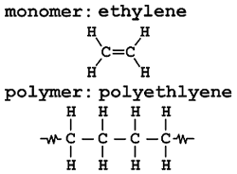
Polymer
Polymer: Large molecule formed by covalent bonding of repeating smaller units
Monomer: smaller units that combine to form a polymer

Slide 43
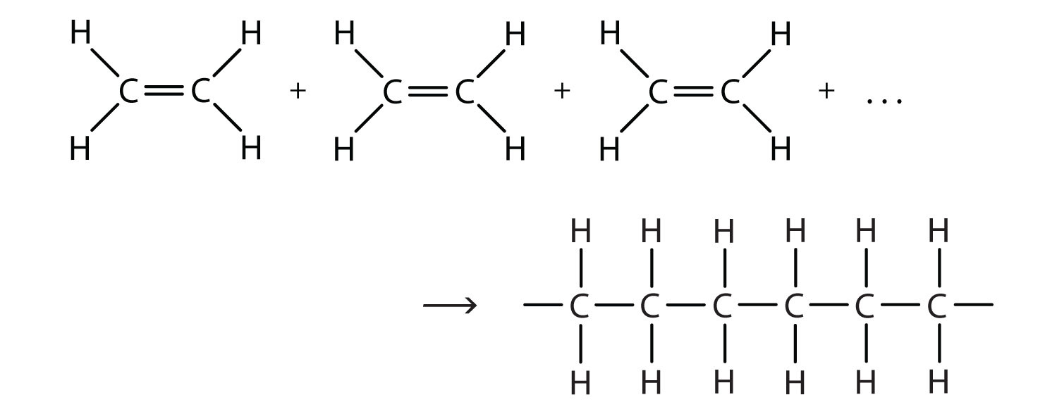
Polymer
Polymer: Large molecule formed by covalent bonding of repeating smaller units
Monomer: smaller units that combine to form a polymer

Slide 44
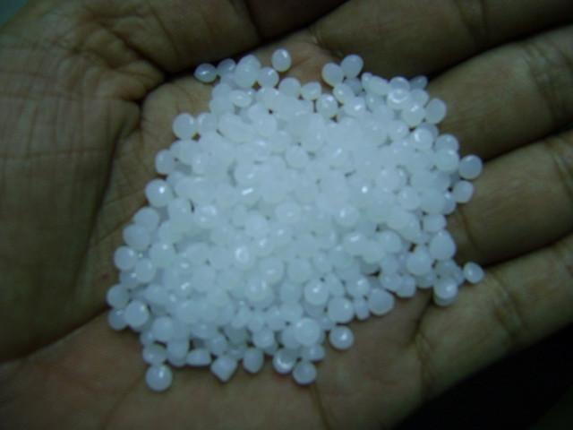
Polymers
Polyethylene (also called polythene) is used to make plastic wrappings and plastic bottles.
Polypropylene is prepared by the polymerization of propene. Polypropylene is a stiffer polymer than polyethylene and is used extensively in utensils and containers.

Slide 45
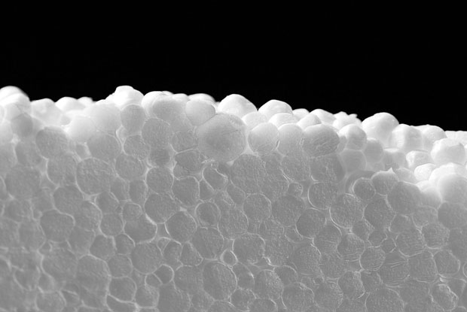
Polymers
Polystyrene
Polystyrene in the form of a rigid foam is a poor heat conductor, which makes it useful for insulating homes and for manufacturing molded items such as coffee cups.

Slide 46
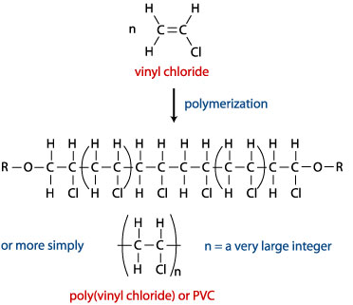
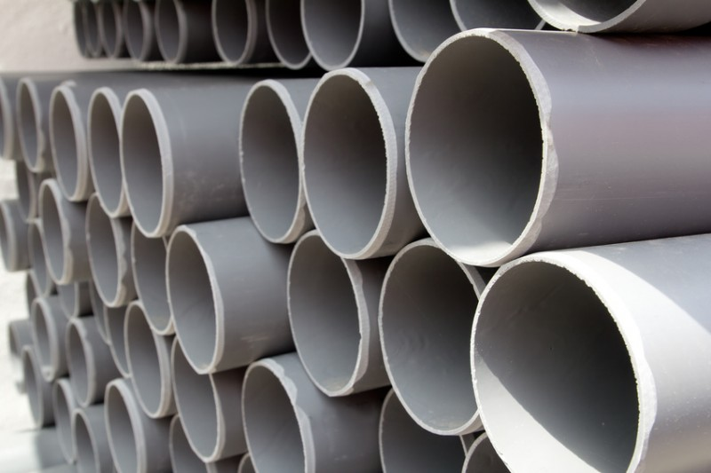
Polymers
Polyvinyl chloride (PVC)
Polyvinyl chloride (PVC) is used for pipes in plumbing

Slide 47
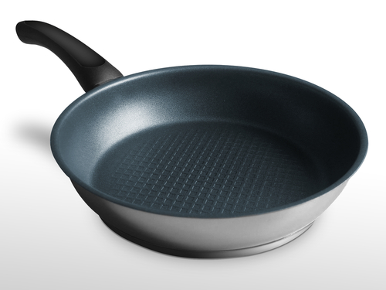
Polymers
Polytetrafluoroethene (Teflon – a trade name – or PTFE) is the product of the polymerization of tetrafluoroethene monomers. You are probably familiar with this polymer as the coating on nonstick cookware.

Slide 48
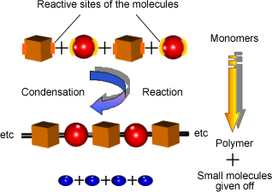
CONDENSATION POLYMERS
the joining of monomer units is usually accompanied by the formation of water as a reaction product.

Slide 49
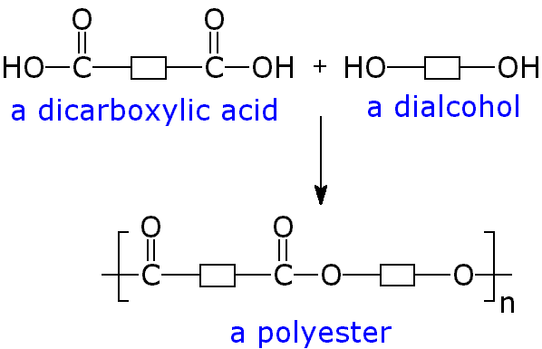
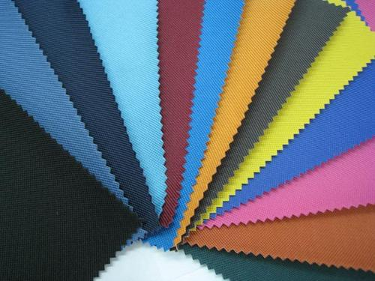
CONDENSATION POLYMERS
Plyester – used in making clothes

Slide 50
CONDENSATION POLYMERS
PET = Polyethylene terephthalate

Slide 51
CONDENSATION POLYMERS
Nylon

Slide 52
CONDENSATION POLYMERS
Kevlar

Slide 53
MOLECULES OF LIFE
The following molecules of life are produced by condensation polymerization:
Proteins – amino acids are joined together
Carbohydrates – monomers such glucose are joined together
Lipids – fatty acids and glycerol are joined together
Nucleic acids – nucleotides are joined together.

Slide 54
Practice questions
16.1
P440 Q1
P451 Q7,10
25.5
P765 Q 27
26.4
P800 Q17,18,19

Slide 55
Practice questions
16.1
Page 470 Q 28,29,30,32,33,
25.5
Page 768 Q28,29,34,35a,49a,b
26.4
Give an example of two polymers. For each one:
say what monomers make it up.
Give one way this polymer could be used.

