Slide 1
Evolution of populations
Sections form ch 15 and ch 16

Slide 2
Evolution is a theory – a well supported explanation of an idea

Slide 3
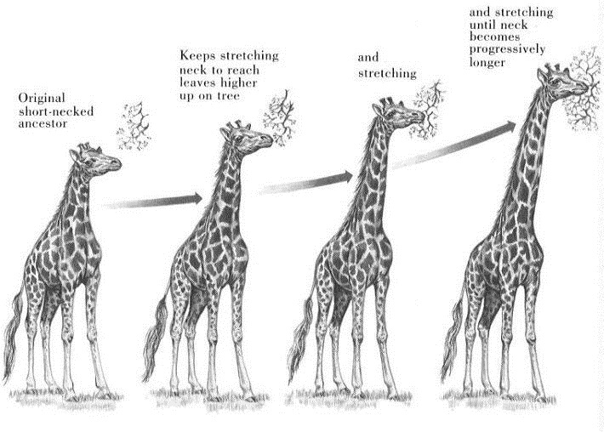
Lamarck Evolution Theory

Slide 4
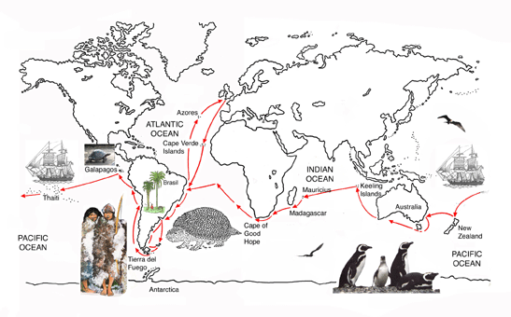
Darwin
Voyage of the Beagle

Slide 5
Voyage of the Beagle

Slide 6
Voyage of the Beagle

Slide 7
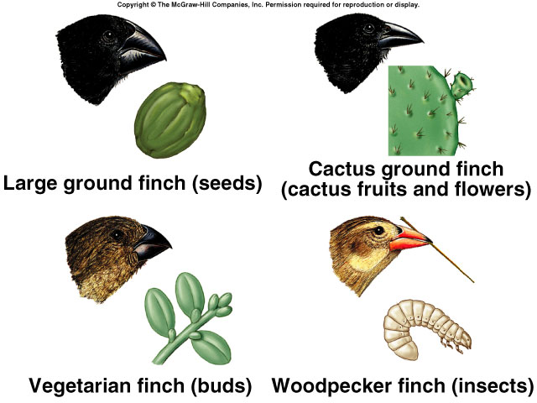
Voyage of the Beagle

Slide 8
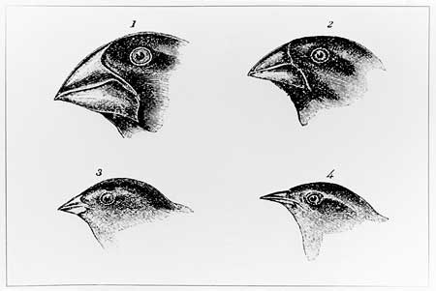
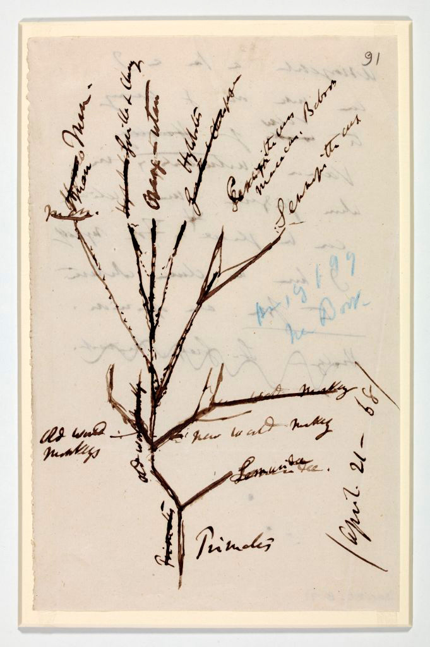

Slide 9
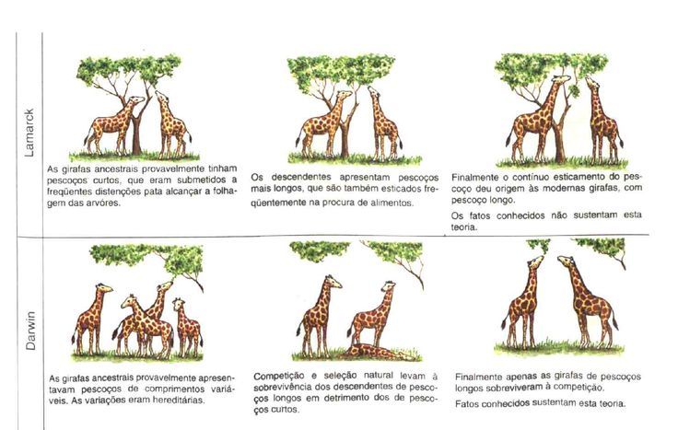
Review Darwin and Lamarck

Slide 10
https://www.youtube.com/watch?v=1BLXV1qO03w
https://www.youtube.com/watch?v=pQp2lFcDEbw

Slide 11
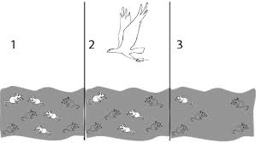
Natural Selection
The process through which members of a species that are best suited to their environment survive and reproduce at a higher rate than other members of the species.

Slide 12
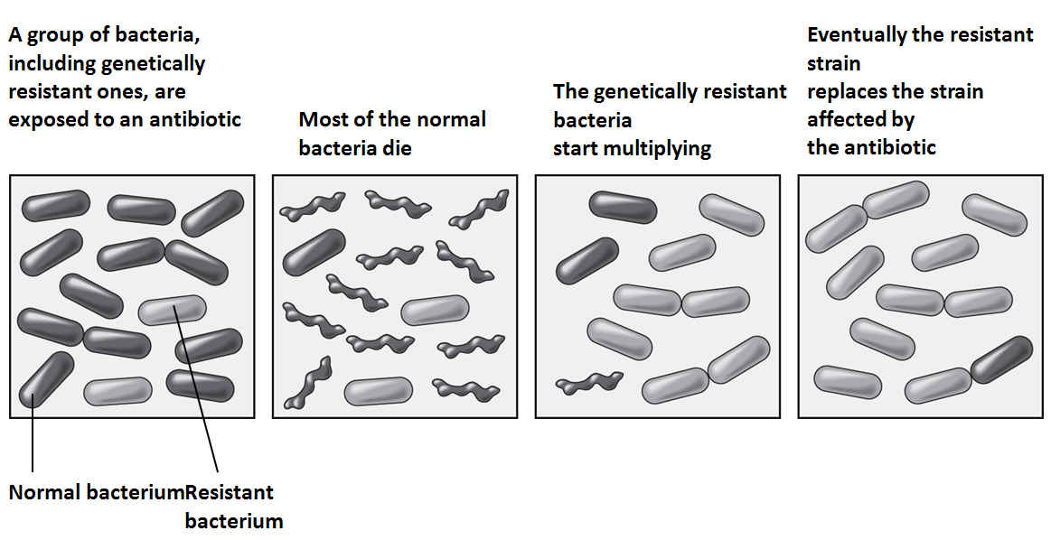
Natural Selection

Slide 13
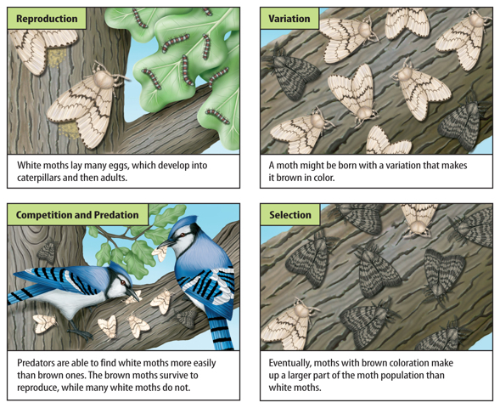
Natural Selection

Slide 14
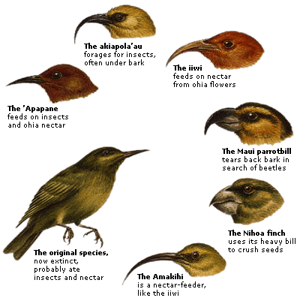
Natural Selection

Slide 15
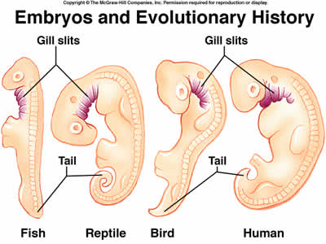
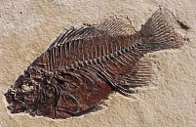
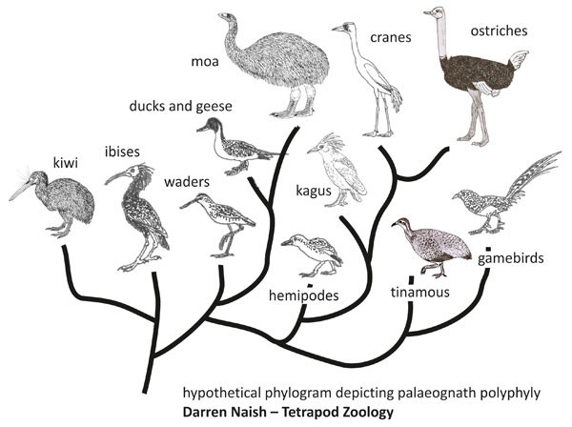
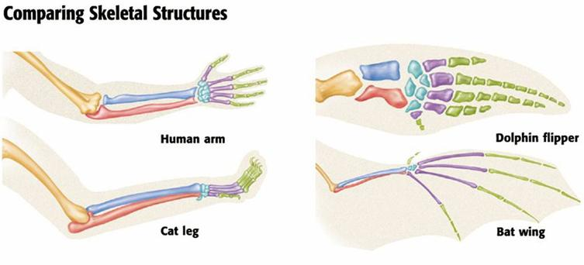
Evidence for natural selection
Fossils
DNA
Similar structures
Embryology

Slide 16
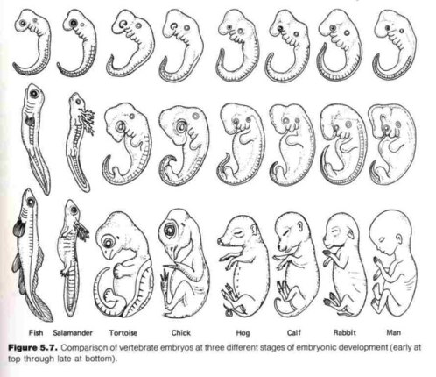
Evidence for natural selection

Slide 17
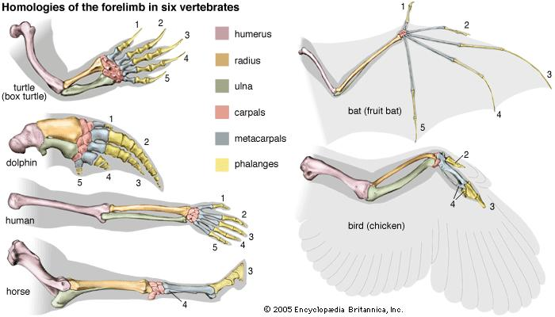
Evidence for natural selection
Fossils
DNA
Similar structures

Slide 18
Questions
Pg 372 Q1,2,3,4,5
Pg 377 Q2,
P386 Q1,2,3,4
Pg389 Q1,2,3,4,5,6, 8,9,10,11,12, 16,17, 19,20,21, 24,25

Slide 19
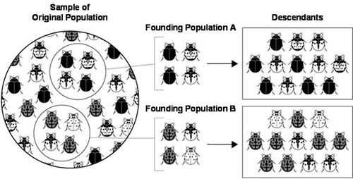
Genetic drift
Change in population due to random chance

Slide 20
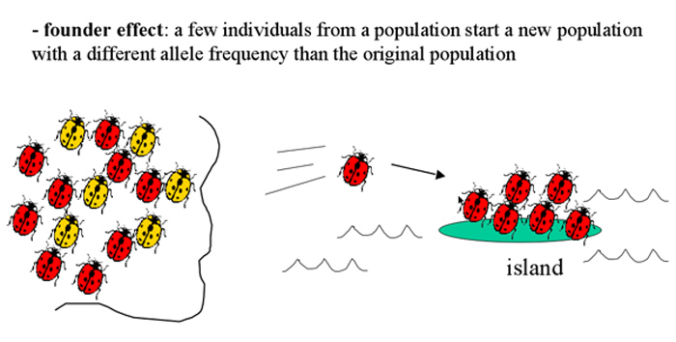
Genetic Drift
Founder effect

Slide 21
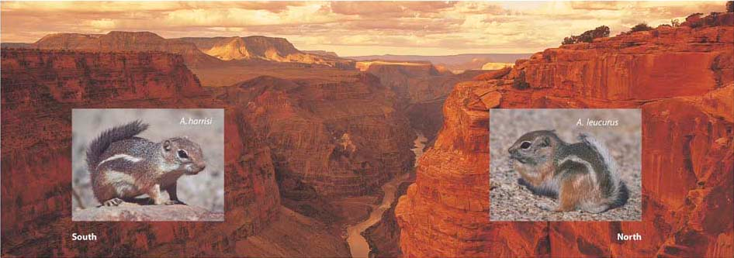
Speciation
Formation of a new species

Slide 22
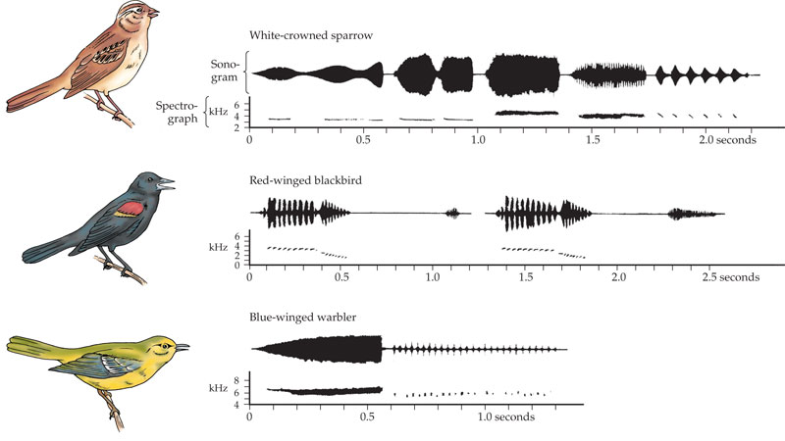
Speciation
Behavioral isolation

Slide 23
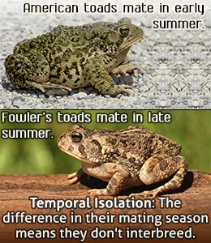
Speciation
Temporal isolation

Slide 24
Chapter 15&16 study guide
Chapter 15
Lamarck’s theory
Darwin’s Theory
Natural selection
Genetic variation
Best suited to environment more likely to survive
Evidence for Evolution
Fossils
DNA
Similar structures
Embryology
Genetic drift
Speciation
Geographic
Behavioral
temporal

