Slide 1
Photosynthesis

Slide 2
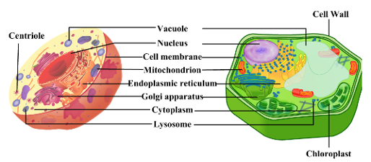
Plant and animal cells
Difference between

Slide 3
Autotrophs vs Heterotrophs
Autotrophs
Heterotrophs
Make their own food through light energy
Can not photosynthesise.
Get food from eating plants or animals

Slide 4
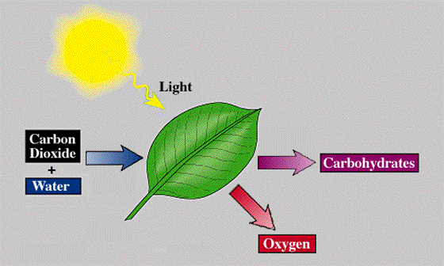
Plant cells
During photosynthesis plants produce energy (ATP)
Plants convert sunlight energy into chemical energy.
This energy is stored in bonds.

Slide 5
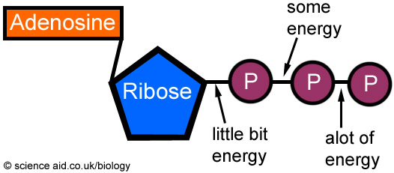
ATP
ATP
Adenosine triphosphate
Energy stored in bonds
When bonds are broken energy is released

Slide 6
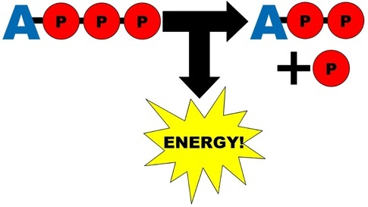
ATP
ATP
ADP
Adenosine triphosphate
Energy stored in bonds
When bonds are broken energy is released
Adenosine diphosphate
Less energy that ATP

Slide 7
ATP
ATP
ADP
Adenosine triphosphate
Energy stored in bonds
When bonds are broken energy is released
Adenosine diphosphate
Less energy that ATP

Slide 8
Text book
Page 203 Q1,2,3,4

Slide 9
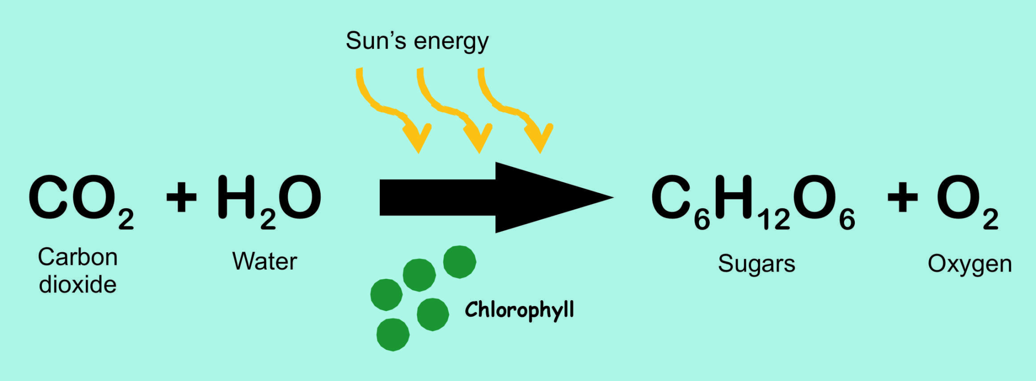
Photosynthesis
Reactants
Products
Photosynthesis uses energy of sunlight to convert water and carbon dioxide into high energy sugars and oxygen

Slide 10
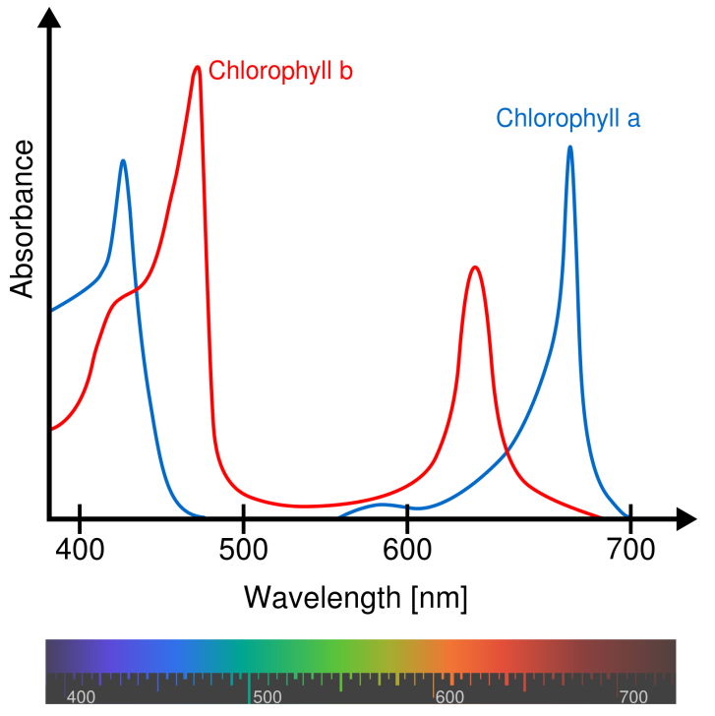
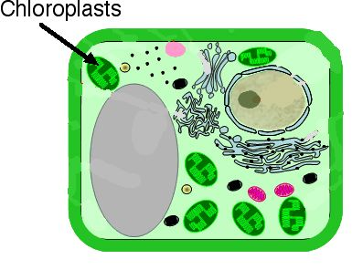
Photosynthesis
Takes place in Chloroplasts
Chlorophyll is inside chloroplasts
Chlorophyll is green
Works best under red or blue light

Slide 11
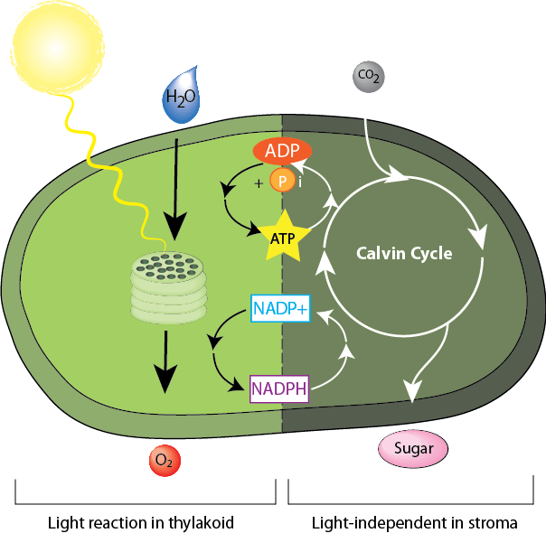
Photosynthesis
Two parts
1. light dependant
Must have light
2. Light independent
(Calvin Cycle)
Does not require light to occur.
Can happen in light or dark

Slide 12
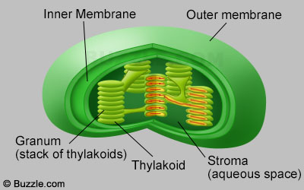
Chloroplast
Chlorophyll are inside thylakoid.
Light dependant photosynthesis takes place granum
Light independent photosynthesis takes place in stroma

Slide 13
Light dependant stage
Light and water go in to the granum of the chloroplast
One H+ is split from the water
Oxygen leaves

Slide 14
Light dependant stage
The H+ then attaches to NADP+ to become NADPH
The ADP and the P join together to become ATP

Slide 15
Light Independent stage
In the Calvin cycle CO2 enters.
The H+ is taken form NADPH and ATP energy
Glucose is made

Slide 16
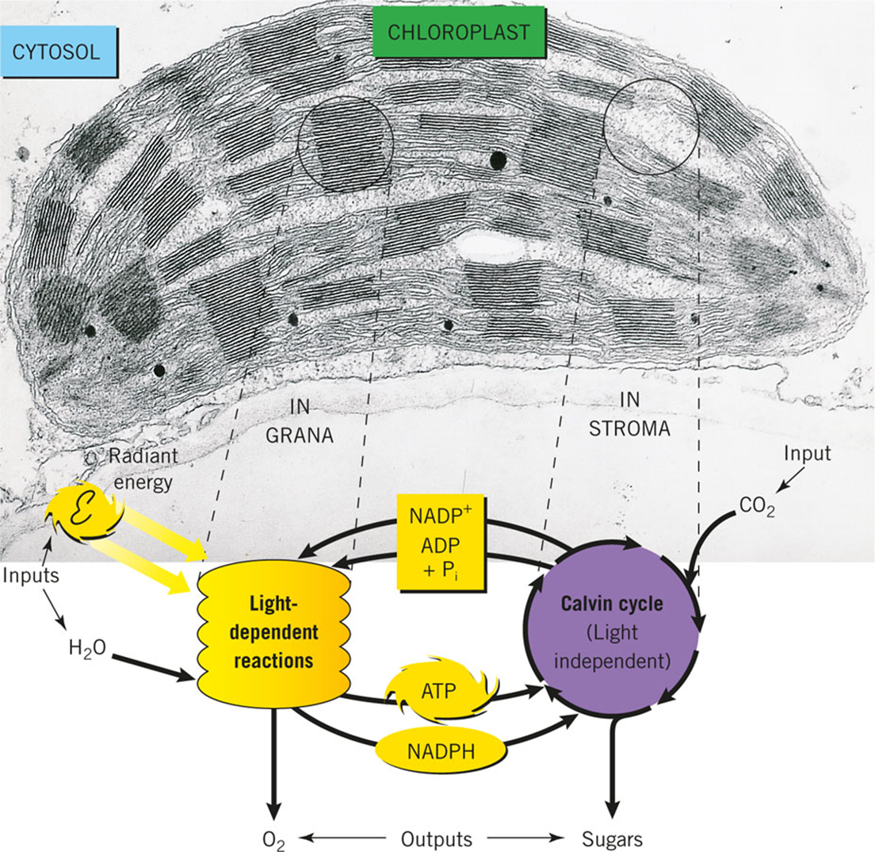

Slide 17
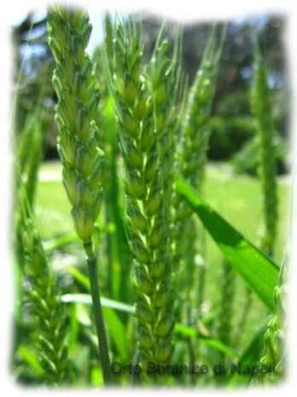
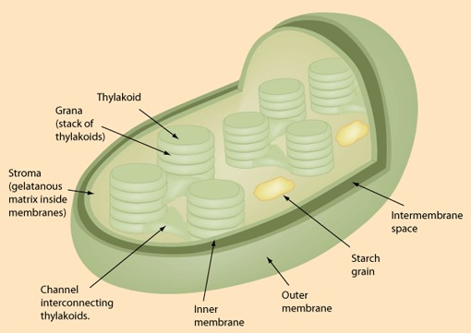
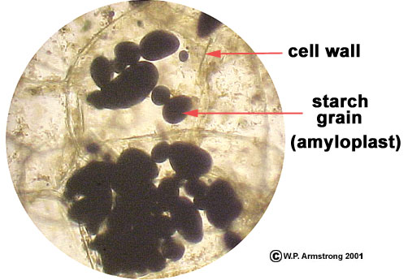
What to do with all this sugar?
Glucose is stored as starch
Used for
Reproduction
growth

Slide 18
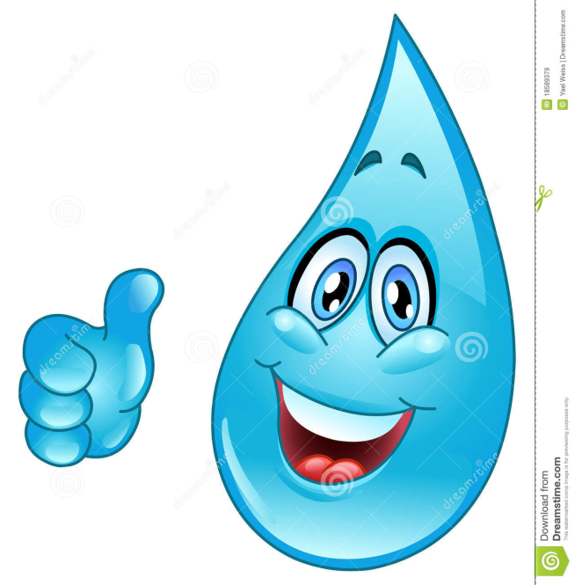
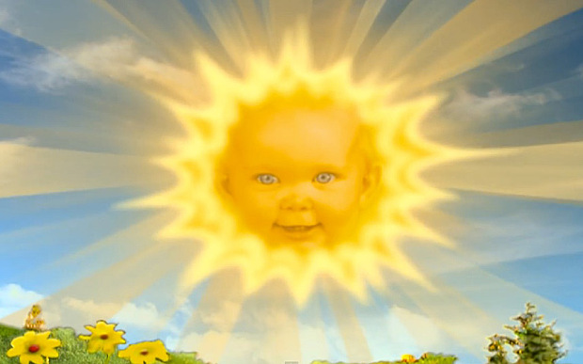
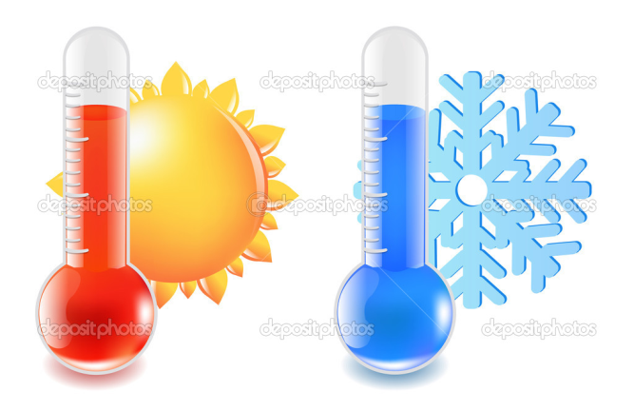
Photosynthesis
Things that affect rate of photosynthesis
Sunlight
If no sunlight then no energy
Temperature
Too cold or too hot the enzymes stop working
Amount of water
No water means no H

Slide 19
Text book
Page 207 Q2,3,4
Page 214 Q1,2,3,4,5

